Slide 1
Instruction-Level Parallelism Dynamic Parallelism
07
Kai Bu
kaibu@zju.edu.cn
http://list.zju.edu.cn/kaibu/comparch2022

Slide 2
Dynamic?

Slide 3
Dynamic vs Static

Slide 4
Dynamic vs Static

Slide 5
Static Branch Prediction
Direction Predictor (taken?)
taken?
PC + inst size
Next Fetch
Address
Program
Counter
hit?
address of the
current branch
target address
Cache of Target Addresses (BTB: Branch Target Buffer)
https://safari.ethz.ch/digitaltechnik/spring2021/lib/exe/fetch.php?media=
onur-digitaldesign_comparch-2021-lecture17b-branch-prediction-i-afterlecture.pdf

Slide 6
Static Branch Prediction
example:
predicted-taken
predicted-not-taken
Direction Predictor (taken?)
taken?
PC + inst size
Next Fetch
Address
Program
Counter
hit?
address of the
current branch
target address
Cache of Target Addresses (BTB: Branch Target Buffer)
https://safari.ethz.ch/digitaltechnik/spring2021/lib/exe/fetch.php?media=
onur-digitaldesign_comparch-2021-lecture17b-branch-prediction-i-afterlecture.pdf

Slide 7
Static Branch Prediction
favor branches biased toward taken/untaken
example:
predicted-taken
predicted-not-taken
Direction Predictor (taken?)
taken?
PC + inst size
Next Fetch
Address
Program
Counter
hit?
address of the
current branch
target address
Cache of Target Addresses (BTB: Branch Target Buffer)
https://safari.ethz.ch/digitaltechnik/spring2021/lib/exe/fetch.php?media=
onur-digitaldesign_comparch-2021-lecture17b-branch-prediction-i-afterlecture.pdf
Notes:
Obviously, such static prediction works well for programs with a strong bias toward taken or untaken branches

Slide 8
Static Branch Prediction
how to handle branches dynamically switching from
taken/untaken?
example:
predicted-taken
predicted-not-taken
Direction Predictor (taken?)
taken?
PC + inst size
Next Fetch
Address
Program
Counter
hit?
address of the
current branch
target address
Cache of Target Addresses (BTB: Branch Target Buffer)
https://safari.ethz.ch/digitaltechnik/spring2021/lib/exe/fetch.php?media=
onur-digitaldesign_comparch-2021-lecture17b-branch-prediction-i-afterlecture.pdf
Notes:
Obviously, such static prediction works well for programs with a strong bias toward taken or untaken branches

Slide 9
Dynamic Branch Prediction
Follow branch history of taken branch
Use branch prediction buffer (or BHT: branch history table) indexed by lower portion of branch address and marked with a bit to track taken/untaken status
Notes:
Dynamic branch prediction is to look up the address of the instruction to see if a branch was taken the last time this instruction was executed, and, if so, to begin fetching new instructions from the same place as the last time.
Consider a loop branch that branches nine times in a row, then is not taken once. What is the prediction accuracy for this branch, assuming the predic- tion bit for this branch remains in the prediction buffer?

Slide 10
Dynamic Branch Prediction
1-bit predictor / last-time predictor
Use branch prediction buffer (or BHT: branch history table) indexed by lower portion of branch address and marked with a bit to track taken/untaken status
bit 1 for taken
bit 0 for untaken
Notes:
Dynamic branch prediction is to look up the address of the instruction to see if a branch was taken the last time this instruction was executed, and, if so, to begin fetching new instructions from the same place as the last time.
Consider a loop branch that branches nine times in a row, then is not taken once. What is the prediction accuracy for this branch, assuming the predic- tion bit for this branch remains in the prediction buffer?

Slide 11
1-bit Predictor
BTB: Branch Target Buffer (Cache of Target Addresses)
tag
BTB index
Program Counter
N-bit
tag
table
BHT:
one
bit
per
entry
BTB:
one target
address per entry
taken?
PC+4
=
¹ ⁰
nextPC
https://safari.ethz.ch/digitaltechnik/spring2021/lib/exe/fetch.php?media=
onur-digitaldesign_comparch-2021-lecture18-branch-prediction-ii-afterlecture.pdf
Notes:
Every time an instruction is fetched, BHT is accessed to determine whether this instruction is a taken branch: https://www.youtube.com/watch?v=l86vndxJdS4

Slide 12
1-bit Predictor
BTB: Branch Target Buffer (Cache of Target Addresses)
tag
BTB index
Program Counter
upate 1-bit BHT with correct outcome after each execution of a branch
N-bit
tag
table
BHT:
one
bit
per
entry
BTB:
one target
address per entry
taken?
PC+4
=
¹ ⁰
nextPC
https://safari.ethz.ch/digitaltechnik/spring2021/lib/exe/fetch.php?media=
onur-digitaldesign_comparch-2021-lecture18-branch-prediction-ii-afterlecture.pdf
Notes:
More about BHT: https://www.youtube.com/watch?v=s4jOyD51dSo

Slide 13
1-bit Predictor
actually
taken
predict
not
taken
predict
taken
actually
not taken
actually
taken
actually
not taken
finite state machine
https://safari.ethz.ch/digitaltechnik/spring2021/lib/exe/fetch.php?media=
onur-digitaldesign_comparch-2021-lecture18-branch-prediction-ii-afterlecture.pdf

Slide 14
1-bit Predictor
Example 1: a loop branch that is taken nine times in a row and then is not taken once; assume predictor initialized as untaken;
prediction accuracy using 1-bit prediction?
Notes:
Dynamic branch prediction is to look up the address of the instruction to see if a branch was taken the last time this instruction was executed, and, if so, to begin fetching new instructions from the same place as the last time.
Consider a loop branch that branches nine times in a row, then is not taken once. What is the prediction accuracy for this branch, assuming the predic- tion bit for this branch remains in the prediction buffer?

Slide 15
1-bit Predictor
Example 1: a loop branch that is taken nine times in a row and then is not taken once; assume predictor initialized as untaken;
prediction accuracy using 1-bit prediction?
trace | T | T | T | T | T | T | T | T | T | N
prior | 0
update
accuracy
Notes:
Dynamic branch prediction is to look up the address of the instruction to see if a branch was taken the last time this instruction was executed, and, if so, to begin fetching new instructions from the same place as the last time.
Consider a loop branch that branches nine times in a row, then is not taken once. What is the prediction accuracy for this branch, assuming the predic- tion bit for this branch remains in the prediction buffer?

Slide 16
1-bit Predictor
Example 1: a loop branch that is taken nine times in a row and then is not taken once; assume predictor initialized as untaken;
prediction accuracy using 1-bit prediction?
trace | T | T | T | T | T | T | T | T | T | N
prior | 0
update
accuracy | 😬
Notes:
Dynamic branch prediction is to look up the address of the instruction to see if a branch was taken the last time this instruction was executed, and, if so, to begin fetching new instructions from the same place as the last time.
Consider a loop branch that branches nine times in a row, then is not taken once. What is the prediction accuracy for this branch, assuming the predic- tion bit for this branch remains in the prediction buffer?

Slide 17
1-bit Predictor
Example 1: a loop branch that is taken nine times in a row and then is not taken once; assume predictor initialized as untaken;
prediction accuracy using 1-bit prediction?
trace | T | T | T | T | T | T | T | T | T | N
prior | 0
update | 1
accuracy | 😬
Notes:
Dynamic branch prediction is to look up the address of the instruction to see if a branch was taken the last time this instruction was executed, and, if so, to begin fetching new instructions from the same place as the last time.
Consider a loop branch that branches nine times in a row, then is not taken once. What is the prediction accuracy for this branch, assuming the predic- tion bit for this branch remains in the prediction buffer?

Slide 18
1-bit Predictor
Example 1: a loop branch that is taken nine times in a row and then is not taken once; assume predictor initialized as untaken;
prediction accuracy using 1-bit prediction?
trace | T | T | T | T | T | T | T | T | T | N
prior | 0 | 1
update | 1
accuracy | 😬
Notes:
Dynamic branch prediction is to look up the address of the instruction to see if a branch was taken the last time this instruction was executed, and, if so, to begin fetching new instructions from the same place as the last time.
Consider a loop branch that branches nine times in a row, then is not taken once. What is the prediction accuracy for this branch, assuming the predic- tion bit for this branch remains in the prediction buffer?

Slide 19
1-bit Predictor
Example 1: a loop branch that is taken nine times in a row and then is not taken once; assume predictor initialized as untaken;
prediction accuracy using 1-bit prediction?
trace | T | T | T | T | T | T | T | T | T | N
prior | 0 | 1
update | 1
accuracy | 😬 | 😊
Notes:
Dynamic branch prediction is to look up the address of the instruction to see if a branch was taken the last time this instruction was executed, and, if so, to begin fetching new instructions from the same place as the last time.
Consider a loop branch that branches nine times in a row, then is not taken once. What is the prediction accuracy for this branch, assuming the predic- tion bit for this branch remains in the prediction buffer?

Slide 20
1-bit Predictor
Example 1: a loop branch that is taken nine times in a row and then is not taken once; assume predictor initialized as untaken;
prediction accuracy using 1-bit prediction?
trace | T | T | T | T | T | T | T | T | T | N
prior | 0 | 1
update | 1 | 1
accuracy | 😬 | 😊
Notes:
Dynamic branch prediction is to look up the address of the instruction to see if a branch was taken the last time this instruction was executed, and, if so, to begin fetching new instructions from the same place as the last time.
Consider a loop branch that branches nine times in a row, then is not taken once. What is the prediction accuracy for this branch, assuming the predic- tion bit for this branch remains in the prediction buffer?

Slide 21
1-bit Predictor
Example 1: a loop branch that is taken nine times in a row and then is not taken once; assume predictor initialized as untaken;
prediction accuracy using 1-bit prediction?
trace | T | T | T | T | T | T | T | T | T | N
prior | 0 | 1 | 1
update | 1 | 1 | 1
accuracy | 😬 | 😊 | 😊
Notes:
Dynamic branch prediction is to look up the address of the instruction to see if a branch was taken the last time this instruction was executed, and, if so, to begin fetching new instructions from the same place as the last time.
Consider a loop branch that branches nine times in a row, then is not taken once. What is the prediction accuracy for this branch, assuming the predic- tion bit for this branch remains in the prediction buffer?

Slide 22
1-bit Predictor
Example 1: a loop branch that is taken nine times in a row and then is not taken once; assume predictor initialized as untaken;
prediction accuracy using 1-bit prediction?
trace | T | T | T | T | T | T | T | T | T | N
prior | 0 | 1 | 1 | 1 | 1 | 1 | 1 | 1 | 1 | 1
update | 1 | 1 | 1 | 1 | 1 | 1 | 1 | 1 | 1
accuracy | 😬 | 😊 | 😊 | 😊 | 😊 | 😊 | 😊 | 😊 | 😊
Notes:
Dynamic branch prediction is to look up the address of the instruction to see if a branch was taken the last time this instruction was executed, and, if so, to begin fetching new instructions from the same place as the last time.
Consider a loop branch that branches nine times in a row, then is not taken once. What is the prediction accuracy for this branch, assuming the predic- tion bit for this branch remains in the prediction buffer?

Slide 23
1-bit Predictor
Example 1: a loop branch that is taken nine times in a row and then is not taken once; assume predictor initialized as untaken;
prediction accuracy using 1-bit prediction?
trace | T | T | T | T | T | T | T | T | T | N
prior | 0 | 1 | 1 | 1 | 1 | 1 | 1 | 1 | 1 | 1
update | 1 | 1 | 1 | 1 | 1 | 1 | 1 | 1 | 1
accuracy | 😬 | 😊 | 😊 | 😊 | 😊 | 😊 | 😊 | 😊 | 😊 | 😬
Notes:
Dynamic branch prediction is to look up the address of the instruction to see if a branch was taken the last time this instruction was executed, and, if so, to begin fetching new instructions from the same place as the last time.
Consider a loop branch that branches nine times in a row, then is not taken once. What is the prediction accuracy for this branch, assuming the predic- tion bit for this branch remains in the prediction buffer?

Slide 24
1-bit Predictor
Example 1: a loop branch that is taken nine times in a row and then is not taken once; assume predictor initialized as untaken;
prediction accuracy using 1-bit prediction: 80%
trace | T | T | T | T | T | T | T | T | T | N
prior | 0 | 1 | 1 | 1 | 1 | 1 | 1 | 1 | 1 | 1
update | 1 | 1 | 1 | 1 | 1 | 1 | 1 | 1 | 1 | 0
accuracy | 😬 | 😊 | 😊 | 😊 | 😊 | 😊 | 😊 | 😊 | 😊 | 😬
Notes:
Dynamic branch prediction is to look up the address of the instruction to see if a branch was taken the last time this instruction was executed, and, if so, to begin fetching new instructions from the same place as the last time.
Consider a loop branch that branches nine times in a row, then is not taken once. What is the prediction accuracy for this branch, assuming the predic- tion bit for this branch remains in the prediction buffer?
The steady-state prediction behavior will mispredict on the first and last loop iterations. Mispredicting the last iteration is inevitable since the prediction bit will say taken: the branch has been taken nine times in a row at that point. The misprediction on the first iteration happens because the bit is flipped on prior execution of the last iteration of the loop, since the branch was not tak- en on that exiting iteration. Thus, the prediction accuracy for this branch that is taken 90% of the time is only 80% (two incorrect predictions and eight correct ones).

Slide 25
1-bit Predictor
Example 1: a loop branch that is taken nine times in a row and then is not taken once; assume predictor initialized as untaken;
prediction accuracy using 1-bit prediction: 80%
trace | T | T | T | T | T | T | T | T | T | N
prior | 0 | 1 | 1 | 1 | 1 | 1 | 1 | 1 | 1 | 1
update | 1 | 1 | 1 | 1 | 1 | 1 | 1 | 1 | 1 | 0
accuracy | 😬 | 😊 | 😊 | 😊 | 😊 | 😊 | 😊 | 😊 | 😊 | 😬
Notes:
Dynamic branch prediction is to look up the address of the instruction to see if a branch was taken the last time this instruction was executed, and, if so, to begin fetching new instructions from the same place as the last time.
Consider a loop branch that branches nine times in a row, then is not taken once. What is the prediction accuracy for this branch, assuming the predic- tion bit for this branch remains in the prediction buffer?
The steady-state prediction behavior will mispredict on the first and last loop iterations. Mispredicting the last iteration is inevitable since the prediction bit will say taken: the branch has been taken nine times in a row at that point. The misprediction on the first iteration happens because the bit is flipped on prior execution of the last iteration of the loop, since the branch was not tak- en on that exiting iteration. Thus, the prediction accuracy for this branch that is taken 90% of the time is only 80% (two incorrect predictions and eight correct ones).

Slide 26
1-bit Predictor
Example 2: a loop branch that is taken and then untaken, repeating 10 iterations; assume predictor initialized as untaken;
prediction accuracy using 1-bit prediction?
trace | T | N | T | N | T | N | T | N | T | N
prior | 0
update
accuracy

Slide 27
1-bit Predictor
Example 2: a loop branch that is taken and then untaken, repeating 10 iterations; assume predictor initialized as untaken;
prediction accuracy using 1-bit prediction?
trace | T | N | T | N | T | N | T | N | T | N
prior | 0
update
accuracy | 😬

Slide 28
1-bit Predictor
Example 2: a loop branch that is taken and then untaken, repeating 10 iterations; assume predictor initialized as untaken;
prediction accuracy using 1-bit prediction?
trace | T | N | T | N | T | N | T | N | T | N
prior | 0
update | 1
accuracy | 😬

Slide 29
1-bit Predictor
Example 2: a loop branch that is taken and then untaken, repeating 10 iterations; assume predictor initialized as untaken;
prediction accuracy using 1-bit prediction?
trace | T | N | T | N | T | N | T | N | T | N
prior | 0 | 1
update | 1
accuracy | 😬

Slide 30
1-bit Predictor
Example 2: a loop branch that is taken and then untaken, repeating 10 iterations; assume predictor initialized as untaken;
prediction accuracy using 1-bit prediction?
trace | T | N | T | N | T | N | T | N | T | N
prior | 0 | 1
update | 1
accuracy | 😬 | 😬

Slide 31
1-bit Predictor
Example 2: a loop branch that is taken and then untaken, repeating 10 iterations; assume predictor initialized as untaken;
prediction accuracy using 1-bit prediction?
trace | T | N | T | N | T | N | T | N | T | N
prior | 0 | 1
update | 1 | 0
accuracy | 😬 | 😬

Slide 32
1-bit Predictor
Example 2: a loop branch that is taken and then untaken, repeating 10 iterations; assume predictor initialized as untaken;
prediction accuracy using 1-bit prediction?
trace | T | N | T | N | T | N | T | N | T | N
prior | 0 | 1 | 0
update | 1 | 0
accuracy | 😬 | 😬 | 😬

Slide 33
1-bit Predictor
Example 2: a loop branch that is taken and then untaken, repeating 10 iterations; assume predictor initialized as untaken;
prediction accuracy using 1-bit prediction?
trace | T | N | T | N | T | N | T | N | T | N
prior | 0 | 1 | 0
update | 1 | 0 | 1
accuracy | 😬 | 😬 | 😬

Slide 34
1-bit Predictor
Example 2: a loop branch that is taken and then untaken, repeating 10 iterations; assume predictor initialized as untaken;
prediction accuracy using 1-bit prediction: 0%
trace | T | N | T | N | T | N | T | N | T | N
prior | 0 | 1 | 0 | 1 | 0 | 1 | 0 | 1 | 0 | 1
update | 1 | 0 | 1 | 0 | 1 | 0 | 1 | 0 | 1 | 0
accuracy | 😬 | 😬 | 😬 | 😬 | 😬 | 😬 | 😬 | 😬 | 😬 | 😬

Slide 35
1-bit Predictor
Limitation: predictor changes too quickly upon each single misprediction li
even though the branch may be mostly taken or mostly not taken
trace | T | N | T | N | T | N | T | N | T | N
prior | 0 | 1 | 0 | 1 | 0 | 1 | 0 | 1 | 0 | 1
update | 1 | 0 | 1 | 0 | 1 | 0 | 1 | 0 | 1 | 0
accuracy | 😬 | 😬 | 😬 | 😬 | 😬 | 😬 | 😬 | 😬 | 😬 | 😬

Slide 36
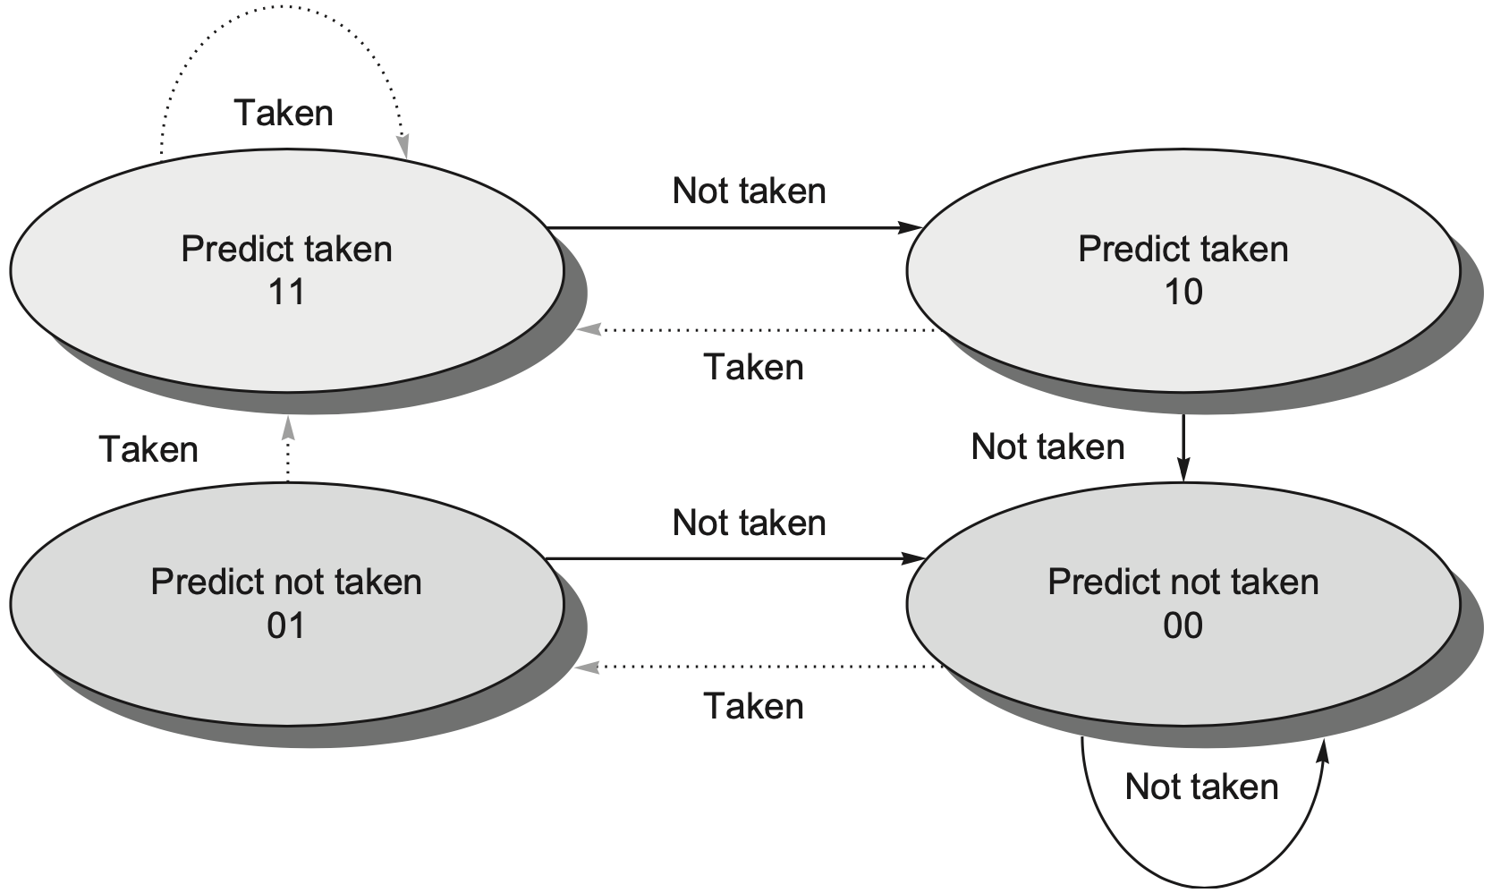
2-bit Predictor
Idea: assign a 2-bit predictor per branch; predictor changes after it misses twice
finite state machine
Notes:
To remedy this weakness, 2-bit prediction schemes are often used. In a 2-bit scheme, a prediction must miss twice before it is changed. Figure C.15 shows the finite-state processor for a 2-bit prediction scheme.
Figure C.15 The states in a 2-bit prediction scheme. By using 2 bits rather than 1, a branch that strongly favors taken or not taken—as many branches do—will be mispre- dicted less often than with a 1-bit predictor. The 2 bits are used to encode the four states in the system. The 2-bit scheme is actually a specialization of a more general scheme that has an n-bit saturating counter for each entry in the prediction buffer. With an n-bitcounter, the counter can take on values between 0 and (2^n - 1): when the counter is greater than or equal to one-half of its maximum value (2^n - 1), the branch is pre- dicted as taken; otherwise, it is predicted as untaken. Studies of n-bit predictors have shown that the 2-bit predictors do almost as well, thus most systems rely on 2-bit branch predictors rather than the more general n-bit predictors.
::
ideally, the accuracy of the predictor would match the taken branch frequency for these highly regular branches.
2-bit prediction schemes are often used
In a 2-bit scheme, a prediction must be wrong twice before it is changed.
By using 2 bits rather than 1, a branch that strongly favors taken or not taken—as many branches do—will be mispredicted only once. The 2 bits are used to encode the four states in the system. The two-bit scheme is a general instance of a counter-based predictor, which is incremented when the prediction is accurate and decremented otherwise, and uses the midpoint of its range as the division between taken and not taken.

Slide 37
2-bit Predictor
Idea: assign a 2-bit predictor per branch; predictor changes after it misses twice
finite state machine
strongly
taken
weakly
taken
weakly
untaken
strongly
untaken
Notes:
To remedy this weakness, 2-bit prediction schemes are often used. In a 2-bit scheme, a prediction must miss twice before it is changed. Figure C.15 shows the finite-state processor for a 2-bit prediction scheme.
Figure C.15 The states in a 2-bit prediction scheme. By using 2 bits rather than 1, a branch that strongly favors taken or not taken—as many branches do—will be mispre- dicted less often than with a 1-bit predictor. The 2 bits are used to encode the four states in the system. The 2-bit scheme is actually a specialization of a more general scheme that has an n-bit saturating counter for each entry in the prediction buffer. With an n-bitcounter, the counter can take on values between 0 and (2^n - 1): when the counter is greater than or equal to one-half of its maximum value (2^n - 1), the branch is pre- dicted as taken; otherwise, it is predicted as untaken. Studies of n-bit predictors have shown that the 2-bit predictors do almost as well, thus most systems rely on 2-bit branch predictors rather than the more general n-bit predictors.

Slide 38
2-bit Predictor
Idea: assign a 2-bit predictor per branch; predictor changes after it misses twice
finite state machine
trace | T | N | T | N | T | N | T | N | T | N
prior | 10
update
accuracy

Slide 39
2-bit Predictor
Idea: assign a 2-bit predictor per branch; predictor changes after it misses twice
finite state machine
trace | T | N | T | N | T | N | T | N | T | N
prior | 10
update
accuracy | 😊

Slide 40
2-bit Predictor
Idea: assign a 2-bit predictor per branch; predictor changes after it misses twice
finite state machine
trace | T | N | T | N | T | N | T | N | T | N
prior | 10 | 11
update | 11
accuracy | 😊

Slide 41
2-bit Predictor
Idea: assign a 2-bit predictor per branch; predictor changes after it misses twice
finite state machine
trace | T | N | T | N | T | N | T | N | T | N
prior | 10 | 11
update | 11
accuracy | 😊 | 😬

Slide 42
2-bit Predictor
Idea: assign a 2-bit predictor per branch; predictor changes after it misses twice
finite state machine
trace | T | N | T | N | T | N | T | N | T | N
prior | 10 | 11 | 10
update | 11 | 10
accuracy | 😊 | 😬

Slide 43
2-bit Predictor
Idea: assign a 2-bit predictor per branch; predictor changes after it misses twice
finite state machine
trace | T | N | T | N | T | N | T | N | T | N
prior | 10 | 11 | 10
update | 11 | 10
accuracy | 😊 | 😬 | 😊

Slide 44
2-bit Predictor
Idea: assign a 2-bit predictor per branch; predictor changes after it misses twice
finite state machine
trace | T | N | T | N | T | N | T | N | T | N
prior | 10 | 11 | 10 | 11
update | 11 | 10 | 11
accuracy | 😊 | 😬 | 😊

Slide 45
2-bit Predictor
Idea: assign a 2-bit predictor per branch; predictor changes after it misses twice
finite state machine
trace | T | N | T | N | T | N | T | N | T | N
prior | 10 | 11 | 10 | 11 | 10 | 11 | 10 | 11 | 10 | 11
update | 11 | 10 | 11 | 10 | 11 | 10 | 11 | 10 | 11 | 10
accuracy | 😊 | 😬 | 😊 | 😬 | 😊 | 😬 | 😊 | 😬 | 😊 | 😬

Slide 46
2-bit Predictor
Idea: assign a 2-bit predictor per branch; predictor changes after it misses twice
finite state machine 50% accuracy
trace | T | N | T | N | T | N | T | N | T | N
prior | 10 | 11 | 10 | 11 | 10 | 11 | 10 | 11 | 10 | 11
update | 11 | 10 | 11 | 10 | 11 | 10 | 11 | 10 | 11 | 10
accuracy | 😊 | 😬 | 😊 | 😬 | 😊 | 😬 | 😊 | 😬 | 😊 | 😬

Slide 47
2-bit Predictor
Idea: assign a 2-bit predictor per branch; predictor changes after it misses twice
finite state machine 50% accuracy 2x storage overhead
trace | T | N | T | N | T | N | T | N | T | N
prior | 10 | 11 | 10 | 11 | 10 | 11 | 10 | 11 | 10 | 11
update | 11 | 10 | 11 | 10 | 11 | 10 | 11 | 10 | 11 | 10
accuracy | 😊 | 😬 | 😊 | 😬 | 😊 | 😬 | 😊 | 😬 | 😊 | 😬

Slide 48
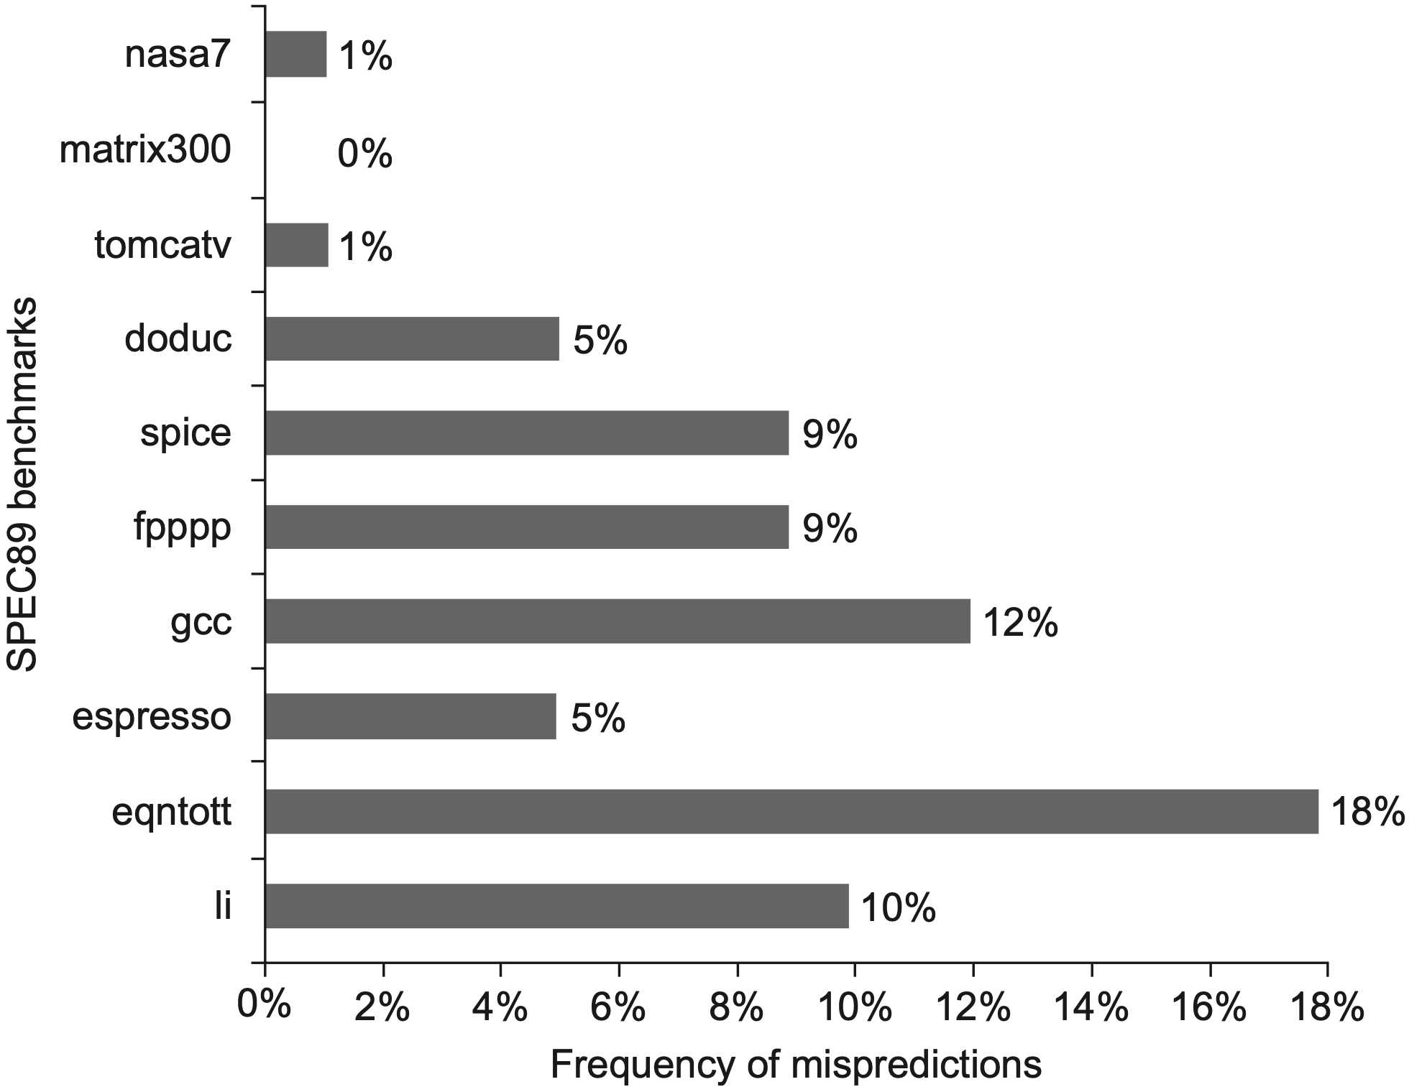
2-bit Predictor
4096-entry
integer: 11%
floating-point: 4%
Notes:
Figure C.16 Prediction accuracy of a 4096-entry 2-bit prediction buffer for the SPEC89 benchmarks. The misprediction rate for the integer benchmarks (gcc, espresso, eqntott, and li) is substantially higher (average of 11%) than that for the floating-point programs (average of 4%). Omitting the floating-point kernels (nasa7, matrix300, and tomcatv) still yields a higher accuracy for the FP benchmarks than for the integer bench- marks. These data, as well as the rest of the data in this section, are taken from a branch- prediction study done using the IBM Power architecture and optimized code for that system. See Pan et al. (1992). Although these data are for an older version of a subset of the SPEC benchmarks, the newer benchmarks are larger and would show slightly worse behavior, especially for the integer benchmarks.

Slide 49
2-bit Predictor
N
Idea: assign an N-bit predictor per branch; range from 0 to 2^{N} - 1;

Slide 50
2-bit Predictor
N
Idea: assign an N-bit predictor per branch; range from 0 to 2^{N} - 1;
Counter threshold: (2^{N} - 1 )/2
greater/= counter predicts taken branch
smaller counter predicts untaken branch

Slide 51
only the most recent so far

Slide 52
generalized to local history

Slide 53
Local Predictor
A branch’s outcome can be correlated with past outcomes of the same branch (other than the outcome of the branch “last-time” it was executed)
Example
for (i=1, i<4, i++) { }

Slide 54
Local Predictor
A branch’s outcome can be correlated with past outcomes of the same branch (other than the outcome of the branch “last-time” it was executed)
Example
for (i=1, i<4, i++) { }
3 consecutive taken + 1 untaken: 1110

Slide 55
Local Predictor
A branch’s outcome can be correlated with past outcomes of the same branch (other than the outcome of the branch “last-time” it was executed)
Example
for (i=1, i<4, i++) { }
3 consecutive taken + 1 untaken: 1110
3-bit local history register: 111→!taken

Slide 56
Local Predictor
which directions earlier instances of *this branch* went
one local history register per branch
Direction predictor (2-bit counters)
taken?
PC + inst size
Next Fetch
Address
Program
Counter
hit?
Address of the
current instruction
target address
Cache of Target Addresses (BTB: Branch Target Buffer)
https://safari.ethz.ch/digitaltechnik/spring2021/lib/exe/fetch.php?media=
onur-digitaldesign_comparch-2021-lecture17b-branch-prediction-i-afterlecture.pdf

Slide 57
Local Predictor
Example: 1-bit history initialized as 0; 2-bit counter/predictor per history initialized as SN; given a (NNT)* loop, how many misprecitions after 100 iterations?
# of mispredictions: ?

Slide 58
Local Predictor
Example: 1-bit history initialized as 0; 2-bit counter/predictor per history initialized as SN; given a (NNT)* loop, how many misprecitions after 100 iterations?
# of mispredictions: ?
trace | N | N | T | N | N | T | N | N | T | N
state | 0, SN,SN
pred
accuracy

Slide 59
Local Predictor
Example: 1-bit history initialized as 0; 2-bit counter/predictor per history initialized as SN; given a (NNT)* loop, how many misprecitions after 100 iterations?
# of mispredictions: ?
trace | N | N | T | N | N | T | N | N | T | N
state | 0, SN,SN
pred | N
accuracy

Slide 60
Local Predictor
Example: 1-bit history initialized as 0; 2-bit counter/predictor per history initialized as SN; given a (NNT)* loop, how many misprecitions after 100 iterations?
# of mispredictions: ?
trace | N | N | T | N | N | T | N | N | T | N
state | 0, SN,SN | 0, SN,SN
pred | N
accuracy | 😊

Slide 61
Local Predictor
Example: 1-bit history initialized as 0; 2-bit counter/predictor per history initialized as SN; given a (NNT)* loop, how many misprecitions after 100 iterations?
# of mispredictions: ?
trace | N | N | T | N | N | T | N | N | T | N
state | 0, SN,SN | 0, SN,SN
pred | N | N
accuracy | 😊

Slide 62
Local Predictor
Example: 1-bit history initialized as 0; 2-bit counter/predictor per history initialized as SN; given a (NNT)* loop, how many misprecitions after 100 iterations?
# of mispredictions: ?
trace | N | N | T | N | N | T | N | N | T | N
state | 0, SN,SN | 0, SN,SN | 0, SN,SN
pred | N | N
accuracy | 😊 | 😊

Slide 63
Local Predictor
Example: 1-bit history initialized as 0; 2-bit counter/predictor per history initialized as SN; given a (NNT)* loop, how many misprecitions after 100 iterations?
# of mispredictions: ?
trace | N | N | T | N | N | T | N | N | T | N
state | 0, SN,SN | 0, SN,SN | 0, SN,SN
pred | N | N | N
accuracy | 😊 | 😊

Slide 64
Local Predictor
Example: 1-bit history initialized as 0; 2-bit counter/predictor per history initialized as SN; given a (NNT)* loop, how many misprecitions after 100 iterations?
# of mispredictions: ?
trace | N | N | T | N | N | T | N | N | T | N
state | 0, SN,SN | 0, SN,SN | 0, SN,SN | 1, WN,SN
pred | N | N | N
accuracy | 😊 | 😊 | 😬

Slide 65
Local Predictor
Example: 1-bit history initialized as 0; 2-bit counter/predictor per history initialized as SN; given a (NNT)* loop, how many misprecitions after 100 iterations?
# of mispredictions: ?
trace | N | N | T | N | N | T | N | N | T | N
state | 0, SN,SN | 0, SN,SN | 0, SN,SN | 1, WN,SN
pred | N | N | N | N
accuracy | 😊 | 😊 | 😬

Slide 66
Local Predictor
Example: 1-bit history initialized as 0; 2-bit counter/predictor per history initialized as SN; given a (NNT)* loop, how many misprecitions after 100 iterations?
# of mispredictions: ?
trace | N | N | T | N | N | T | N | N | T | N
state | 0, SN,SN | 0, SN,SN | 0, SN,SN | 1, WN,SN | 0, WN,SN
pred | N | N | N | N
accuracy | 😊 | 😊 | 😬 | 😊

Slide 67
Local Predictor
Example: 1-bit history initialized as 0; 2-bit counter/predictor per history initialized as SN; given a (NNT)* loop, how many misprecitions after 100 iterations?
# of mispredictions: ?
trace | N | N | T | N | N | T | N | N | T | N
state | 0, SN,SN | 0, SN,SN | 0, SN,SN | 1, WN,SN | 0, WN,SN
pred | N | N | N | N | N
accuracy | 😊 | 😊 | 😬 | 😊

Slide 68
Local Predictor
Example: 1-bit history initialized as 0; 2-bit counter/predictor per history initialized as SN; given a (NNT)* loop, how many misprecitions after 100 iterations?
# of mispredictions: ?
trace | N | N | T | N | N | T | N | N | T | N
state | 0, SN,SN | 0, SN,SN | 0, SN,SN | 1, WN,SN | 0, WN,SN | 0, SN,SN
pred | N | N | N | N | N
accuracy | 😊 | 😊 | 😬 | 😊 | 😊

Slide 69
Local Predictor
Example: 1-bit history initialized as 0; 2-bit counter/predictor per history initialized as SN; given a (NNT)* loop, how many misprecitions after 100 iterations?
# of mispredictions: ?
trace | N | N | T | N | N | T | N | N | T | N
state | 0, SN,SN | 0, SN,SN | 0, SN,SN | 1, WN,SN | 0, WN,SN | 0, SN,SN
pred | N | N | N | N | N | N
accuracy | 😊 | 😊 | 😬 | 😊 | 😊

Slide 70
Local Predictor
Example: 1-bit history initialized as 0; 2-bit counter/predictor per history initialized as SN; given a (NNT)* loop, how many misprecitions after 100 iterations?
# of mispredictions: ?
trace | N | N | T | N | N | T | N | N | T | N
state | 0, SN,SN | 0, SN,SN | 0, SN,SN | 1, WN,SN | 0, WN,SN | 0, SN,SN | 1, WN,SN
pred | N | N | N | N | N | N
accuracy | 😊 | 😊 | 😬 | 😊 | 😊 | 😬

Slide 71
Local Predictor
Example: 1-bit history initialized as 0; 2-bit counter/predictor per history initialized as SN; given a (NNT)* loop, how many misprecitions after 100 iterations?
# of mispredictions: ?
trace | N | N | T | N | N | T | N | N | T | N
state | 0, SN,SN | 0, SN,SN | 0, SN,SN | 1, WN,SN | 0, WN,SN | 0, SN,SN | 1, WN,SN
pred | N | N | N | N | N | N
accuracy | 😊 | 😊 | 😬 | 😊 | 😊 | 😬

Slide 72
Local Predictor
Example: 1-bit history initialized as 0; 2-bit counter/predictor per history initialized as SN; given a (NNT)* loop, how many misprecitions after 100 iterations?
# of mispredictions: 1 per iteration
trace | N | N | T | N | N | T | N | N | T | N
state | 0, SN,SN | 0, SN,SN | 0, SN,SN | 1, WN,SN | 0, WN,SN | 0, SN,SN | 1, WN,SN
pred | N | N | N | N | N | N
accuracy | 😊 | 😊 | 😬 | 😊 | 😊 | 😬

Slide 73
Local Predictor
Example: 1-bit history initialized as 0; 2-bit counter/predictor per history initialized as SN; given a (NNT)* loop, how many misprecitions after 100 iterations?
# of mispredictions: 100
trace | N | N | T | N | N | T | N | N | T | N
state | 0, SN,SN | 0, SN,SN | 0, SN,SN | 1, WN,SN | 0, WN,SN | 0, SN,SN | 1, WN,SN
pred | N | N | N | N | N | N
accuracy | 😊 | 😊 | 😬 | 😊 | 😊 | 😬

Slide 74
only a single branch so far

Slide 75

no man is an island
Notes:
https://www.nikkei.com/article/DGXZQOGN235I70T20C21A7000000/

Slide 76
Correlate Branch Prediction
Correlating/Two-level Predictor
use the behavior of other branches to make a prediction;
make prediction based on the outcome of the branch the last time the same global branch history was encountered

Slide 77
Correlate Branch Prediction
Example: eqntott benchmark
if (aa==2)
aa=0;
if (bb==2)
bb=0;
if (aa!=bb) {…
Notes:
Equation to two two

Slide 78
Correlate Branch Prediction
Example: eqntott benchmark
if (aa==2)
aa=0;
if (bb==2)
bb=0;
if (aa!=bb) {…
x1 for aa
x2 for bb
addi
bnez
add
addi
bnez
add
sub
beqz
L1:
L2:
x3, x1, -2
x3, L1
x1, x0, x0
x3, x2, -2
x3, L2
x2, x0, x0
x3, x1, x2
x3, L3
Notes:
Here is the RISC-V code that we would typically generate for this code fragment assuming that aa and bb are assigned to registers x1 and x2:

Slide 79
Correlate Branch Prediction
Example: eqntott benchmark
if (aa==2)
aa=0;
if (bb==2)
bb=0;
if (aa!=bb) {…
addi
bnez
add
addi
bnez
add
sub
beqz
b1
L1:
b2
L2:
b3
x3, x1, -2
x3, L1
x1, x0, x0
x3, x2, -2
x3, L2
x2, x0, x0
x3, x1, x2
x3, L3
Notes:
Let’s label these branches b1, b2, and b3. The key observation is that the behavior of branch b3 is correlated with the behavior of branches b1 and b2. Clearly, if both branches b1 and b2 are taken (i.e., if the conditions both evaluate to true and aa and bb are both assigned 0), then b3 will not be taken, because aa and bb are clearly equal. A predictor that uses the behavior of only a single branch to predict the out- come of that branch can never capture this behavior.

Slide 80
Correlate Branch Prediction
Example: eqntott benchmark
if (aa==2)
aa=0;
if (bb==2)
bb=0;
if (aa!=bb) {…
if b1&b2 taken
addi
bnez
add
addi
bnez
add
sub
beqz
b1
L1:
b2
L2:
b3
x3, x1, -2
x3, L1
x1, x0, x0
x3, x2, -2
x3, L2
x2, x0, x0
x3, x1, x2
x3, L3
😊
😊
Notes:
Let’s label these branches b1, b2, and b3. The key observation is that the behavior of branch b3 is correlated with the behavior of branches b1 and b2. Clearly, if both branches b1 and b2 are taken (i.e., if the conditions both evaluate to true and aa and bb are both assigned 0), then b3 will not be taken, because aa and bb are clearly equal. A predictor that uses the behavior of only a single branch to predict the out- come of that branch can never capture this behavior.

Slide 81
Correlate Branch Prediction
Example: eqntott benchmark
if (aa==2)
aa=0;
if (bb==2)
bb=0;
if (aa!=bb) {…
if b1&b2 taken
then b3 untaken
addi
bnez
add
addi
bnez
add
sub
beqz
b1
L1:
b2
L2:
b3
x3, x1, -2
x3, L1
x1, x0, x0
x3, x2, -2
x3, L2
x2, x0, x0
x3, x1, x2
x3, L3
😊
😊
😬
Notes:
Let’s label these branches b1, b2, and b3. The key observation is that the behavior of branch b3 is correlated with the behavior of branches b1 and b2. Clearly, if both branches b1 and b2 are taken (i.e., if the conditions both evaluate to true and aa and bb are both assigned 0), then b3 will not be taken, because aa and bb are clearly equal. A predictor that uses the behavior of only a single branch to predict the out- come of that branch can never capture this behavior.

Slide 82
Two-Level Predictor
which direction earlier
branches went
Direction Predictor (2-bit counters)
taken?
Global Branch
History
PC + inst size
Next Fetch
Address
Program
Counter
hit?
address of the
current instruction
target address
Cache of Target Addresses (BTB: Branch Target Buffer)
https://safari.ethz.ch/digitaltechnik/spring2021/lib/exe/fetch.php?media=
onur-digitaldesign_comparch-2021-lecture17b-branch-prediction-i-afterlecture.pdf

Slide 83
Two-Level Predictor
use a left-shift register to track global branch history
which direction earlier
branches went
Direction Predictor (2-bit counters)
taken?
Global Branch
History
PC + inst size
Next Fetch
Address
Program
Counter
hit?
address of the
current instruction
target address
Cache of Target Addresses (BTB: Branch Target Buffer)
https://safari.ethz.ch/digitaltechnik/spring2021/lib/exe/fetch.php?media=
onur-digitaldesign_comparch-2021-lecture17b-branch-prediction-i-afterlecture.pdf

Slide 84
Two-Level Predictor
Example: eqntott benchmark
predict b3 using
b1 & b2
if b1&b2 taken
then b3 untaken
addi
bnez
add
addi
bnez
add
sub
beqz
b1
L1:
b2
L2:
b3
x3, x1, -2
x3, L1
x1, x0, x0
x3, x2, -2
x3, L2
x2, x0, x0
x3, x1, x2
x3, L3
😊
state | global | predictor
prior | 00 | ?...
b1 taken | 01 | ?...
b2 taken | 11 | untaken
😊
😬
Notes:
Let’s label these branches b1, b2, and b3. The key observation is that the behavior of branch b3 is correlated with the behavior of branches b1 and b2. Clearly, if both branches b1 and b2 are taken (i.e., if the conditions both evaluate to true and aa and bb are both assigned 0), then b3 will not be taken, because aa and bb are clearly equal. A predictor that uses the behavior of only a single branch to predict the out- come of that branch can never capture this behavior.

Slide 85
Two-Level Predictor
(m, n) predictor
use the behavior of the last m branches to choose from 2^{m} branch predictors, each predictor is an n-bit counter
storage cost per branch given an individual pattern history table (PHT)
2^{m} x n bits

Slide 86
Two-Level Predictor
(m, n) predictor
use the behavior of the last m branches to choose from 2^{m} branch predictors, each predictor is an n-bit counter
storage cost per branch given an individual pattern history table (PHT)
2^{m} x n bits
lower b-bit of branch address for indices
2^{m} x n x 2^{b} bits

Slide 87
Two-Level Predictor
(m, n) predictor
use the behavior of the last m branches to choose from 2^{m} branch predictors, each predictor is an n-bit counter
storage cost of all branch predictors given a unified PHT
2^{m} x n bits
Notes:
using a unified PHT, not branch specific, so need not to track branch-address specifics

Slide 88
Two-Level Predictor
(m, n) predictor
use the behavior of the last m branches to choose from 2^{m} branch predictors, each predictor is an n-bit counter
storage cost of all branch predictors given a unified PHT
2^{m} x n bits
predictor becomes less branch specific

Slide 89
Hybrid/Alloyed Predictor
combine local branch info and global branch history
which direction earlier
branches went
Direction predictor (2-bit counters)
taken?
Global Branch
History
PC + inst size
Next Fetch
Address
XOR
Program
Counter
hit?
Address of the
current instruction
gshare
predictor
target address
Cache of Target Addresses (BTB: Branch Target Buffer)
https://safari.ethz.ch/digitaltechnik/spring2021/lib/exe/fetch.php?media=
onur-digitaldesign_comparch-2021-lecture17b-branch-prediction-i-afterlecture.pdf
Notes:
Perhaps the best-known example of a correlating predictor is McFarling’s gshare predictor. In gshare the index is formed by combining the address of the branch and the most recent conditional branch outcomes using an exclusive- OR, which essentially acts as a hash of the branch address and the branch history. The hashed result is used to index a prediction array of 2-bit counters, as shown in Figure 3.4. The gshare predictor works remarkably well for a simple predictor, and is often used as the baseline for comparison with more sophisticated predictors. Predictors that combine local branch information (i.e., branch-address per se in this case) and global branch history are also called alloyed predictors or hybrid predictors.

Slide 90
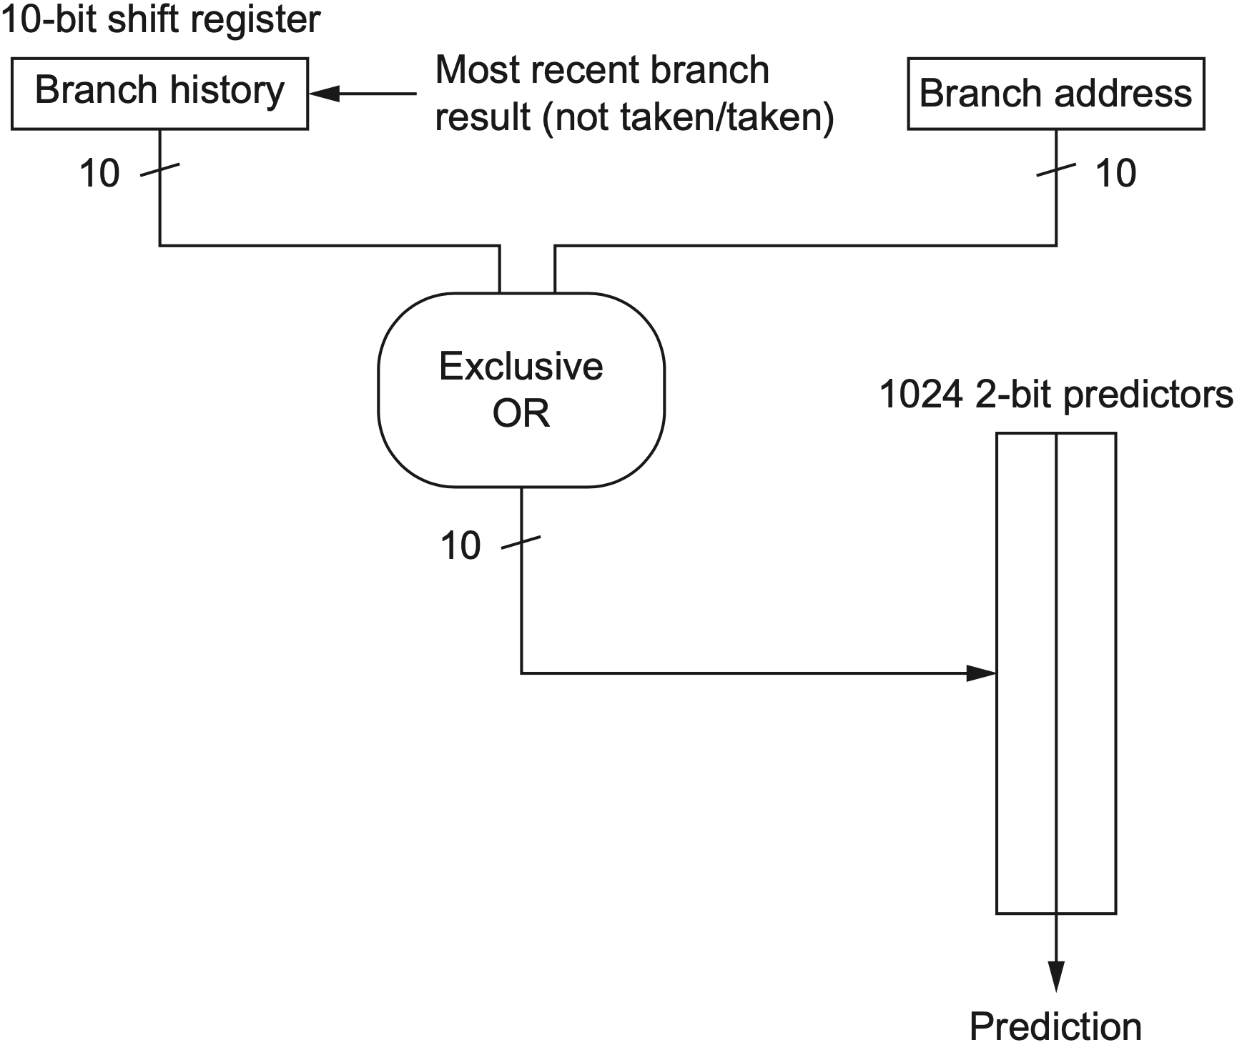
Hybrid/Alloyed Predictor
combine local branch info and global branch history
gshare
predictor: example
Notes:
Perhaps the best-known example of a correlating predictor is McFarling’s gshare predictor. In gshare the index is formed by combining the address of the branch and the most recent conditional branch outcomes using an exclusive- OR, which essentially acts as a hash of the branch address and the branch history. The hashed result is used to index a prediction array of 2-bit counters, as shown in Figure 3.4. The gshare predictor works remarkably well for a simple predictor, and is often used as the baseline for comparison with more sophisticated predictors. Predictors that combine local branch information and global branch history are also called alloyed predictors or hybrid predictors.

Slide 91
only a single predictor so far

Slide 92
no predictor fits all branches

Slide 93
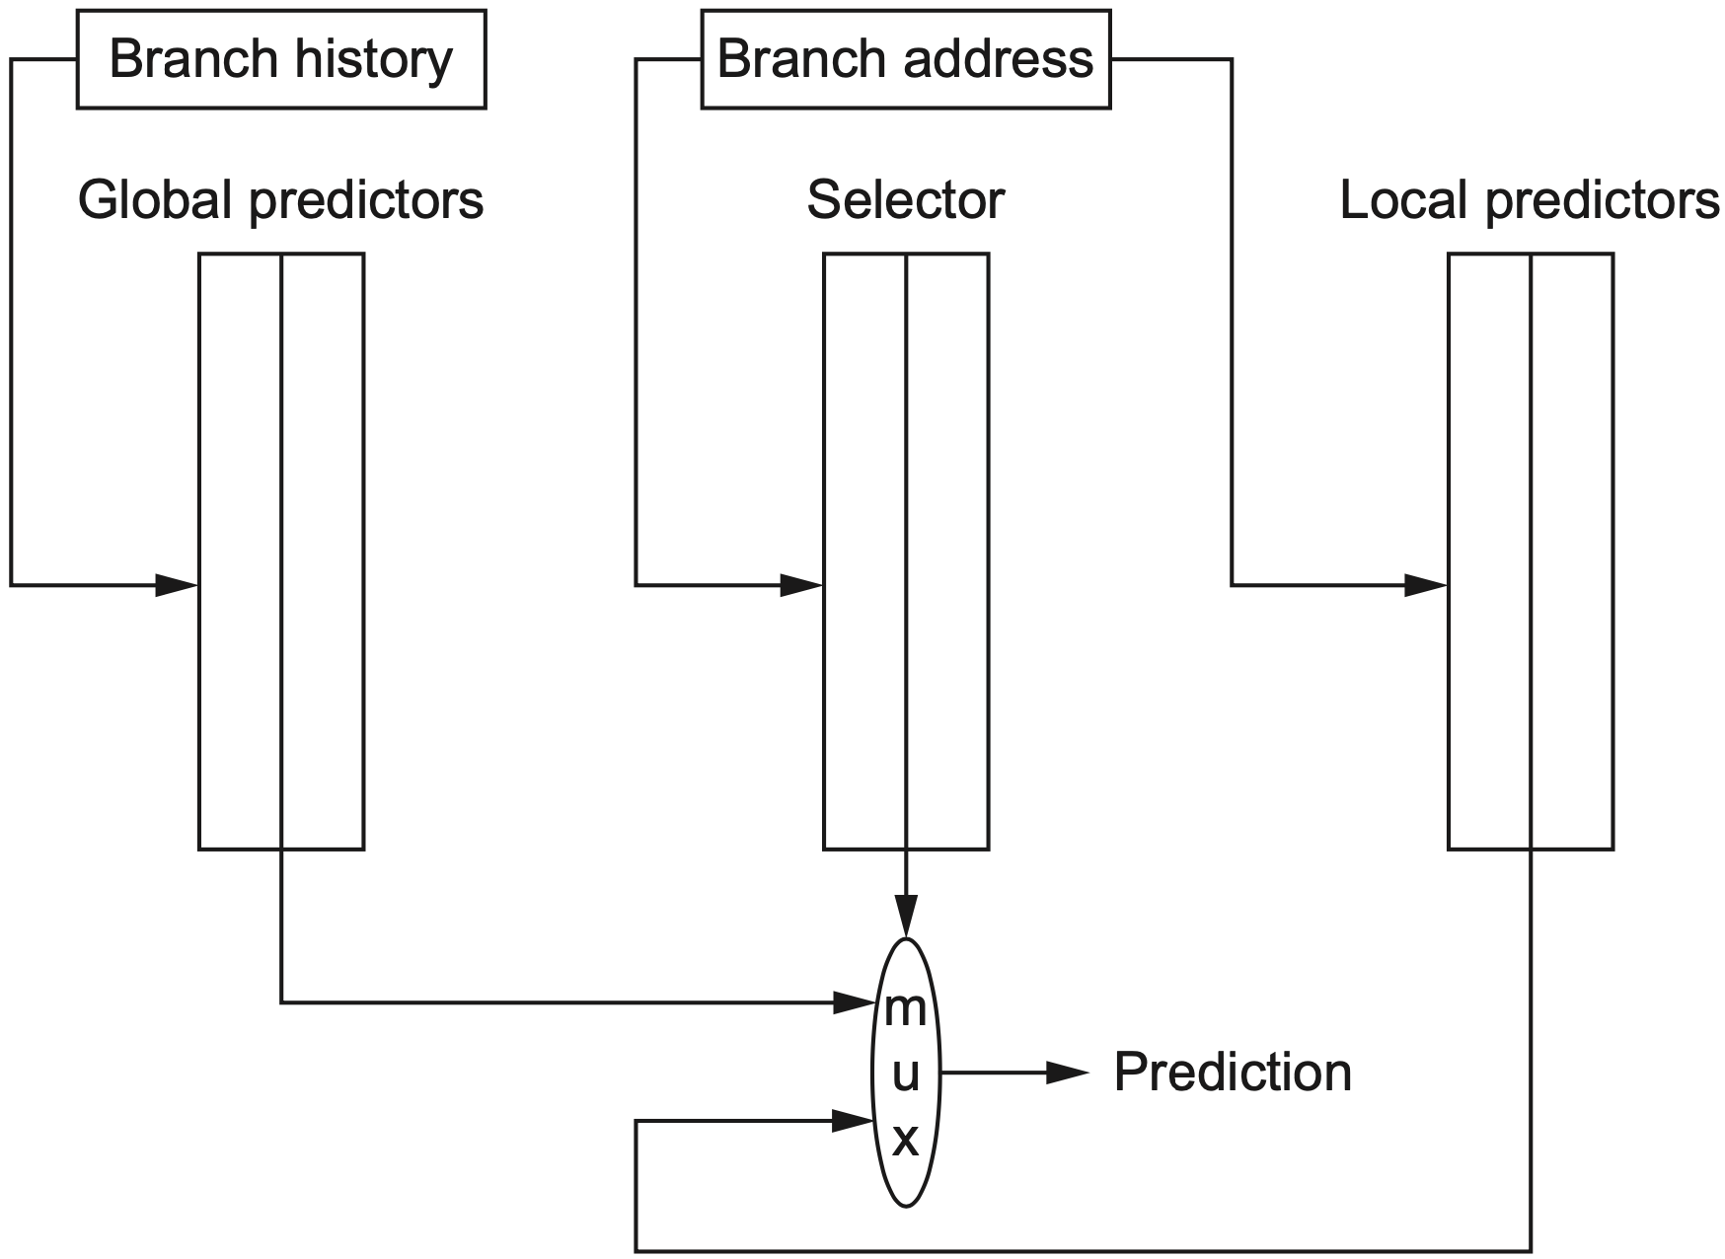
Hybrid Predictor
Use more than one type of predictor
Select the best prediction

Slide 94
Tournament Predictor
Global predictor + Local predictor
Choose either with a selector
which predictor
to use
indexed with
the branch address
indexed with
the most recent branch history
Notes:
Figure 3.5 A tournament predictor using the branch address to index a set of 2-bit selection counters, which choose between a local and a global predictor. In this case, the index to the selector table is the current branch address. The two tables are also 2-bit predictors that are indexed by the global history and branch address, respec- tively. The selector acts like a 2-bit predictor, changing the preferred predictor for a branch address when two mis- predicts occur in a row. The number of bits of the branch address used to index the selector table and the local predictor table is equal to the length of the global branch history used to index the global prediction table. Note that misprediction is a bit tricky because we need to change both the selector table and either the global or local predictor.

Slide 95
Tournament Predictor
Global predictor + Local predictor
Choose either with a selector
2-bit selection counter
changed after two mispredictions
indexed with
the branch address
indexed with
the most recent branch history
Notes:
Figure 3.5 A tournament predictor using the branch address to index a set of 2-bit selection counters, which choose between a local and a global predictor. In this case, the index to the selector table is the current branch address. The two tables are also 2-bit predictors that are indexed by the global history and branch address, respec- tively. The selector acts like a 2-bit predictor, changing the preferred predictor for a branch address when two mis- predicts occur in a row. The number of bits of the branch address used to index the selector table and the local predictor table is equal to the length of the global branch history used to index the global prediction table. Note that misprediction is a bit tricky because we need to change both the selector table and either the global or local predictor.

Slide 96
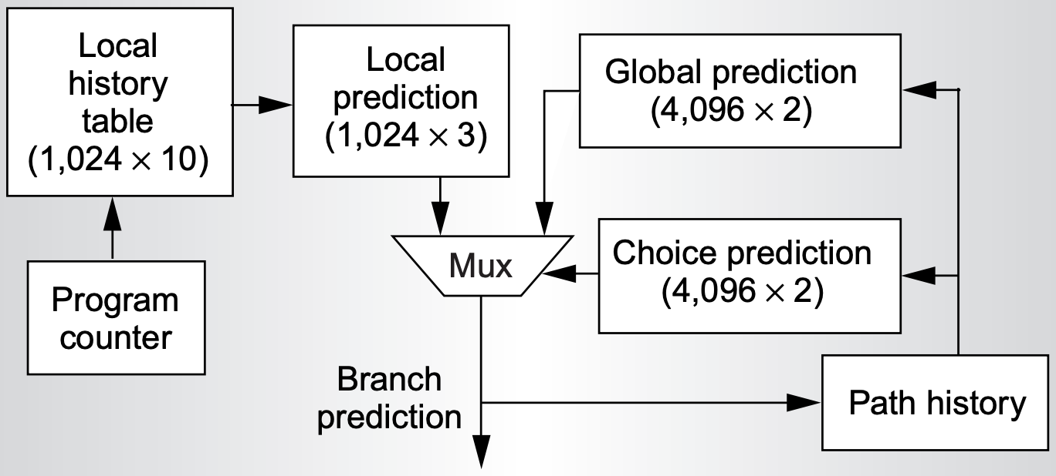
Tournament Predictor
Global predictor + Local predictor
Choose either with a selector
Alpha 21264 Tournament Predictor
https://www.cis.upenn.edu/~milom/cis501-Fall05/papers/Alpha21264.pdf
Notes:
More details about Alpha 21264 Tournament Predictor in http://class.ece.iastate.edu/tyagi/cpre581/lectures/Lecture10.pdf
(not required)

Slide 97
Tagged Hybrid Predictor
Use a series of global predictors indexed with different length histories
Use tags in global history tables
Choose a prediction from a global history table only if its tag matches the hash of branch address and global branch history
Select the predictor with the longest history where the tags also match

Slide 98
Tagged Hybrid Predictor
Use a series of global predictors indexed with different length histories
Branch history length forms a geometric series

Slide 99
TAgged Hybrid Predictor
Use a series of global predictors indexed with different length histories
Branch history length forms a GEometric series: 0, 2, 4, 8, 16…

Slide 100
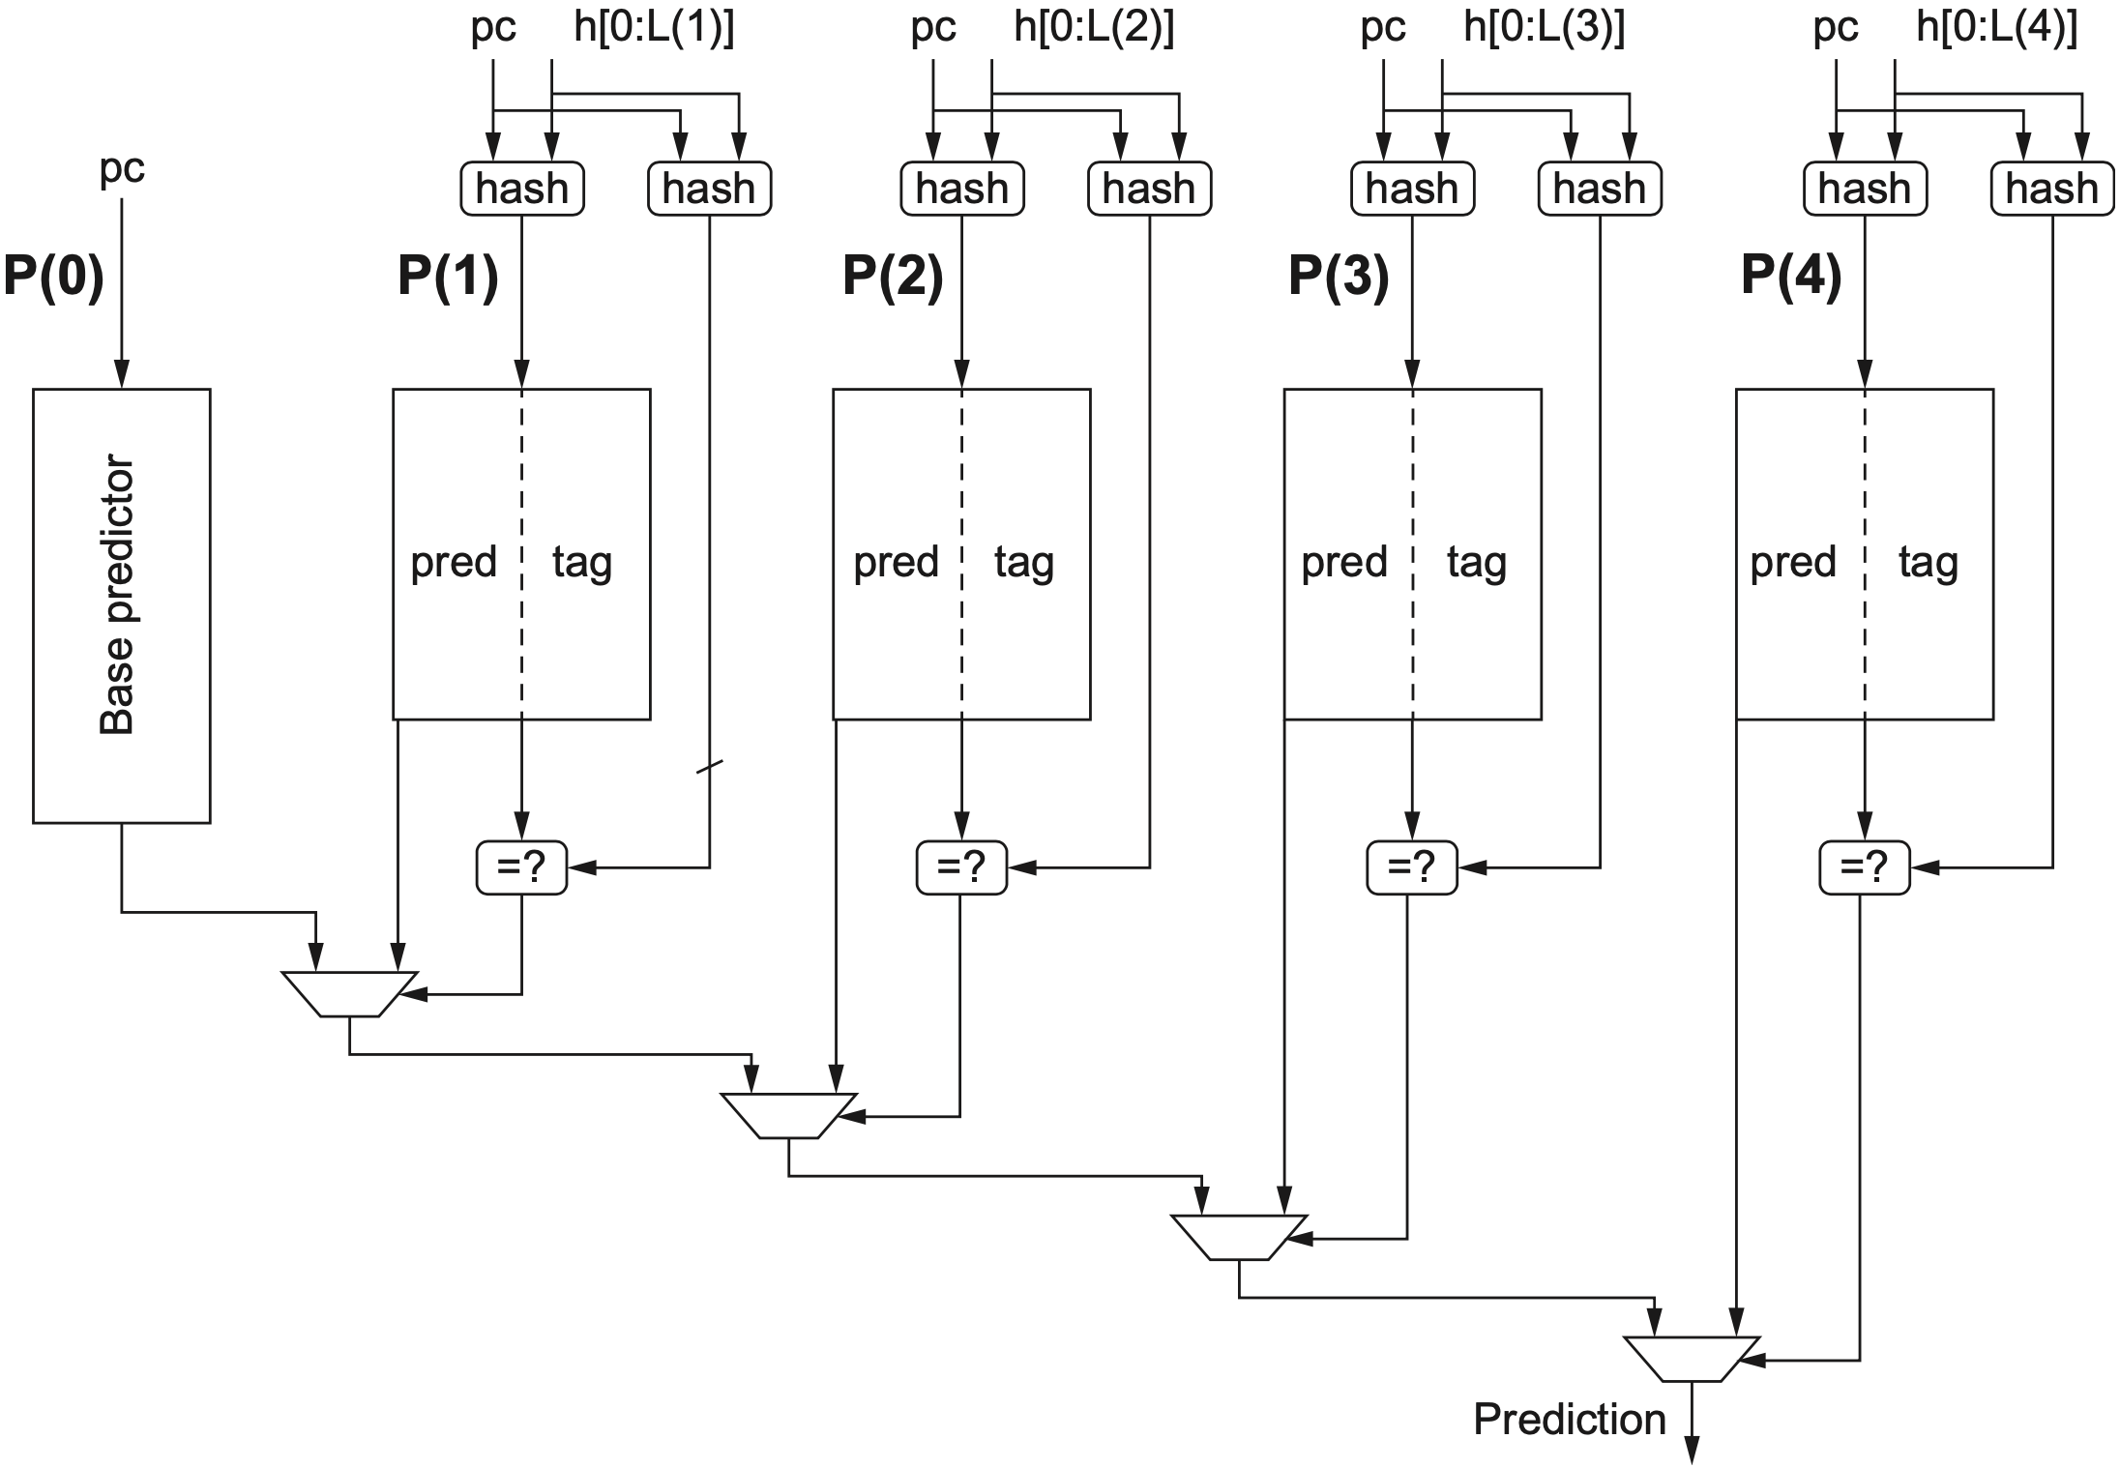
Tagged Hybrid Predictor
AGEPredictor
P(i) is accessed using hash of PC & history of the most recent i branches
Notes:
Figure 3.7 A five-component tagged hybrid predictor has five separate prediction tables, indexed by a hash of the branch address and a segment of recent branch history of length 0–4 labeled “h” in this figure. The hash can be as simple as an exclusive-OR, as in gshare. Each predictor is a 2-bit (or possibly 3-bit) predictor. The tags are typically 4–8 bits. The chosen prediction is the one with the longest history where the tags also match.
recent i branches use i-bit global branch history, which can index 2^i branch history entries

Slide 101
Tagged Hybrid Predictor
AGEPredictor
P(i) is accessed using hash of PC & history of the most recent i branches
P(0) always matches because it uses no tags
Notes:
The prediction for a given branch is the predictor with the longest branch his- tory that also has matching tags. P(0) always matches because it uses no tags and becomes the default prediction if none of P(1) through P(n) match.

Slide 102
Tagged Hybrid Predictor
AGEPredictor
P(i) is accessed using hash of PC & history of the most recent i branches
P(0) always matches because it uses no tags
Each predictor also includes a 2-bit use field, which indicates whether a
prediction was recently used and therefore likely to be more accurate
Notes:
The tagged hybrid version of this predictor also includes a 2-bit use field in each of the history-indexed predictors. The use field indicates whether a prediction was recently used and therefore likely to be more accurate; the use field can be period- ically reset in all entries so that old predictions are cleared. Many more details are involved in implementing this style of predictor, especially how to handle mispre- dictions. The search space for the optimal predictor is also very large because the number of predictors, the exact history used for indexing, and the size of each pre- dictor are all variable.

Slide 103
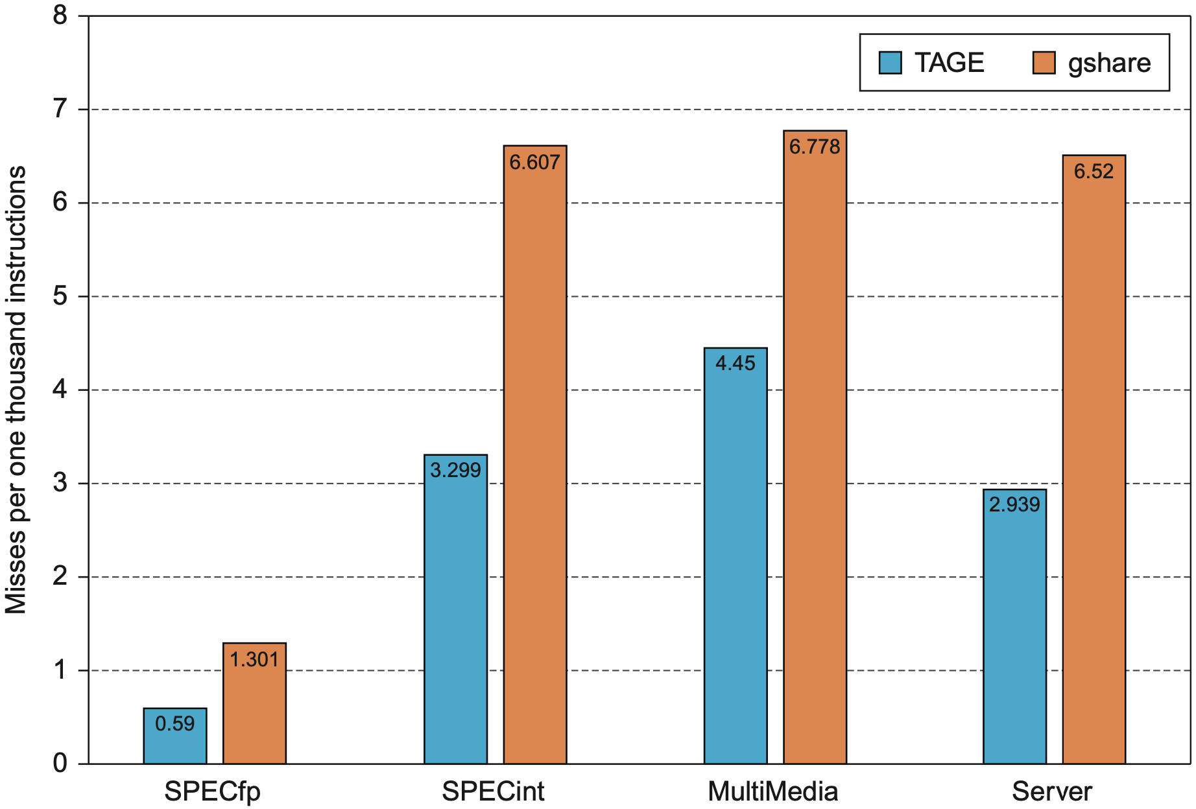
Tagged Hybrid Predictor
AGEPredictor
Performance
branch frequency: 20%~25%
1.8%~2.2%
2.7%~3.4%
Notes:
Figure3.8 A comparison of the misprediction rate (measured as mispredicts per 1000 instructions executed) for tagged hybrid versus gshare. Both predictors use the same total number of bits, although tagged hybrid uses some of that storage for tags, while gshare contains no tags. The benchmarks consist of traces from SPECfp and SPECint, a series of multimedia and server benchmarks. The latter two behave more like SPECint.

Slide 104
handle control hazard so far

Slide 105
how to handle data hazard?

Slide 106
how to handle data hazard?

Slide 107
how to handle data hazard?
fdiv.d
fadd.d
fsub.d
f0, f2, f4
f10, f0, f8
f12, f8, f14

Slide 108
how to handle data hazard?
fdiv.d
fadd.d
fsub.d
f0, f2, f4
f10, f0, f8
f12, f8, f14
Notes:
A simple statically scheduled pipeline fetches an instruction and issues it, unless there is a data dependence between an instruction already in the pipeline and the fetched instruction that cannot be hidden with bypassing or forwarding. (Forward- ing logic reduces the effective pipeline latency so that the certain dependences do not result in hazards.) If there is a data dependence that cannot be hidden, then the hazard detection hardware stalls the pipeline starting with the instruction that uses the result. No new instructions are fetched or issued until the dependence is cleared.
A major limitation of simple pipelining techniques is that they use in-order instruc- tion issue and execution: instructions are issued in program order, and if an instruc- tion is stalled in the pipeline, no later instructions can proceed. Thus, if there is a dependence between two closely spaced instructions in the pipeline, it will lead to a hazard, and a stall will result. If there are multiple functional units, these units could lie idle. If instruction j depends on a long-running instruction i, currently in execution in the pipeline, then all instructions after j must be stalled until i is finished and j can execute. For example, consider this code:
fdiv.d f0,f2,f4
fadd.d f10,f0,f8
fsub.d f12,f8,f14
The fsub.d instruction cannot execute because the dependence of fadd.d on fdiv.d causes the pipeline to stall; yet, fsub.d is not data-dependent on any- thing in the pipeline. This hazard creates a performance limitation that can be elim- inated by not requiring instructions to execute in program order.

Slide 109
how to handle data hazard?
fsub.d is stalled until fdiv.d produces f0
and fadd.d resumes;
fdiv.d
fadd.d
fsub.d
f0, f2, f4
f10, f0, f8
f12, f8, f14
Notes:
A simple statically scheduled pipeline fetches an instruction and issues it, unless there is a data dependence between an instruction already in the pipeline and the fetched instruction that cannot be hidden with bypassing or forwarding. (Forward- ing logic reduces the effective pipeline latency so that the certain dependences do not result in hazards.) If there is a data dependence that cannot be hidden, then the hazard detection hardware stalls the pipeline starting with the instruction that uses the result. No new instructions are fetched or issued until the dependence is cleared.
A major limitation of simple pipelining techniques is that they use in-order instruc- tion issue and execution: instructions are issued in program order, and if an instruc- tion is stalled in the pipeline, no later instructions can proceed. Thus, if there is a dependence between two closely spaced instructions in the pipeline, it will lead to a hazard, and a stall will result. If there are multiple functional units, these units could lie idle. If instruction j depends on a long-running instruction i, currently in execution in the pipeline, then all instructions after j must be stalled until i is finished and j can execute. For example, consider this code:
fdiv.d f0,f2,f4
fadd.d f10,f0,f8
fsub.d f12,f8,f14
The fsub.d instruction cannot execute because the dependence of fadd.d on fdiv.d causes the pipeline to stall; yet, fsub.d is not data-dependent on any- thing in the pipeline. This hazard creates a performance limitation that can be elim- inated by not requiring instructions to execute in program order.

Slide 110
how to handle data hazard?
fsub.d is, however, not data-dependent
on either fdiv.d or fadd.d
fdiv.d
fadd.d
fsub.d
f0, f2, f4
f10, f0, f8
f12, f8, f14
Notes:
A simple statically scheduled pipeline fetches an instruction and issues it, unless there is a data dependence between an instruction already in the pipeline and the fetched instruction that cannot be hidden with bypassing or forwarding. (Forward- ing logic reduces the effective pipeline latency so that the certain dependences do not result in hazards.) If there is a data dependence that cannot be hidden, then the hazard detection hardware stalls the pipeline starting with the instruction that uses the result. No new instructions are fetched or issued until the dependence is cleared.
A major limitation of simple pipelining techniques is that they use in-order instruc- tion issue and execution: instructions are issued in program order, and if an instruc- tion is stalled in the pipeline, no later instructions can proceed. Thus, if there is a dependence between two closely spaced instructions in the pipeline, it will lead to a hazard, and a stall will result. If there are multiple functional units, these units could lie idle. If instruction j depends on a long-running instruction i, currently in execution in the pipeline, then all instructions after j must be stalled until i is finished and j can execute. For example, consider this code:
fdiv.d f0,f2,f4
fadd.d f10,f0,f8
fsub.d f12,f8,f14
The fsub.d instruction cannot execute because the dependence of fadd.d on fdiv.d causes the pipeline to stall; yet, fsub.d is not data-dependent on any- thing in the pipeline. This hazard creates a performance limitation that can be elim- inated by not requiring instructions to execute in program order.

Slide 111
how to handle data hazard?
fsub.d is, however, not data-dependent
on either fdiv.d or fadd.d
fdiv.d
fadd.d
fsub.d
f0, f2, f4
f10, f0, f8
f12, f8, f14
Notes:
A simple statically scheduled pipeline fetches an instruction and issues it, unless there is a data dependence between an instruction already in the pipeline and the fetched instruction that cannot be hidden with bypassing or forwarding. (Forward- ing logic reduces the effective pipeline latency so that the certain dependences do not result in hazards.) If there is a data dependence that cannot be hidden, then the hazard detection hardware stalls the pipeline starting with the instruction that uses the result. No new instructions are fetched or issued until the dependence is cleared.
A major limitation of simple pipelining techniques is that they use in-order instruc- tion issue and execution: instructions are issued in program order, and if an instruc- tion is stalled in the pipeline, no later instructions can proceed. Thus, if there is a dependence between two closely spaced instructions in the pipeline, it will lead to a hazard, and a stall will result. If there are multiple functional units, these units could lie idle. If instruction j depends on a long-running instruction i, currently in execution in the pipeline, then all instructions after j must be stalled until i is finished and j can execute. For example, consider this code:
fdiv.d f0,f2,f4
fadd.d f10,f0,f8
fsub.d f12,f8,f14
The fsub.d instruction cannot execute because the dependence of fadd.d on fdiv.d causes the pipeline to stall; yet, fsub.d is not data-dependent on any- thing in the pipeline. This hazard creates a performance limitation that can be elim- inated by not requiring instructions to execute in program order.

Slide 112
break the rule
fsub.d is executed while fadd.d waits for
fdiv.d to produce f0
fdiv.d
fadd.d
fsub.d
f0, f2, f4
f10, f0, f8
f12, f8, f14
Notes:
A simple statically scheduled pipeline fetches an instruction and issues it, unless there is a data dependence between an instruction already in the pipeline and the fetched instruction that cannot be hidden with bypassing or forwarding. (Forward- ing logic reduces the effective pipeline latency so that the certain dependences do not result in hazards.) If there is a data dependence that cannot be hidden, then the hazard detection hardware stalls the pipeline starting with the instruction that uses the result. No new instructions are fetched or issued until the dependence is cleared.
A major limitation of simple pipelining techniques is that they use in-order instruc- tion issue and execution: instructions are issued in program order, and if an instruc- tion is stalled in the pipeline, no later instructions can proceed. Thus, if there is a dependence between two closely spaced instructions in the pipeline, it will lead to a hazard, and a stall will result. If there are multiple functional units, these units could lie idle. If instruction j depends on a long-running instruction i, currently in execution in the pipeline, then all instructions after j must be stalled until i is finished and j can execute. For example, consider this code:
fdiv.d f0,f2,f4
fadd.d f10,f0,f8
fsub.d f12,f8,f14
The fsub.d instruction cannot execute because the dependence of fadd.d on fdiv.d causes the pipeline to stall; yet, fsub.d is not data-dependent on any- thing in the pipeline. This hazard creates a performance limitation that can be elim- inated by not requiring instructions to execute in program order.

Slide 113
dynamic scheduling
hardware reorders the instruction execution
to reduce the stalls while maintaining
data flow and exception behavior
Notes:
In this section, we explore dynamic scheduling, a technique by which the hard- ware reorders the instruction execution to reduce the stalls while maintaining data flow and exception behavior.
Dynamic scheduling offers several advantages. First, it allows code that was compiled with one pipeline in mind to run efficiently on a different pipeline, eliminating the need to have multiple binaries and recompile for a different microarchitecture. In today’s computing environment, where much of the software is from third parties and distributed in binary form, this advantage is sig- nificant. Second, it enables handling some cases when dependences are unknown at compile time; for example, they may involve a memory reference or a data- dependent branch, or they may result from a modern programming environment that uses dynamic linking or dispatching. Third, and perhaps most importantly, it allows the processor to tolerate unpredictable delays, such as cache misses, by executing other code while waiting for the miss to resolve.

Slide 114
Dynamic Scheduling
Enable out-of-order execution (and thus out-of-order completion)
Split ID into two stages: Issue: decode instructions, check for structural hazards Read operands: wait until no data hazards, then read operands
IF Issue Read-Operands EX MEM WB

Slide 115
Dynamic Scheduling
Issue from IF: in order
Read operands to EX: out of order when there are sufficient resources and no data dependences
Scheduling policy: upon stalling instr, issue other instructions if they do not depend on any active or stalled instruction

Slide 116
Dynamic Scheduling
Issue from IF: in order
Read operands to EX: out of order when there are sufficient resources and no data dependences
Scheduling policy: upon stalling instr, issue other instructions if they do not depend on any active or stalled instruction
How to schedule: use a centralized hazard detection and resolution unit
Notes:
when the next instruction to execute is stalled, other instructions can be issued and executed if they do not depend on any active or stalled instruction.

Slide 117
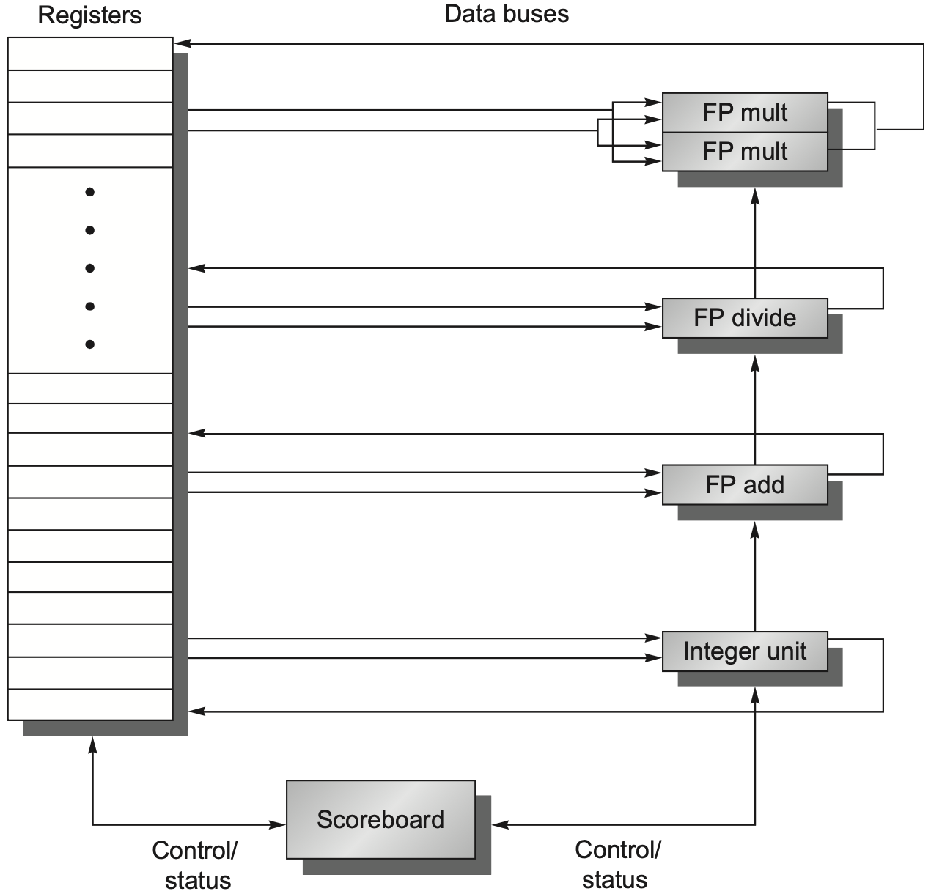
Scoreboarding
Scoreboard controls the instruction progression from one step to the next by communicating with functional units
Three parts: Instruction status Functional unit status Register result status
Notes:
Scoreboard-ing is a technique for allowing instructions to execute out of order when there are sufficient resources and no data dependences; it is named after the CDC 6600 scoreboard, which developed this capability.

Slide 118
Instruction Status
Indicate which of the four steps the instruction is in
Four steps: issue, read operands, execution, write back
Omit memory access because the out-of-order focuses more on FP operations

Slide 119
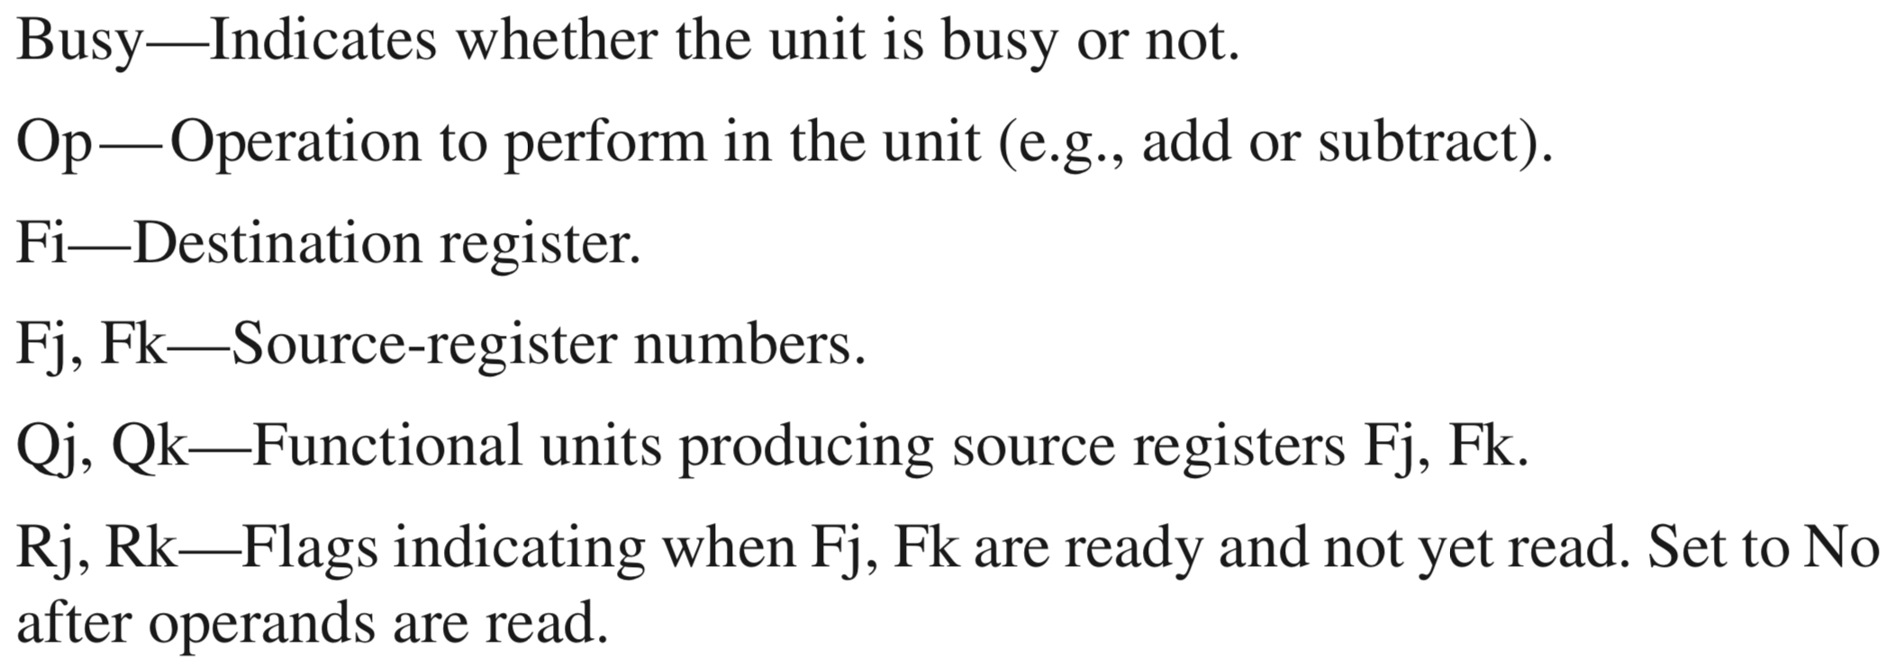
Functional Unit Status
Indicate the state of the functional unit
Nine fields per functional unit (FU)
Notes:
Rj, Rk: how to set if Not Ready?

Slide 120
Register Result Status
Indicate which functional unit will write each register, if an active instruction has the register as its destination
Set to blank whenever no pending instructions will wirte that register

Slide 121
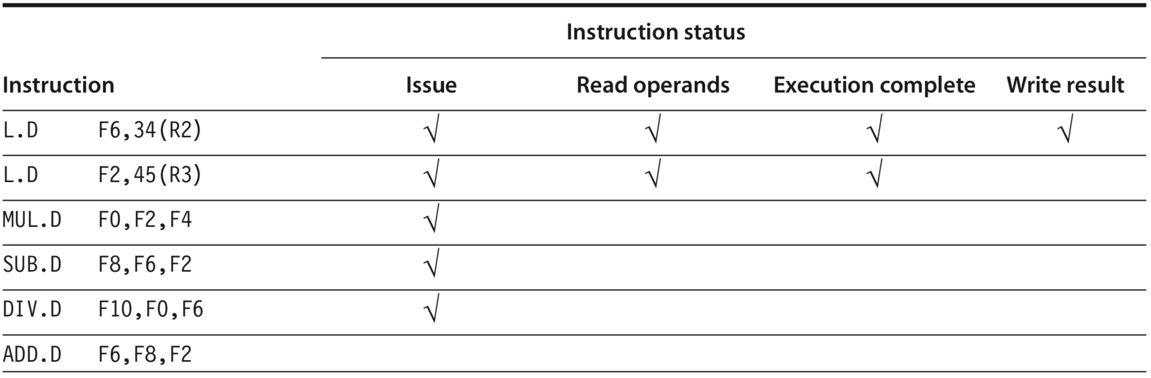
Scoreboard Example
all instructions
in scoreboard
stalled due to structural hazard with SUB.D
2nd L.D is ready to write result
Notes:
5th edition, C.7
MUL.D depends on L.D for F2, so upon L.D completes preparing F2, MUL.D is yet to read it, so its Read Operands stantus is not ready
Components of the scoreboard. Each instruction that has issued or is pending issue has an entry in the instruction status table.
The instruction status table says that: (1) the first L.D has completed and written its result, and (2) the second L.D has completed execution but has not yet written its result. The MUL.D, SUB.D, and DIV.D have all issued but are stalled, waiting for their operands.
The ADD.D instruc- tion is stalled because of a structural hazard; it will clear when the SUB.D completes. If an entry in one of these score- board tables is not being used, it is left blank. For example, the Rk field is not used on a load and the Mult2 unit is unused, hence their fields have no meaning. Also, once an operand has been read, the Rj and Rk fields are set to No. Figure C.58 shows why this last step is crucial.

Slide 122
Scoreboard Example
wait for F2
wait for F2
wait for F0
stalled due to structural hazard with SUB.D
2nd L.D is ready to write result
Notes:
5th edition, C.7
MUL.D depends on L.D for F2, so upon L.D completes preparing F2, MUL.D is yet to read it, so its Read Operands stantus is not ready
Components of the scoreboard. Each instruction that has issued or is pending issue has an entry in the instruction status table. There is one entry in the functional unit status table for each functional unit. Once an instruction issues, the record of its operands is kept in the functional unit status table. Finally, the register result table indicates which unit will produce each pending result; the number of entries is equal to the number of registers. The instruction status table says that: (1) the first L.D has completed and written its result, and (2) the second L.D has completed execution but has not yet written its result. The MUL.D, SUB.D, and DIV.D have all issued but are stalled, waiting for their operands.

Slide 123
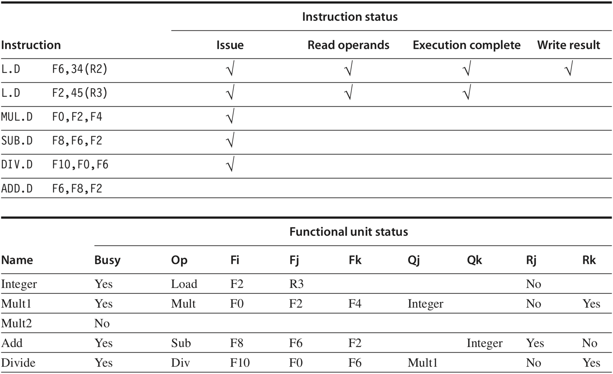
Scoreboard Example
Notes:
Indicate the state of the functional unit
Nine fields per functional unit (FU)
Busy—Indicates whether the unit is busy or not.
Op — Operation to perform in the unit (e.g., add or subtract).
Fi—Destination register.
Fj, Fk—Source-register numbers.
Qj, Qk—Functional units producing source registers Fj, Fk.
Rj, Rk—Flags indicating when Fj, Fk are ready and not yet read. Set to No after operands are read.
There is one entry in the functional unit status table for each functional unit. Once an instruction issues, the record of its operands is kept in the functional unit status table.
The functional unit status says that the first multiply unit is waiting for the integer unit, the add unit is waiting for the integer unit, and the divide unit is waiting for the first multiply unit.

Slide 124
Scoreboard Example

Slide 125
Scoreboard Example
dest
s1
s2
s1-src
s2-src

Slide 126
Scoreboard Example
dest
s1
s2
s1-src
s2-src
F2 from 2nd L.D

Slide 127
Scoreboard Example
dest
s1
s2
s1-src
s2-src
F2 from 2nd L.D

Slide 128
Scoreboard Example
dest
s1
s2
s1-src
s2-src
F0 from MUL.D

Slide 129
Scoreboard Example
dest
s1
s2
s1-src
s2-src
these No’s for ops Not Ready?
F0 from MUL.D

Slide 130
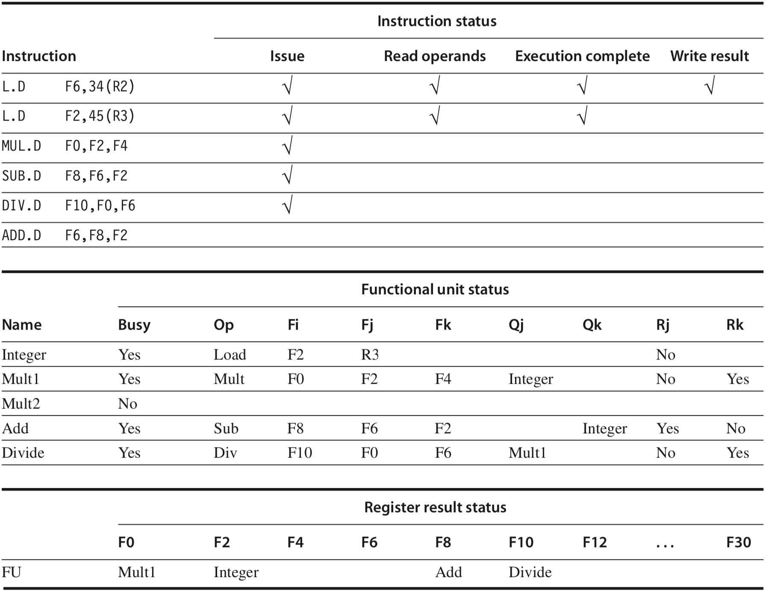
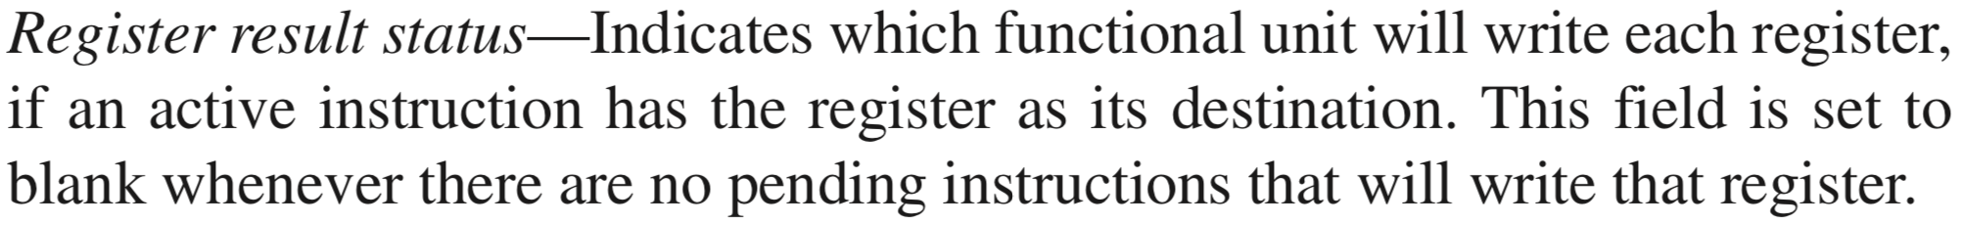
Scoreboard Example
check destination registers
Notes:
Finally, the register result table indicates which unit will produce each pending result; the number of entries is equal to the number of registers.

Slide 131
Scoreboard Example
check corresponding functional units
check destination registers

Slide 132
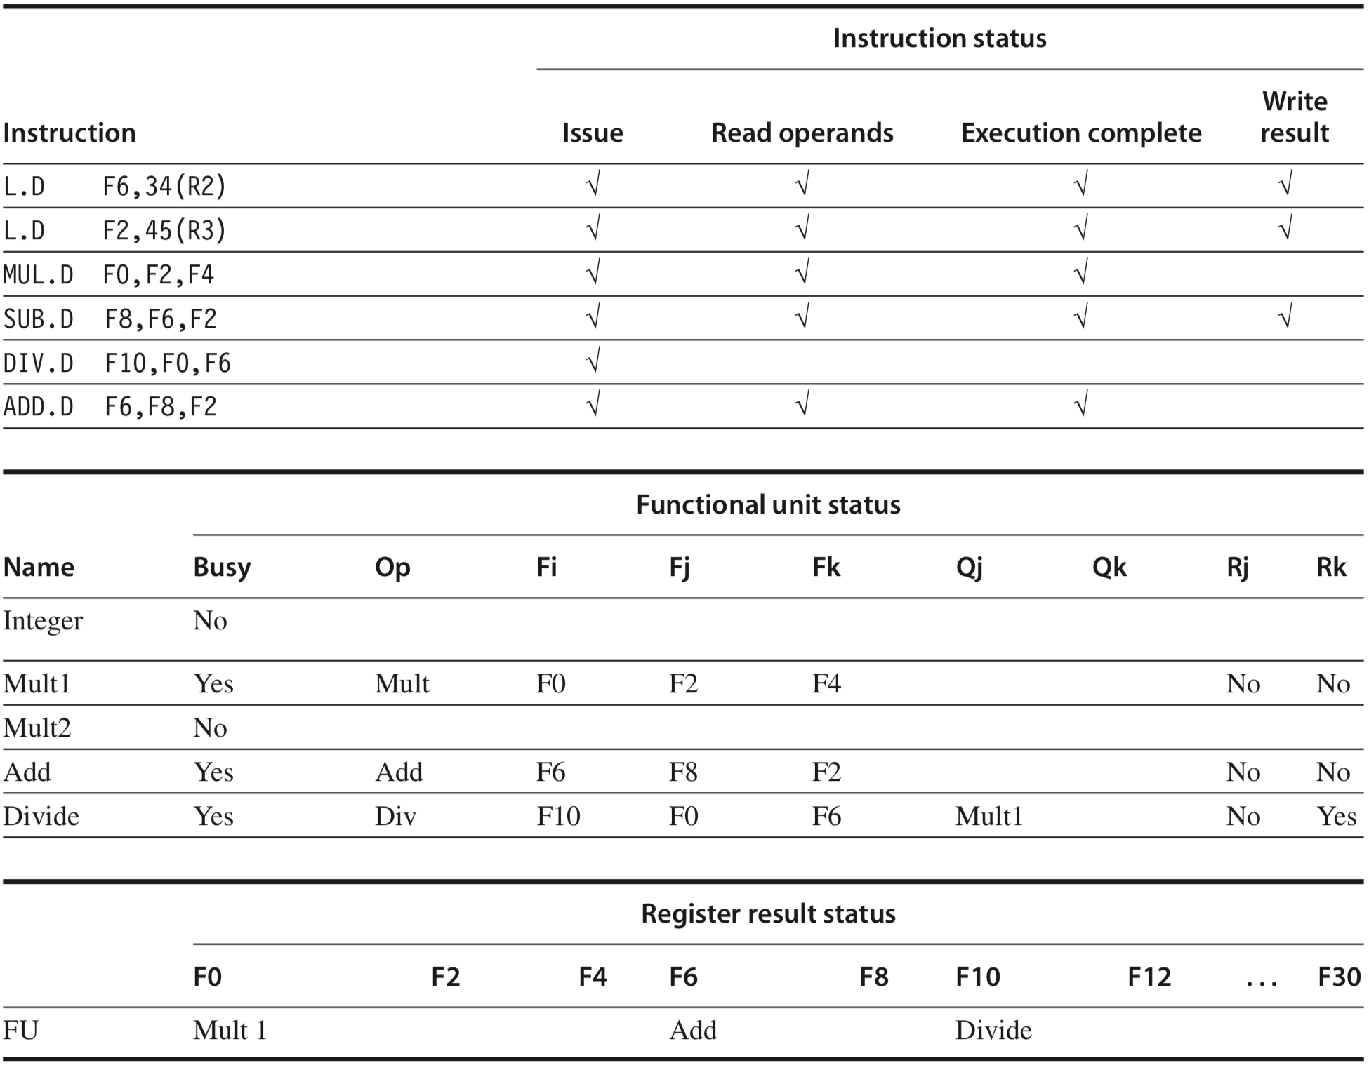
Scoreboard Example
MUL.D is ready to write result
dest
s1
s2
s1-src
s2-src
Notes:
SUB.D has also completed to release the Adder functional unit for ADD.D to use.
The ADD.D has read its operands and is in execution, although it was forced to wait until the SUB.D finished to get the functional unit. ADD.D cannot proceed to write result because of the WAR hazard on F6, which is used by the DIV.D.
Scoreboard tables just before the MUL.D goes to write result. The DIV.D has not yet read either of its operands, since it has a dependence on the result of the multiply. The ADD.D has read its operands and is in execu- tion, although it was forced to wait until the SUB.D finished to get the functional unit. ADD.D cannot proceed to write result because of the WAR hazard on F6, which is used by the DIV.D. The Q fields are only relevant when a functional unit is waiting for another unit.

Slide 133
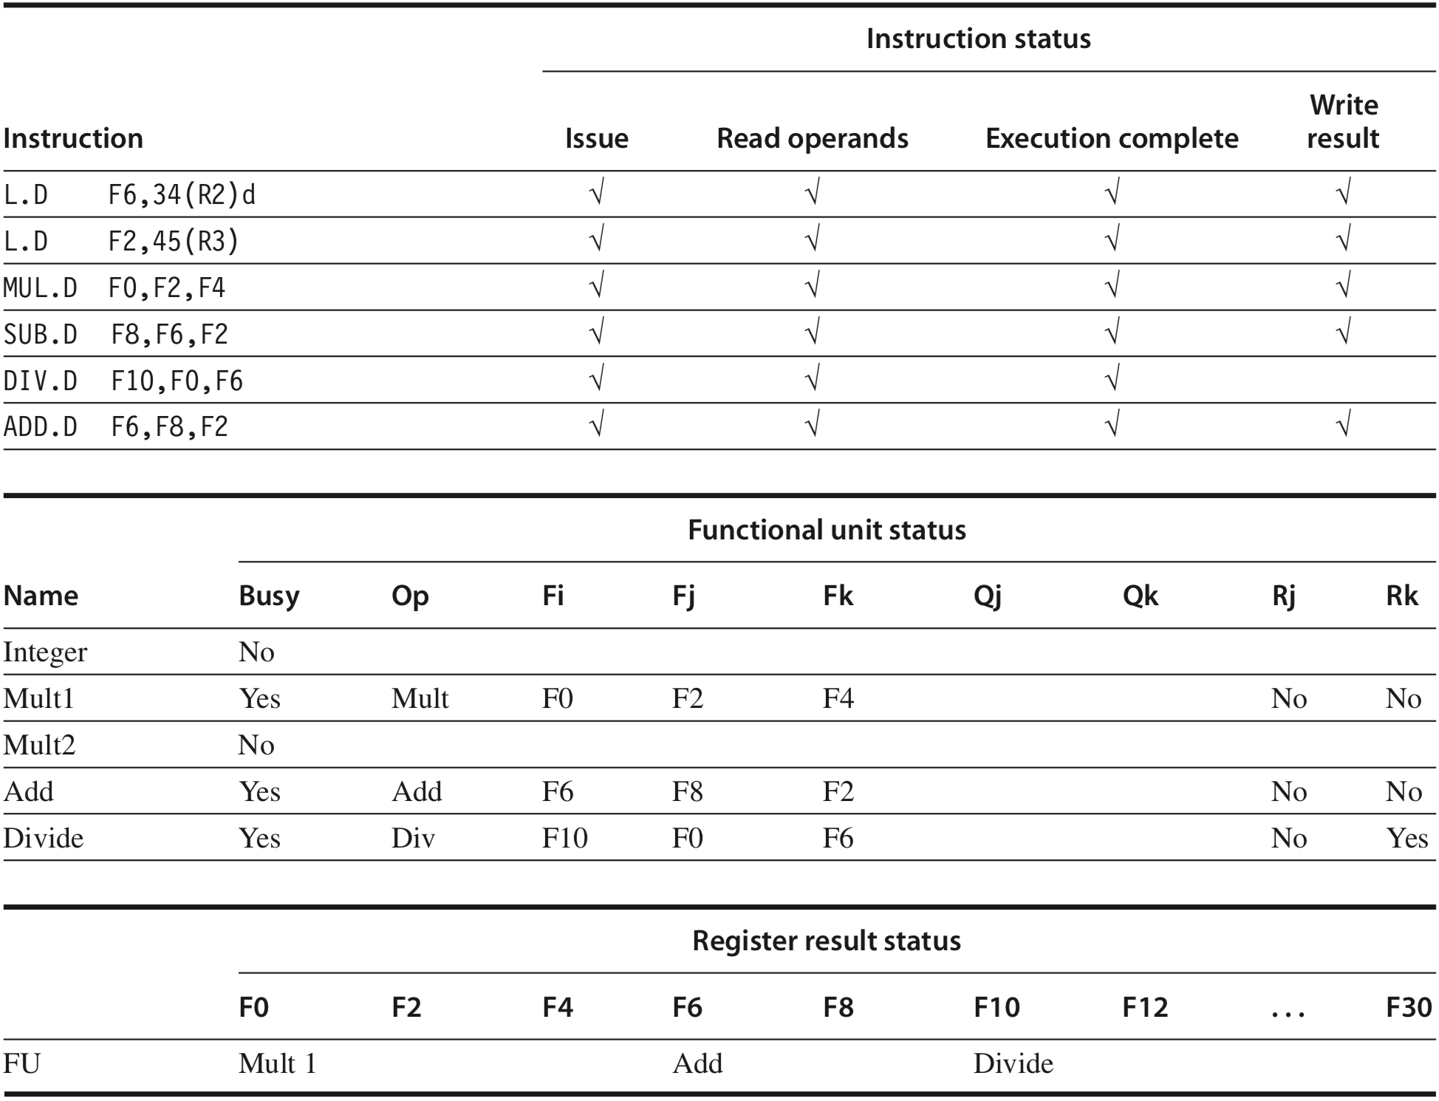
Scoreboard Example
DIV.D is ready to write result
dest
s1
s2
s1-src
s2-src
F6 already read?
Notes:
ADD.D was able to complete as soon as DIV.D passed through read operands and got a copy of F6. Only the DIV.D remains to finish.
Figure C.57 Scoreboard tables just before the DIV.D goes to write result. ADD.D was able to complete as soon as DIV.D passed through read operands and got a copy of F6. Only the DIV.D remains to finish.

Slide 134

scoreboard not for exam?!

Slide 135
scoreboard not for exam?!
yet helpful for understanding the more sophisticated Tomasulo’s Alg

Slide 136
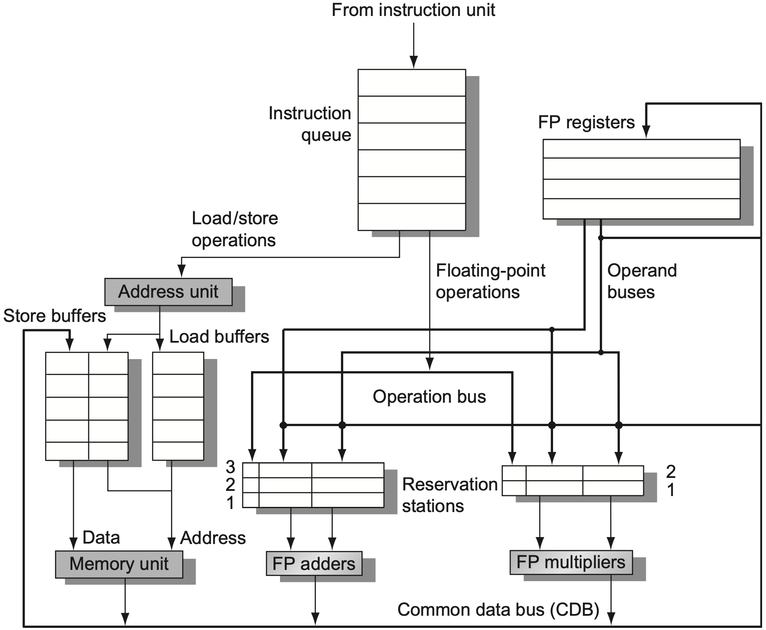
Tomasulo’s Algorithm
Notes:
Figure 3.10 The basic structure of a RISC-V floating-point unit using Tomasulo’s algorithm. Instructions are sent from the instruction unit into the instruction queue from which they are issued in first-in, first-out (FIFO) order. The reservation stations include the operation and the actual operands, as well as information used for detecting and resolving hazards. Load buffers have three functions: (1) hold the components of the effective address until it is com- puted, (2) track outstanding loads that are waiting on the memory, and (3) hold the results of completed loads that are waiting for the CDB. Similarly, store buffers have three functions: (1) hold the components of the effective address until it is computed, (2) hold the destination memory addresses of outstanding stores that are waiting for the data value to store, and (3) hold the address and value to store until the memory unit is available. All results from either the FP units or the load unit are put on the CDB, which goes to the FP register file as well as to the reservation stations and store buffers. The FP adders implement addition and subtraction, and the FP multipliers do multiplication and division.

Slide 137
queue fetched instructions;
issue an instruction if no structural hazard;

Slide 138
queue fetched instructions;
issue an instruction if no structural hazard;

Slide 139
hold effective address related info;
track outstanding loads that are waiting on mem;
hold results of completed loads that are waiting for CDB (common data bus, broadcast);
Notes:
Load buffers have three functions:
hold the components of the effective address until it is computed,
track outstanding loads that are waiting on the memory, and
hold the results of completed loads that are waiting for the CDB.

Slide 140
hold effective address related info;
hold dest mem addr of outstanding stores that are waiting for data value to store;
hold address and value to store until memory is available;
Notes:
Similarly, store buffers have three functions:
hold the components of the effective address until it is computed,
hold the destination memory addresses of outstanding stores that are waiting for the data value to store, and
hold the address and value to store until the memory unit is available.

Slide 141
hold operation info;
hold actual operands;
hold info for detecting and resolving hazards;
Notes:
The reservation stations include the operation and the actual operands, as well as information used for detecting and resolving hazards.

Slide 142
execute upon FP units and operands are available;
get actual operands from reservation stations (instead of registers);
Notes:
The FP adders implement addition and subtraction, and
the FP multipliers do multiplication and division.

Slide 143
load upon memory and address are available;
store upon memory, data, address are available;
Notes:
Similarly, for load/store

Slide 144
for all load/store and FP operations

Slide 145
for all load/store and FP operations
results are put on CDB, which broadcasts results to FP registers, reservation stations, store buffers
Notes:
All results from either the FP units or the load unit are put on the CDB, which goes to the FP register file as well as to the reservation stations and store buffers.

Slide 146
Tomasulo’s Algorithm
Two major advantages over scoreboard:
Distribution of hazard detection logic across load/store buffers and reservation stations
Elimination of stalls for WAW and WAR hazards through
Register Renaming

Slide 147
Register Renaming
Eliminate WAW and WAR hazards
Rename related destination registers, including those with a pending read or write for an earlier instruction
Enable out-of-order write that does not affect any instructions depending on an earlier value of an operand
Notes:
RAW hazards are avoided by executing an instruction only when its operands are available, which is exactly what the simpler scoreboarding approach provides.
WAR and WAW hazards, which arise from name dependences, are eliminated by register renaming. Register renaming eliminates these hazards by renaming all destination registers, including those with a pending read or write for an earlier instruction, so that the out-of-order write does not affect any instructions that depend on an earlier value of an operand.

Slide 148
Register Renaming
f0, f2, f4
f6, f0, f8
f6, 0(x1)
f8, f10, f14
f6, f10, f8
Example code sequence
fdiv.d
fadd.d
fsd
fsub.d
fmul.d

Slide 149
RAW Hazard
f0, f2, f4
f6, f0, f8
f6, 0(x1)
f8, f10, f14
f6, f10, f8
Example code sequence
fdiv.d
fadd.d
fsd
fsub.d
fmul.d

Slide 150
RAW Hazard
f0, f2, f4
f6, f0, f8
f6, 0(x1)
f8, f10, f14
f6, f10, f8
Example code sequence
Execute an instruction only when its operands are available
fdiv.d
fadd.d
fsd
fsub.d
fmul.d

Slide 151
WAR Hazard
f0, f2, f4
f6, f0, f8
f6, 0(x1)
f8, f10, f14
f6, f10, f8
Example code sequence
fdiv.d
fadd.d
fsd
fsub.d
fmul.d

Slide 152
WAW Hazard
f0, f2, f4
f6, f0, f8
f6, 0(x1)
f8, f10, f14
f6, f10, f8
Example code sequence
fdiv.d
fadd.d
fsd
fsub.d
fmul.d

Slide 153
WAR/WAW Hazard
f0, f2, f4
f6, f0, f8
f6, 0(x1)
f8, f10, f14
f6, f10, f8
Example code sequence
fdiv.d
fadd.d
fsd
fsub.d
fmul.d

Slide 154
how to rename registers?

Slide 155
how to rename registers?
an extended set of physical registers is used to hold both the architecturally visible
registers (x0,…x31 and f0,…f31) as well as temporary values;
Notes:
Part of Chapter 3.9 on Page 234

Slide 156
how to rename registers?
if a given physical register does not appear as a source and it is not designated as arch,
alternatively, another instruction that writes the same architectural reg commits,
it may be reclaimed and reallocated;
Notes:
With register renaming, deallocating registers is more complex, since before we free up a physical register, we must know that it no longer corresponds to an architectural register and that no further uses of the physical register are outstand- ing. A physical register corresponds to an architectural register until the architec- tural register is rewritten, causing the renaming table to point elsewhere. That is, if no renaming entry points to a particular physical register, then it no longer cor- responds to an architectural register. There may, however, still be uses of the physical register outstanding. The processor can determine whether this is the case by examining the source register specifiers of all instructions in the func- tional unit queues. If a given physical register does not appear as a source and it is not designated as an architectural register, it may be reclaimed and reallocated.
Alternatively, the processor can simply wait until another instruction that writes the same architectural register commits. At that point, there can be no fur- ther uses of the older value outstanding. Although this method may tie up a phys- ical register slightly longer than necessary, it is easy to implement and is used in most recent superscalars.

Slide 157
WAR/WAW Hazard
f0, f2, f4
f6, f0, f8
f6, 0(x1)
f8, f10, f14
f6, f10, f8
Example code sequence
WAR: rename latter/destination
WAW: rename former
fdiv.d
fadd.d
fsd
fsub.d
fmul.d
guarantee program order
Notes:
Toward out-of-order execution
That is, if WAR/WAW is not addressed via register renaming, fsub.d that writes to f8 cannot be executed prior to fadd.d that reads from f8, as such rearrangement violates program order, albeit it does not have to be;
So, after renaming the latter fsub.d with f8 as detination, say T in the next slide, fsub.d can be execution anytime right after both values in f10 and f14 are ready, regardless of whether fadd.d has already read out of the value from f8.

Slide 158
WAR/WAW Hazard
f0, f2, f4
f6, f0, f8
f6, 0(x1)
f8, f10, f14
f6, f10, f8
Example code sequence
WAR: rename latter/destination
WAW: rename former
after rename dest, rename later source
fdiv.d
fadd.d
fsd
fsub.d
fmul.d
guarantee program order

Slide 159
WAR/WAW Hazard
f0, f2, f4
f6, f0, f8
f6, 0(x1)
T, f10, f14
f6, f10, T
Example code sequence
WAR: rename latter/destination
WAW: rename former
after rename dest, rename later source
fdiv.d
fadd.d
fsd
fsub.d
fmul.d
guarantee program order

Slide 160
WAR/WAW Hazard
f0, f2, f4
S, f0, f8
S, 0(x1)
T, f10, f14
f6, f10, T
Example code sequence
WAR: rename latter/destination
WAW: rename former
after rename dest, rename later source
fdiv.d
fadd.d
fsd
fsub.d
fmul.d
guarantee program order

Slide 161
WAR/WAW Hazard
f0, f2, f4
S, f0, f8
S, 0(x1)
T, f10, f14
f6, f10, T
Example code sequence
WAR: rename latter/destination
WAW: rename former
after rename dest, rename later source
fdiv.d
fadd.d
fsd
fsub.d
fmul.d
guarantee program order

Slide 162
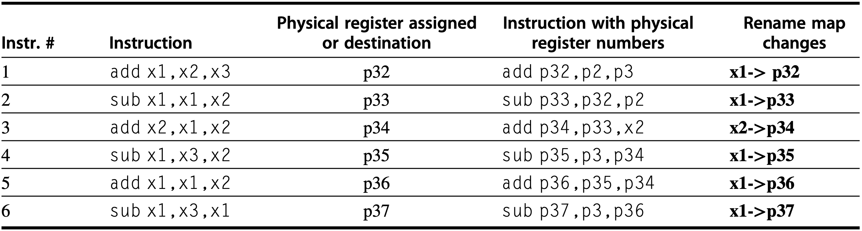
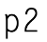
Register Renaming
Example: six-instruction code sequence
Architectural registers x1, x2, and x3 are initially held by physical registers p1, p2, and p3, respectively
Notes:
Figure 3.29 An example of six instructions to be issued in the same clock cycle and what has to happen. The instructions are shown in program order: 1–6; they are, however, issued in 1 clock cycle! The notation pi is used to refer to a physical register; the contents of that register at any point is determined by the renaming map. For sim- plicity, we assume that the physical registers holding the architectural registers x1, x2, and x3 are initially p1, p2, and p3 (they could be any physical register). The instructions are issued with physical register numbers, as shown in column four. The rename map, which appears in the last column, shows how the map would change if the instruc- tions were issued sequentially. The difficulty is that all this renaming and replacement of architectural registers by physical renaming registers happens effectively in 1 cycle, not sequentially. The issue logic must find all the depen- dences and “rewrite” the instruction in parallel.

Slide 163
Register Renaming
Example: six-instruction code sequence
Architectural registers x1, x2, and x3 are initially held by physical registers p1, p2, and p3, respectively
Notes:
Figure 3.29 An example of six instructions to be issued in the same clock cycle and what has to happen. The instructions are shown in program order: 1–6; they are, however, issued in 1 clock cycle! The notation pi is used to refer to a physical register; the contents of that register at any point is determined by the renaming map. For sim- plicity, we assume that the physical registers holding the architectural registers x1, x2, and x3 are initially p1, p2, and p3 (they could be any physical register). The instructions are issued with physical register numbers, as shown in column four. The rename map, which appears in the last column, shows how the map would change if the instruc- tions were issued sequentially. The difficulty is that all this renaming and replacement of architectural registers by physical renaming registers happens effectively in 1 cycle, not sequentially. The issue logic must find all the depen- dences and “rewrite” the instruction in parallel.

Slide 164
Register Renaming
Example: six-instruction code sequence
Architectural registers x1, x2, and x3 are initially held by physical registers p1, p2, and p3, respectively
Notes:
Figure 3.29 An example of six instructions to be issued in the same clock cycle and what has to happen. The instructions are shown in program order: 1–6; they are, however, issued in 1 clock cycle! The notation pi is used to refer to a physical register; the contents of that register at any point is determined by the renaming map. For sim- plicity, we assume that the physical registers holding the architectural registers x1, x2, and x3 are initially p1, p2, and p3 (they could be any physical register). The instructions are issued with physical register numbers, as shown in column four. The rename map, which appears in the last column, shows how the map would change if the instruc- tions were issued sequentially. The difficulty is that all this renaming and replacement of architectural registers by physical renaming registers happens effectively in 1 cycle, not sequentially. The issue logic must find all the depen- dences and “rewrite” the instruction in parallel.

Slide 165
Register Renaming
Example: six-instruction code sequence
Architectural registers x1, x2, and x3 are initially held by physical registers p1, p2, and p3, respectively
Notes:
Figure 3.29 An example of six instructions to be issued in the same clock cycle and what has to happen. The instructions are shown in program order: 1–6; they are, however, issued in 1 clock cycle! The notation pi is used to refer to a physical register; the contents of that register at any point is determined by the renaming map. For sim- plicity, we assume that the physical registers holding the architectural registers x1, x2, and x3 are initially p1, p2, and p3 (they could be any physical register). The instructions are issued with physical register numbers, as shown in column four. The rename map, which appears in the last column, shows how the map would change if the instruc- tions were issued sequentially. The difficulty is that all this renaming and replacement of architectural registers by physical renaming registers happens effectively in 1 cycle, not sequentially. The issue logic must find all the depen- dences and “rewrite” the instruction in parallel.

Slide 166
Register Renaming
Example: six-instruction code sequence
Architectural registers x1, x2, and x3 are initially held by physical registers p1, p2, and p3, respectively
Notes:
Figure 3.29 An example of six instructions to be issued in the same clock cycle and what has to happen. The instructions are shown in program order: 1–6; they are, however, issued in 1 clock cycle! The notation pi is used to refer to a physical register; the contents of that register at any point is determined by the renaming map. For sim- plicity, we assume that the physical registers holding the architectural registers x1, x2, and x3 are initially p1, p2, and p3 (they could be any physical register). The instructions are issued with physical register numbers, as shown in column four. The rename map, which appears in the last column, shows how the map would change if the instruc- tions were issued sequentially. The difficulty is that all this renaming and replacement of architectural registers by physical renaming registers happens effectively in 1 cycle, not sequentially. The issue logic must find all the depen- dences and “rewrite” the instruction in parallel.

Slide 167
Register Renaming
More examples:
add
sub
xor
mul
add
x1, x2, x3
x4, x1, x5
x6, x7, x8
x5, x8, x9
x4, x8, x9
Notes:
Figure 3.29 An example of six instructions to be issued in the same clock cycle and what has to happen. The instructions are shown in program order: 1–6; they are, however, issued in 1 clock cycle! The notation pi is used to refer to a physical register; the contents of that register at any point is determined by the renaming map. For sim- plicity, we assume that the physical registers holding the architectural registers x1, x2, and x3 are initially p1, p2, and p3 (they could be any physical register). The instructions are issued with physical register numbers, as shown in column four. The rename map, which appears in the last column, shows how the map would change if the instruc- tions were issued sequentially. The difficulty is that all this renaming and replacement of architectural registers by physical renaming registers happens effectively in 1 cycle, not sequentially. The issue logic must find all the depen- dences and “rewrite” the instruction in parallel.

Slide 168
Register Renaming
More examples:
add
sub
xor
mul
add
x1, x2, x3
x4, x1, x5
x6, x7, x8
x5, x8, x9
x4, x8, x9
add
sub
xor
mul
add
p1, x2, x3
p2, p1, x5
p3, x7, x8
p4, x8, x9
p5, x8, x9
Notes:
Figure 3.29 An example of six instructions to be issued in the same clock cycle and what has to happen. The instructions are shown in program order: 1–6; they are, however, issued in 1 clock cycle! The notation pi is used to refer to a physical register; the contents of that register at any point is determined by the renaming map. For sim- plicity, we assume that the physical registers holding the architectural registers x1, x2, and x3 are initially p1, p2, and p3 (they could be any physical register). The instructions are issued with physical register numbers, as shown in column four. The rename map, which appears in the last column, shows how the map would change if the instruc- tions were issued sequentially. The difficulty is that all this renaming and replacement of architectural registers by physical renaming registers happens effectively in 1 cycle, not sequentially. The issue logic must find all the depen- dences and “rewrite” the instruction in parallel.

Slide 169
Register Renaming
More examples:
add
sub
xor
mul
add
x1, x2, x3
x4, x1, x5
x6, x7, x8
x5, x8, x9
x4, x8, x9
add
sub
xor
mul
add
p1, x2, x3
p2, p1, x5
p3, x7, x8
p4, x8, x9
p5, x8, x9
follow default allocation
Notes:
Figure 3.29 An example of six instructions to be issued in the same clock cycle and what has to happen. The instructions are shown in program order: 1–6; they are, however, issued in 1 clock cycle! The notation pi is used to refer to a physical register; the contents of that register at any point is determined by the renaming map. For sim- plicity, we assume that the physical registers holding the architectural registers x1, x2, and x3 are initially p1, p2, and p3 (they could be any physical register). The instructions are issued with physical register numbers, as shown in column four. The rename map, which appears in the last column, shows how the map would change if the instruc- tions were issued sequentially. The difficulty is that all this renaming and replacement of architectural registers by physical renaming registers happens effectively in 1 cycle, not sequentially. The issue logic must find all the depen- dences and “rewrite” the instruction in parallel.

Slide 170
Register Renaming
More examples:
add
sub
xor
mul
add
x1, x2, x3
x4, x1, x5
x6, x7, x8
x5, x8, x9
x4, x8, x9
add
sub
xor
mul
add
p1, p12, p13
p2, p1, p15
p3, p17, p18
p4, p18, p19
p5, p18, p19
follow default allocation
Notes:
Figure 3.29 An example of six instructions to be issued in the same clock cycle and what has to happen. The instructions are shown in program order: 1–6; they are, however, issued in 1 clock cycle! The notation pi is used to refer to a physical register; the contents of that register at any point is determined by the renaming map. For sim- plicity, we assume that the physical registers holding the architectural registers x1, x2, and x3 are initially p1, p2, and p3 (they could be any physical register). The instructions are issued with physical register numbers, as shown in column four. The rename map, which appears in the last column, shows how the map would change if the instruc- tions were issued sequentially. The difficulty is that all this renaming and replacement of architectural registers by physical renaming registers happens effectively in 1 cycle, not sequentially. The issue logic must find all the depen- dences and “rewrite” the instruction in parallel.

Slide 171
Register Renaming
More examples:
mul
add
mul
add
mul
add
x2, x2, x2
x1, x1, x2
x2, x4, x4
x3, x3, x2
x2, x6, x6
x5, x5, x2
Notes:
Figure 3.29 An example of six instructions to be issued in the same clock cycle and what has to happen. The instructions are shown in program order: 1–6; they are, however, issued in 1 clock cycle! The notation pi is used to refer to a physical register; the contents of that register at any point is determined by the renaming map. For sim- plicity, we assume that the physical registers holding the architectural registers x1, x2, and x3 are initially p1, p2, and p3 (they could be any physical register). The instructions are issued with physical register numbers, as shown in column four. The rename map, which appears in the last column, shows how the map would change if the instruc- tions were issued sequentially. The difficulty is that all this renaming and replacement of architectural registers by physical renaming registers happens effectively in 1 cycle, not sequentially. The issue logic must find all the depen- dences and “rewrite” the instruction in parallel.

Slide 172
Register Renaming
More examples:
mul
add
mul
add
mul
add
x2, x2, x2
x1, x1, x2
x2, x4, x4
x3, x3, x2
x2, x6, x6
x5, x5, x2
x1 | x2 | x3 | x4 | x5 | x6
p1 | p2 | p3 | p4 | p5 | p6
Notes:
Figure 3.29 An example of six instructions to be issued in the same clock cycle and what has to happen. The instructions are shown in program order: 1–6; they are, however, issued in 1 clock cycle! The notation pi is used to refer to a physical register; the contents of that register at any point is determined by the renaming map. For sim- plicity, we assume that the physical registers holding the architectural registers x1, x2, and x3 are initially p1, p2, and p3 (they could be any physical register). The instructions are issued with physical register numbers, as shown in column four. The rename map, which appears in the last column, shows how the map would change if the instruc- tions were issued sequentially. The difficulty is that all this renaming and replacement of architectural registers by physical renaming registers happens effectively in 1 cycle, not sequentially. The issue logic must find all the depen- dences and “rewrite” the instruction in parallel.

Slide 173
Register Renaming
More examples:
mul
add
mul
add
mul
add
x2, x2, x2
x1, x1, x2
x2, x4, x4
x3, x3, x2
x2, x6, x6
x5, x5, x2
mul
p7, p2, p2
x1 | x2 | x3 | x4 | x5 | x6
p1 | p7 | p3 | p4 | p5 | p6
Notes:
Figure 3.29 An example of six instructions to be issued in the same clock cycle and what has to happen. The instructions are shown in program order: 1–6; they are, however, issued in 1 clock cycle! The notation pi is used to refer to a physical register; the contents of that register at any point is determined by the renaming map. For sim- plicity, we assume that the physical registers holding the architectural registers x1, x2, and x3 are initially p1, p2, and p3 (they could be any physical register). The instructions are issued with physical register numbers, as shown in column four. The rename map, which appears in the last column, shows how the map would change if the instruc- tions were issued sequentially. The difficulty is that all this renaming and replacement of architectural registers by physical renaming registers happens effectively in 1 cycle, not sequentially. The issue logic must find all the depen- dences and “rewrite” the instruction in parallel.

Slide 174
Register Renaming
More examples:
mul
add
mul
add
mul
add
x2, x2, x2
x1, x1, x2
x2, x4, x4
x3, x3, x2
x2, x6, x6
x5, x5, x2
mul
add
p7, p2, p2
p8, p1, p7
x1 | x2 | x3 | x4 | x5 | x6
p8 | p7 | p3 | p4 | p5 | p6
Notes:
Figure 3.29 An example of six instructions to be issued in the same clock cycle and what has to happen. The instructions are shown in program order: 1–6; they are, however, issued in 1 clock cycle! The notation pi is used to refer to a physical register; the contents of that register at any point is determined by the renaming map. For sim- plicity, we assume that the physical registers holding the architectural registers x1, x2, and x3 are initially p1, p2, and p3 (they could be any physical register). The instructions are issued with physical register numbers, as shown in column four. The rename map, which appears in the last column, shows how the map would change if the instruc- tions were issued sequentially. The difficulty is that all this renaming and replacement of architectural registers by physical renaming registers happens effectively in 1 cycle, not sequentially. The issue logic must find all the depen- dences and “rewrite” the instruction in parallel.

Slide 175
Register Renaming
More examples:
mul
add
mul
add
mul
add
x2, x2, x2
x1, x1, x2
x2, x4, x4
x3, x3, x2
x2, x6, x6
x5, x5, x2
mul
add
mul
p7, p2, p2
p8, p1, p7
p9, p4, p4
x1 | x2 | x3 | x4 | x5 | x6
p8 | p7→p9 | p3 | p4 | p5 | p6
Notes:
Figure 3.29 An example of six instructions to be issued in the same clock cycle and what has to happen. The instructions are shown in program order: 1–6; they are, however, issued in 1 clock cycle! The notation pi is used to refer to a physical register; the contents of that register at any point is determined by the renaming map. For sim- plicity, we assume that the physical registers holding the architectural registers x1, x2, and x3 are initially p1, p2, and p3 (they could be any physical register). The instructions are issued with physical register numbers, as shown in column four. The rename map, which appears in the last column, shows how the map would change if the instruc- tions were issued sequentially. The difficulty is that all this renaming and replacement of architectural registers by physical renaming registers happens effectively in 1 cycle, not sequentially. The issue logic must find all the depen- dences and “rewrite” the instruction in parallel.

Slide 176
Register Renaming
More examples:
mul
add
mul
add
mul
add
x2, x2, x2
x1, x1, x2
x2, x4, x4
x3, x3, x2
x2, x6, x6
x5, x5, x2
mul
add
mul
add
p7, p2, p2
p8, p1, p7
p9, p4, p4
p10, p3, p9
x1 | x2 | x3 | x4 | x5 | x6
p8 | p9 | p10 | p4 | p5 | p6
Notes:
Figure 3.29 An example of six instructions to be issued in the same clock cycle and what has to happen. The instructions are shown in program order: 1–6; they are, however, issued in 1 clock cycle! The notation pi is used to refer to a physical register; the contents of that register at any point is determined by the renaming map. For sim- plicity, we assume that the physical registers holding the architectural registers x1, x2, and x3 are initially p1, p2, and p3 (they could be any physical register). The instructions are issued with physical register numbers, as shown in column four. The rename map, which appears in the last column, shows how the map would change if the instruc- tions were issued sequentially. The difficulty is that all this renaming and replacement of architectural registers by physical renaming registers happens effectively in 1 cycle, not sequentially. The issue logic must find all the depen- dences and “rewrite” the instruction in parallel.

Slide 177
Register Renaming
More examples:
mul
add
mul
add
mul
add
x2, x2, x2
x1, x1, x2
x2, x4, x4
x3, x3, x2
x2, x6, x6
x5, x5, x2
mul
add
mul
add
mul
p7, p2, p2
p8, p1, p7
p9, p4, p4
p10, p3, p9
p11, p6, p6
x1 | x2 | x3 | x4 | x5 | x6
p8 |  | p10 | p4 | p5 | p6
p9→p11
Notes:
Figure 3.29 An example of six instructions to be issued in the same clock cycle and what has to happen. The instructions are shown in program order: 1–6; they are, however, issued in 1 clock cycle! The notation pi is used to refer to a physical register; the contents of that register at any point is determined by the renaming map. For sim- plicity, we assume that the physical registers holding the architectural registers x1, x2, and x3 are initially p1, p2, and p3 (they could be any physical register). The instructions are issued with physical register numbers, as shown in column four. The rename map, which appears in the last column, shows how the map would change if the instruc- tions were issued sequentially. The difficulty is that all this renaming and replacement of architectural registers by physical renaming registers happens effectively in 1 cycle, not sequentially. The issue logic must find all the depen- dences and “rewrite” the instruction in parallel.

Slide 178
Register Renaming
More examples:
mul
add
mul
add
mul
add
x2, x2, x2
x1, x1, x2
x2, x4, x4
x3, x3, x2
x2, x6, x6
x5, x5, x2
mul
add
mul
add
mul
add
p7, p2, p2
p8, p1, p7
p9, p4, p4
p10, p3, p9
p11, p6, p6
p12, p5, p11
x1 | x2 | x3 | x4 | x5 | x6
p8 | p11 | p10 | p4 | p12 | p6
Notes:
Figure 3.29 An example of six instructions to be issued in the same clock cycle and what has to happen. The instructions are shown in program order: 1–6; they are, however, issued in 1 clock cycle! The notation pi is used to refer to a physical register; the contents of that register at any point is determined by the renaming map. For sim- plicity, we assume that the physical registers holding the architectural registers x1, x2, and x3 are initially p1, p2, and p3 (they could be any physical register). The instructions are issued with physical register numbers, as shown in column four. The rename map, which appears in the last column, shows how the map would change if the instruc- tions were issued sequentially. The difficulty is that all this renaming and replacement of architectural registers by physical renaming registers happens effectively in 1 cycle, not sequentially. The issue logic must find all the depen- dences and “rewrite” the instruction in parallel.

Slide 179
in-order vs out-of-order!
for in-order execution, all instructions after a stalled instruction cannot proceed
Notes:
Part of Chapter 3.9 on Page 234

Slide 180
how to tomasulo?
Notes:
https://www.youtube.com/watch?v=PZZvhqnch5o&list=PLAwxTw4SYaPkNw98-MFodLzKgi6bYGjZs&index=27

Slide 181
Notes:
Figure 3.10 The basic structure of a RISC-V floating-point unit using Tomasulo’s algorithm. Instructions are sent from the instruction unit into the instruction queue from which they are issued in first-in, first-out (FIFO) order. The reservation stations include the operation and the actual operands, as well as information used for detecting and resolving hazards. Load buffers have three functions: (1) hold the components of the effective address until it is com- puted, (2) track outstanding loads that are waiting on the memory, and (3) hold the results of completed loads that are waiting for the CDB. Similarly, store buffers have three functions: (1) hold the components of the effective address until it is computed, (2) hold the destination memory addresses of outstanding stores that are waiting for the data value to store, and (3) hold the address and value to store until the memory unit is available. All results from either the FP units or the load unit are put on the CDB, which goes to the FP register file as well as to the reservation stations and store buffers. The FP adders implement addition and subtraction, and the FP multipliers do multiplication and division.

Slide 182
write results on CDB, which broadcasts results to FP registers, reservation stations, store buffers
issue an instruction if no structural hazard;
execute upon FP units and operands are available;
Notes:
Figure 3.10 The basic structure of a RISC-V floating-point unit using Tomasulo’s algorithm. Instructions are sent from the instruction unit into the instruction queue from which they are issued in first-in, first-out (FIFO) order. The reservation stations include the operation and the actual operands, as well as information used for detecting and resolving hazards. Load buffers have three functions: (1) hold the components of the effective address until it is com- puted, (2) track outstanding loads that are waiting on the memory, and (3) hold the results of completed loads that are waiting for the CDB. Similarly, store buffers have three functions: (1) hold the components of the effective address until it is computed, (2) hold the destination memory addresses of outstanding stores that are waiting for the data value to store, and (3) hold the address and value to store until the memory unit is available. All results from either the FP units or the load unit are put on the CDB, which goes to the FP register file as well as to the reservation stations and store buffers. The FP adders implement addition and subtraction, and the FP multipliers do multiplication and division.

Slide 183
Tomasulo’s Algorithm
Issue
Execute
Write result
Notes:
Before we describe the details of the reservation stations and the algorithm, let’s look at the steps an instruction goes through. There are only three steps, although each one can now take an arbitrary number of clock cycles:
Issue, Execute, Write Result

Slide 184
Tomasulo’s Algorithm
Issue/Dispatch get next instr from instr queue head upon empty reservation-station/buffer; rename registers if necessary;
Execute
Write result
Notes:
1. Issue—Getthenextinstructionfromtheheadoftheinstructionqueue,whichis maintained in FIFO order to ensure the maintenance of correct data flow. If there is a matching reservation station that is empty, issue the instruction to the station with the operand values, if they are currently in the registers. If there is not an empty reservation station, then there is a structural hazard, and the instruction issue stalls until a station or buffer is freed. If the operands are not in the reg- isters, keep track of the functional units that will produce the operands. This step renames registers, eliminating WAR and WAW hazards. (This stage is some- times called dispatch in a dynamically scheduled processor.)

Slide 185
Tomasulo’s Algorithm
Issue
Execute when all operands are available, execute the operation at functional unit; no instr is allowed to execute until a branch that preceds the instruction in program order has completed;
Write result
Notes:
2. Execute—If one or more of the operands is not yet available, monitor the com- mon data bus while waiting for it to be computed. When an operand becomes available, it is placed into any reservation station awaiting it. When all the oper- ands are available, the operation can be executed at the corresponding functional unit. By delaying instruction execution until the operands are available, RAW hazards are avoided. (Some dynamically scheduled processors call this step “issue,” but we use the name “execute,” which was used in the first dynamically scheduled processor, the CDC 6600.)
Notice that several instructions could become ready in the same clock cycle for the same functional unit. Although independent functional units could begin execution in the same clock cycle for different instructions, if more than one instruction is ready for a single functional unit, the unit will have to choose among them. For the floating-point reservation stations, this choice may be made arbitrarily; loads and stores, however, present an additional complication.
Loads and stores require a two-step execution process. The first step com- putes the effective address when the base register is available, and the effective address is then placed in the load or store buffer. Loads in the load buffer exe- cute as soon as the memory unit is available. Stores in the store buffer wait for the value to be stored before being sent to the memory unit. Loads and stores are maintained in program order through the effective address calculation, which will help to prevent hazards through memory.
To preserve exception behavior, no instruction is allowed to initiate execu- tion until a branch that precedes the instruction in program order has completed. This restriction guarantees that an instruction that causes an exception during execution really would have been executed. In a processor using branch predic- tion (as all dynamically scheduled processors do), this means that the processor must know that the branch prediction was correct before allowing an instruction after the branch to begin execution. If the processor records the occurrence of the exception, but does not actually raise it, an instruction can start execution but not stall until it enters Write Result.
Speculation provides a more flexible and more complete method to handle exceptions, so we will delay making this enhancement and show how specula- tion handles this problem later.

Slide 186
Tomasulo’s Algorithm
Issue
Execute
Write result when the result is available, write it on CDB, which broadcasts it to registers, reservation stations, and store buffers
Notes:
3. Write result—When the result is available, write it on the CDB and from there into the registers and into any reservation stations (including store buffers) wait- ing for this result. Stores are buffered in the store buffer until both the value to be stored and the store address are available; then the result is written as soon as the memory unit is free.

Slide 187
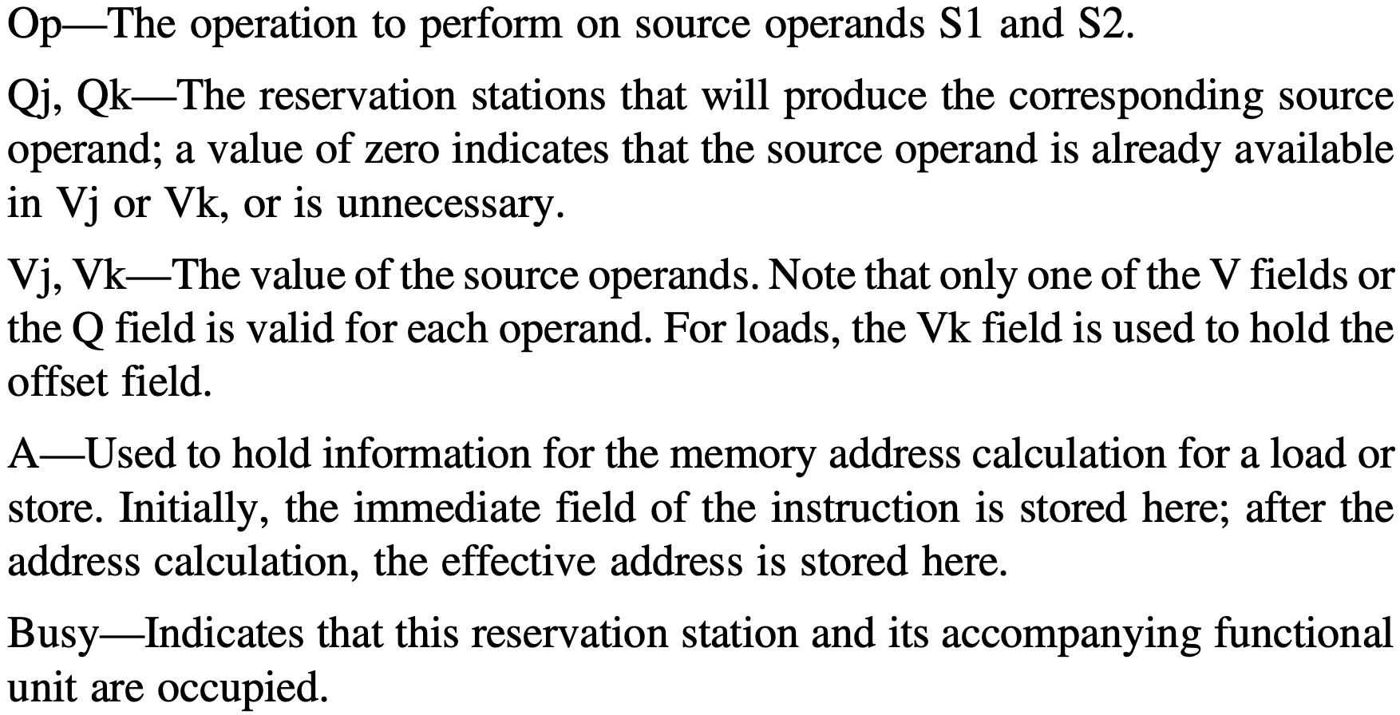
Reservation Station Status
Seven fields:

Slide 188
Reservation Station Status
Seven fields:
for load/store buffer

Slide 189
Register File Status
One field Qi: number of the researvation station that contains the operation whose result should be stored into this register; set to blank or 0 if no currently active instruction is computing a result destined for this register → the value is simply the register contents
Notes:
The register file has a field, Qi:
Qi—The number of the reservation station that contains the operation whose result should be stored into this register. If the value of Qi is blank (or 0), no currently active instruction is computing a result destined for this register,
meaning that the value is simply the register contents.

Slide 190
Load/Store Buffer Status
One field A: hold the result of the effective address once the first step of execution has been completed; as for load/store, effective address is computed in the execution stage
Notes:
The load and store buffers each have a field, A, which holds the result of the effec- tive address once the first step of execution has been completed.

Slide 191
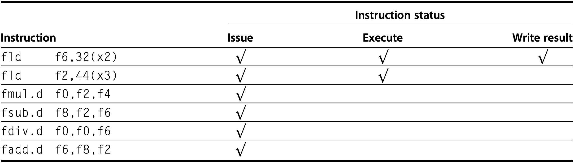
Tomasulo Example
f10
1st fld has completed and written
2nd fld has executed

Slide 192
Tomasulo Example
f6 ready
f2 not ready
f10
1st fld has completed and written
2nd fld has executed

Slide 193
Tomasulo Example
f6 ready
f2 not ready
f10
1st fld has completed and written
2nd fld has executed
fmul/fsub/fadd cannot execute

Slide 194
Tomasulo Example
f6 ready
f2 not ready
f0 not ready
f10
1st fld has completed and written
2nd fld has executed
fmul/fsub/fadd cannot execute

Slide 195
Tomasulo Example
f6 ready
f2 not ready
f0 not ready
f10
1st fld has completed and written
2nd fld has executed
fmul/fsub/fadd cannot execute
fdiv cannot execute

Slide 196
Tomasulo Example
f6 ready
f2 not ready
f0 not ready
f10
f6 WAR: fsub.d/fdiv.d → fadd.d
why co-issued?

Slide 197
Tomasulo Example
f6 ready
f2 not ready
f0 not ready
f10
f6 WAR: fsub.d/fdiv.d → fadd.d
why co-issued?
fmul/fsub/fadd cannot execute
fdiv cannot execute

Slide 198
Tomasulo Example
f6 ready
f2 not ready
f0 not ready
f10
f6 WAR: fsub.d/fdiv.d → fadd.d
why co-issued: register renaming
fsub/fdiv get f6 from fld buffer
fadd latter write wins

Slide 199
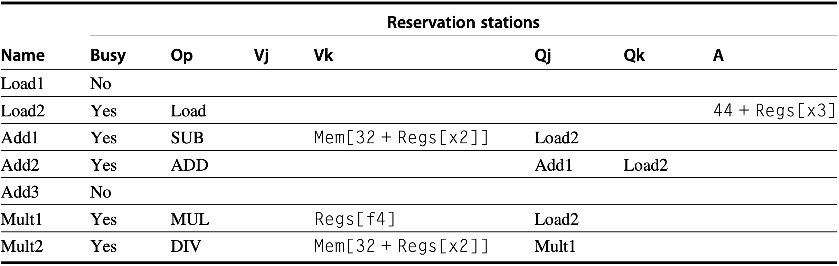
Tomasulo Example

Slide 200
Tomasulo Example
f10

Slide 201
Tomasulo Example
f10
fld has completed and written

Slide 202
Tomasulo Example
f10
computed effective address
fld has completed and written

Slide 203
Tomasulo Example
f10
fld has completed and written
directly from f4
computed effective address
wait for f2 from fld

Slide 204
Tomasulo Example
f10
directly from f4
Load1
wait for f2 from fld

Slide 205
Tomasulo Example
f10
directly from f4
Load1
wait for f2 from fld
f0 ← fmul

Slide 206
Tomasulo Example
f10
f0 ← fmul
wait for f2 from fld
wait for f8 from fsub
Notes:
Reservation station status form is filled with the help of register status, that is, to determine which reservation stations that Qj and Qk relate to;

Slide 207
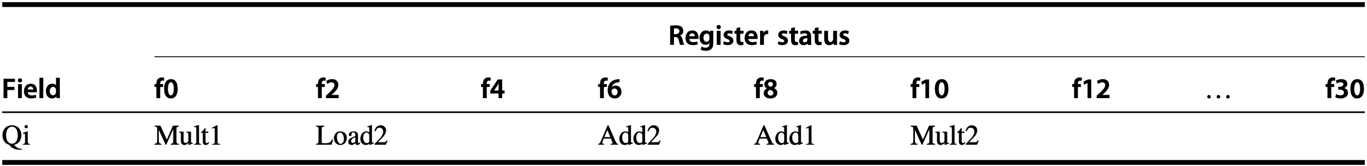
Tomasulo Example
f10

Slide 208
Tomasulo Example
check destination registers
f10

Slide 209
Tomasulo Example
check destination registers
f10
check corresponding instructions and reservation stations
and buffers

Slide 210
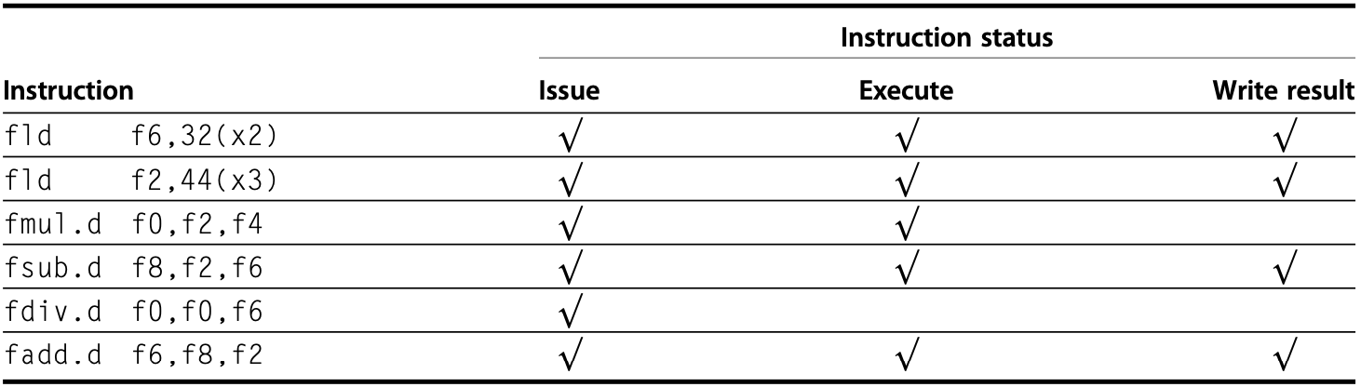
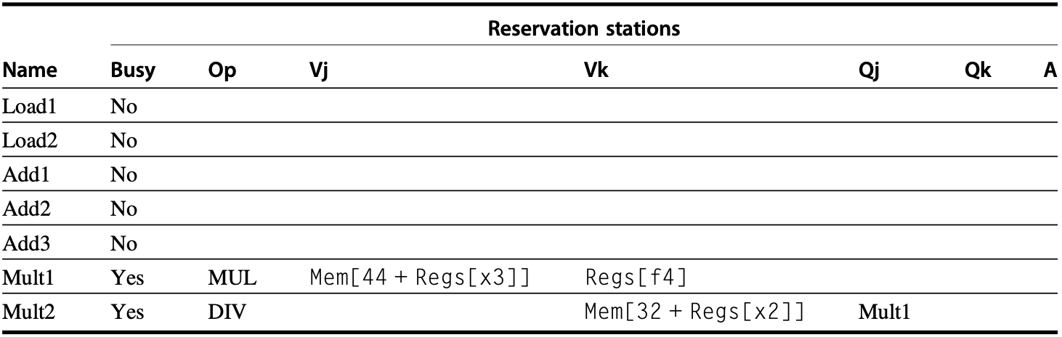
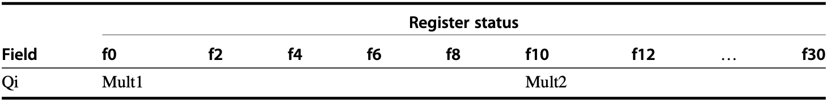
Tomasulo Example
fmul.d is ready to write result
f10

Slide 211
show me the code

Slide 212
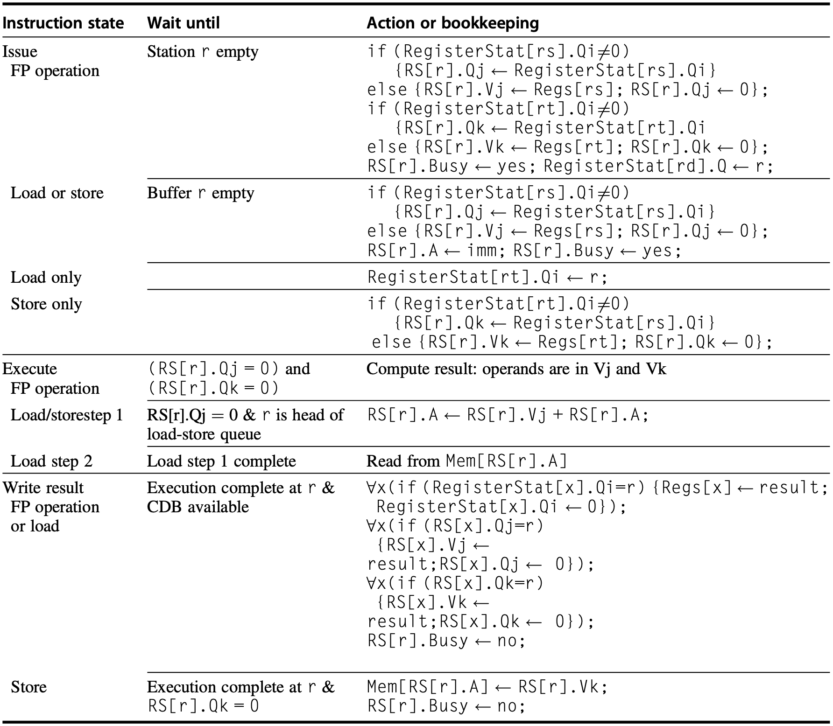
Tomasulo’s Algorithm
i
Notes:
Figure 3.13 Steps in the algorithm and what is required for each step. For the issuing instruction, rd is the des- tination, rs and rt are the source register numbers, imm is the sign-extended immediate field, and r is the reser- vation station or buffer that the instruction is assigned to. RS is the reservation station data structure. The value returned by an FP unit or by the load unit is called result. RegisterStat is the register status data structure (not the register file, which is Regs[]). When an instruction is issued, the destination register has its Qi field set to the number of the buffer or reservation station to which the instruction is issued. If the operands are available in the registers, they are stored in the V fields. Otherwise, the Q fields are set to indicate the reservation station that will produce the values needed as source operands. The instruction waits at the reservation station until both its operands are available, indicated by zero in the Q fields. The Q fields are set to zero either when this instruction is issued or when an instruction on which this instruction depends completes and does its write back. When an instruction has finished execution and the CDB is available, it can do its write back. All the buffers, registers, and reservation stations whose values of Qj or Qk are the same as the completing reservation station update their values from the CDB and mark the Q fields to indicate that values have been received. Thus the CDB can broadcast its result to many destinations in a single clock cycle, and if the waiting instructions have their operands, they can all begin execution on the next clock cycle. Loads go through two steps in execute, and stores perform slightly differently during Write Result, where they may have to wait for the value to store. Remember that, to preserve exception behav- ior, instructions should not be allowed to execute if a branch that is earlier in program order has not yet completed. Because no concept of program order is maintained after the issue stage, this restriction is usually implemented by preventing any instruction from leaving the issue step if there is a pending branch already in the pipeline. In Section 3.6, we will see how speculation support removes this restriction.

Slide 213
Tomasulo’s Algorithm
i
step-by-step

Slide 214
Tomasulo’s Algorithm
rd: destination
rs, rt: source
RS: reservation station
i
step-by-step

Slide 215
i
otherwise, structural hazard should wait in instruction queue

Slide 216
otherwise, structural hazard should wait in instruction queue
Qi != 0 indicates that rs waits for some other result,
which is also waited by r
i

Slide 217
Qi = 0 indicates that rs value is available,
get the value from rs and set r.Qj to 0
Qi = 0 indicates that rs value is available,
get the value from rs and set r.Qj to 0
Qi != 0 indicates that rs waits for some other result,
which is also waited by r
i

Slide 218
Qi = 0 indicates that rs value is available,
get the value from rs and set r.Qj to 0
same policy for the other operand rt
i
hold imm for computing effective address
Qi = 0 indicates that rs value is available,
get the value from rs and set r.Qj to 0

Slide 219
i
occupied by issued instruction
same policy for the other operand rt

Slide 220
i
link r to which register that waits for its result
same policy for the other operand rt

Slide 221
i
same policy for the other operand rt
link r to which register that waits for its result
FP: compute upon both operands are available

Slide 222
i
same policy for the other operand rt
link r to which register that waits for its result
load/store: compute effective address

Slide 223
i
same policy for the other operand rt
load: read data from memory
link r to which register that waits for its result
load: read data from memory

Slide 224
i
same policy for the other operand rt
link r to which register that waits for its result
load: read data from memory
write result to rd
result available
load: read data from memory

Slide 225
i
same policy for the other operand rt
link r to which register that waits for its result
load: read data from memory
write result to rd
write result to
dependent source operands
result available
load: read data from memory

Slide 226
i
same policy for the other operand rt
link r to which register that waits for its result
load: read data from memory
result available
write result to
dependent source operands
release station/buffer

Slide 227
i
same policy for the other operand rt
link r to which register that waits for its result
load: read data from memory
write result to
dependent source operands
result available
data available
store: write data to memory
release station/buffer
release station/buffer

Slide 228
how to tomasulo with static?

Slide 229
Tomasulo & Loop Unrolling
f0, 0(x1)
f4, f0, f2
f4, 0(x1)
x1, x1, -8
x1, x2, Loop
Example code sequence
Loop:
fld
fmul.d
fsd
addi
bne
Notes:
To understand the full power of eliminating WAW and WAR hazards through dynamic renaming of registers, we must look at a loop. Consider the following sim- ple sequence for multiplying the elements of an array by a scalar in f2:
If we predict that branches are taken, using reservation stations will allow multiple executions of this loop to proceed at once. This advantage is gained without changing the code—in effect, the loop is unrolled dynamically by the hard- ware using the reservation stations obtained by renaming to act as additional registers.
Let’s assume we have issued all the instructions in two successive iterations of the loop, but none of the floating-point load/stores or operations have com- pleted. Figure 3.14 shows reservation stations, register status tables, and load and store buffers at this point.

Slide 230
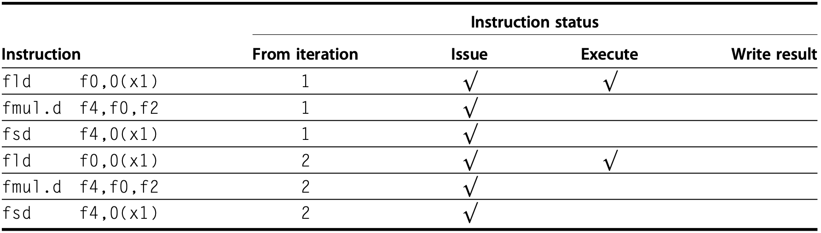
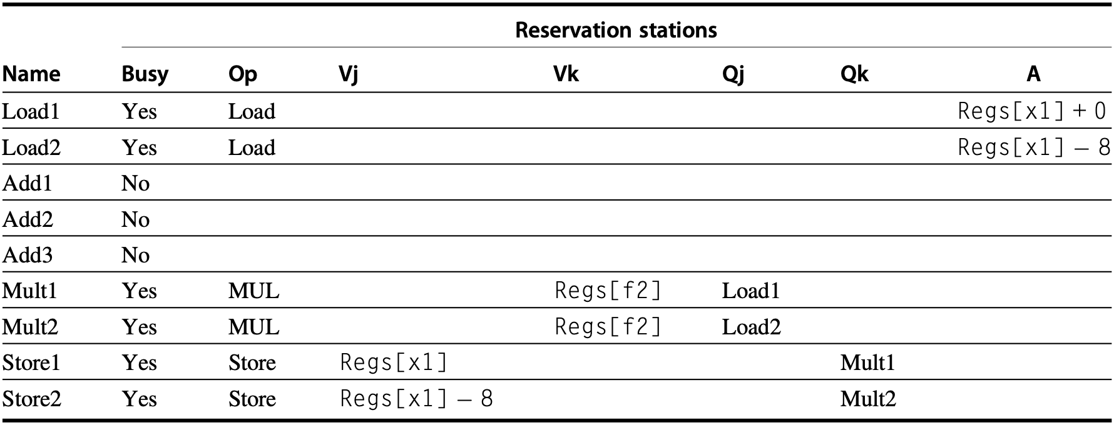
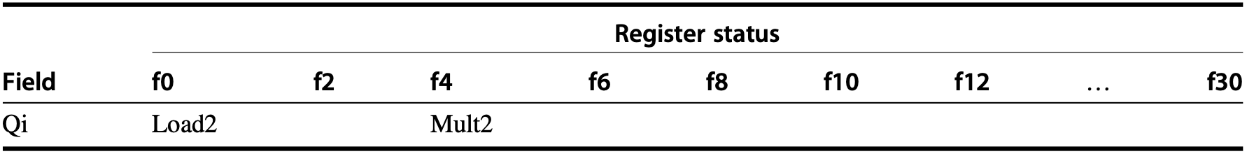
Tomasulo & Loop Unrolling
two iterations & no complete instr
Notes:
Figure 3.14 Two active iterations of the loop with no instruction yet completed. Entries in the multiplier reser- vation stations indicate that the outstanding loads are the sources. The store reservation stations indicate that the multiply destination is the source of the value to store.
(The integer ALU operation is ignored, and it is assumed the branch was predicted as taken.) Once the system reaches this state, two copies of the loop could be sustained with a CPI close to 1.0, provided the multiplies could complete in four clock cycles. With a latency of six cycles, additional iterations will need to be processed before the steady state can be reached. This requires more reservation stations to hold instructions that are in execution. As we will see later in this chapter, when extended with multiple issue instructions, Tomasulo’s approach can sustain more than one instruction per clock.

Slide 231
how to tomasulo with static?
remember branch prediction?

Slide 232
Branch Prediction
Example
20-stage pipeline
1 out of 5 instructions is a branch
5-instruction block ends with a branch
How long to fetch 500 instructions given various prediction accuracy?
100%: 1 instr per CC → 500 CC
99%: 500 + 20 x 1 = 520 CC
90%: 500 + 20 x 10 = 700 CC

Slide 233
how to tomasulo with static?
remember branch prediction:
while resolving branch, fetch&issue instr
if correct prediction, continue execution
if misprediction, re-fetch instructions

Slide 234
how to tomasulo with static?
if correct prediction, continue execution
Notes:
As we try to exploit more instruction-level parallelism, maintaining control depen- dences becomes an increasing burden. Branch prediction reduces the direct stalls attributable to branches, but for a processor executing multiple instructions per clock, just predicting branches accurately may not be sufficient to generate the desired amount of instruction-level parallelism. A wide-issue processor may need to execute a branch every clock cycle to maintain maximum performance. Thus exploiting more parallelism requires that we overcome the limitation of control dependence.

Slide 235
how to exec before resolved?
if correct prediction, continue execution

Slide 236
how to exec before resolved?
if correct prediction, continue execution
speculate on branch outcome
execute program as if guesses are correct
Notes:
Overcoming control dependence is done by speculating on the outcome of branches and executing the program as if our guesses are correct. This mech- anism represents a subtle, but important, extension over branch prediction with dynamic scheduling.

Slide 237
how to exec before resolved?
if correct prediction, continue execution
fetch, issue, and execute instructions as if
branch predictions are always correct;
commit results till prediction is determined;
undo effects by misprediction;
Notes:
In particular, with speculation, we fetch, issue, and exe- cute instructions, as if our branch predictions are always correct; dynamic scheduling only fetches and issues such instructions. Of course, we need mech- anisms to handle the situation where the speculation is incorrect. Appendix H discusses a variety of mechanisms for supporting speculation by the compiler. In this section, we explore hardware speculation, which extends the ideas of dynamic scheduling.

Slide 238
Hardware Speculation
out-of-order execution&in-order commit
Instruction Commit allow an instruction to update register file or memory until the instruction is no longer speculative
Reorder Buffer (ROB) additional set of hardware buffers to hold the results of instructions that have finished execution but have not committed
Notes:
Hardware-based speculation combines three key ideas:
dynamic branch prediction to choose which instructions to execute,
speculation to allow the execution of instructions before the control dependences are resolved (with the ability to undo the effects of an incorrectly speculated sequence), and
dynamic scheduling to deal with the scheduling of different combinations of basic blocks. (In comparison, dynamic scheduling without speculation only partially overlaps basic blocks because it requires that a branch be resolved before actually executing any instructions in the successor basic block.).
The key idea behind implementing speculation is to allow instructions to exe- cute out of order but to force them to commit in order and to prevent any irrevo- cable action (such as updating state or taking an exception) until an instruction commits. Therefore, when we add speculation, we need to separate the process of completing execution from instruction commit, because instructions may finish execution considerably before they are ready to commit. Adding this commit phase to the instruction execution sequence requires an additional set of hardware buffers that hold the results of instructions that have finished execution but have not com- mitted. This hardware buffer, which we call the reorder buffer, is also used to pass results among instructions that may be speculated.

Slide 239
Hardware Speculation
out-of-order execution&in-order commit
Instruction Commit allow an instruction to update register file or memory until the instruction is no longer speculative
Reorder Buffer (ROB) similar to stations/buffers in Tomasulo, act as a source of operands for instr; results updated to registers/memory until instruction commits;
Reorder Buffer (ROB)
Notes:
The reorder buffer (ROB) provides additional registers in the same way as the reservation stations in Tomasulo’s algorithm extend the register set. The ROB holds the result of an instruction between the time the operation associated with the instruction completes and the time the instruction commits. The ROB therefore is a source of operands for instructions, just as the reservation stations provide operands in Tomasulo’s algorithm. The key difference is that in Tomasulo’s algo- rithm, once an instruction writes its result, all subsequently issued instructions will find the result in the register file. With speculation, the register file is not updated until the instruction commits (and we know definitively that the instruction should execute); thus, the ROB supplies operands in the interval between completion of instruction execution and instruction commit. The ROB is similar to the store buffer in Tomasulo’s algorithm, and we integrate the function of the store buffer into the ROB for simplicity.

Slide 240
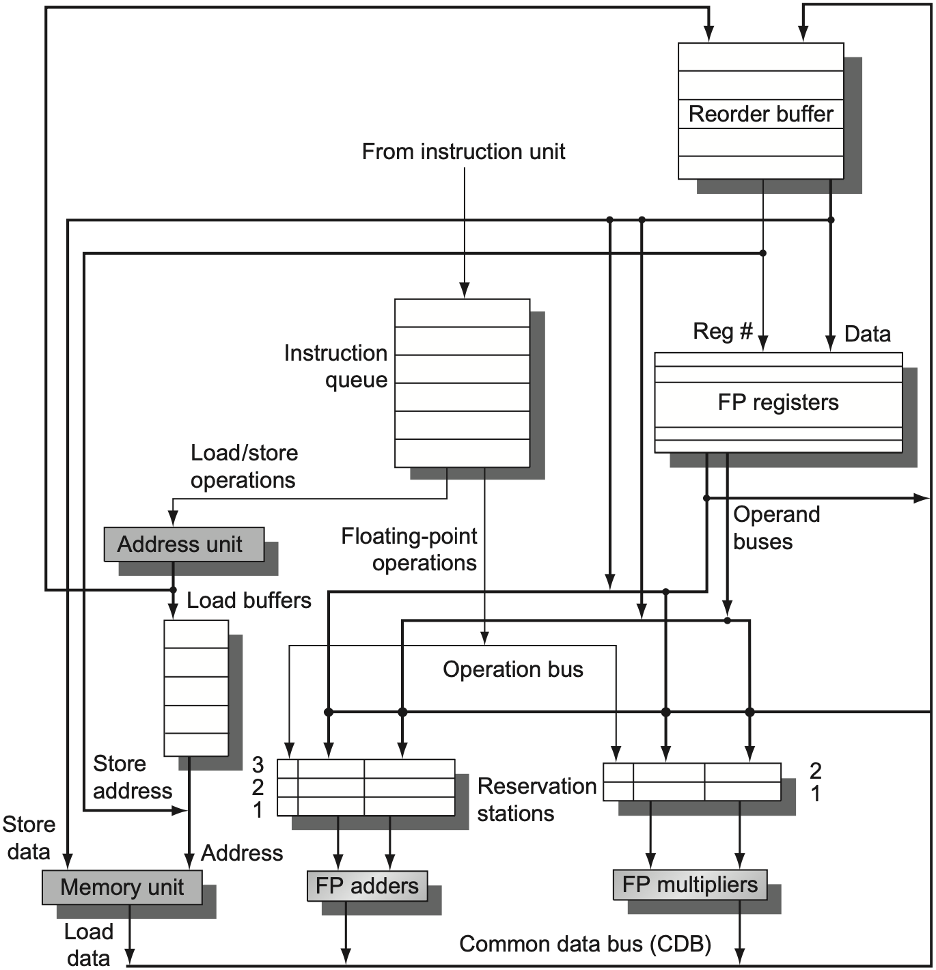
Hardware Speculation
Reorder Buffer (ROB)
Notes:
Figure 3.15 The basic structure of a FP unit using Tomasulo’s algorithm and extended to handle speculation. Comparing this to Figure 3.10 on page 198, which implemented Tomasulo’s algorithm, we can see that the major change is the addition of the ROB and the elimination of the store buffer, whose function is integrated into the ROB. This mechanism can be extended to allow multiple issues per clock by making the CDB wider to allow for mul- tiple completions per clock.

Slide 241
Hardware Speculation
Reorder Buffer (ROB)
results from CDB to:
ROB instead of directly to registers
Notes:
Figure 3.15 The basic structure of a FP unit using Tomasulo’s algorithm and extended to handle speculation. Comparing this to Figure 3.10 on page 198, which implemented Tomasulo’s algorithm, we can see that the major change is the addition of the ROB and the elimination of the store buffer, whose function is integrated into the ROB. This mechanism can be extended to allow multiple issues per clock by making the CDB wider to allow for mul- tiple completions per clock.

Slide 242
Hardware Speculation
Reorder Buffer (ROB)
results from ROB to:
registers upon commit;
stations/memory as source op;
Notes:
Figure 3.15 The basic structure of a FP unit using Tomasulo’s algorithm and extended to handle speculation. Comparing this to Figure 3.10 on page 198, which implemented Tomasulo’s algorithm, we can see that the major change is the addition of the ROB and the elimination of the store buffer, whose function is integrated into the ROB. This mechanism can be extended to allow multiple issues per clock by making the CDB wider to allow for mul- tiple completions per clock.

Slide 243
Hardware Speculation
Reorder Buffer (ROB)
store buffers subsumed to:
ROB
Notes:
Figure 3.15 The basic structure of a FP unit using Tomasulo’s algorithm and extended to handle speculation. Comparing this to Figure 3.10 on page 198, which implemented Tomasulo’s algorithm, we can see that the major change is the addition of the ROB and the elimination of the store buffer, whose function is integrated into the ROB. This mechanism can be extended to allow multiple issues per clock by making the CDB wider to allow for mul- tiple completions per clock.
The ROB subsumes the store buffers. Stores still execute in two steps, but the second step is performed by instruction commit. Although the renaming function of the reservation stations is replaced by the ROB, we still need a place to buffer oper- ations (and operands) between the time they issue and the time they begin execution. This function is still provided by the reservation stations. Because every instruction has a position in the ROB until it commits, we tag a result using the ROB entry number rather than using the reservation station number. This tagging requires that the ROB assigned for an instruction must be tracked in the reservation station. Later in this sec- tion, we will explore an alternative implementation that uses extra registers for renam- ing and a queue that replaces the ROB to decide when instructions can commit.

Slide 244
Hardware Speculation
Reorder Buffer (ROB) entry fields:
Instruction type
Destination
Value
Ready
Reorder Buffer (ROB)
Notes:
Specifically, each entry in the ROB contains four fields: the instruction type, the destination field, the value field, and the ready field. The instruction type field indicates whether the instruction is a branch (and has no destination result), a store (which has a mem- ory address destination), or a register operation (ALU operation or load, which has register destinations). The destination field supplies the register number (for loads and ALU operations) or the memory address (for stores) where the instruction result should be written. The value field is used to hold the value of the instruction result until the instruction commits. We will see an example of ROB entries shortly. Finally, the ready field indicates that the instruction has completed execution, and the value is ready.

Slide 245
Hardware Speculation
Reorder Buffer (ROB) entry fields:
Instruction type branch, store, register op (ALU/load)
Destination register # for loads and ALU operations memory address for stores
Value hold insr result until instruction commits
Ready: execution complete, value ready
Reorder Buffer (ROB)
Notes:
Specifically, each entry in the ROB contains four fields: the instruction type, the destination field, the value field, and the ready field. The instruction type field indicates whether the instruction is a branch (and has no destination result), a store (which has a mem- ory address destination), or a register operation (ALU operation or load, which has register destinations). The destination field supplies the register number (for loads and ALU operations) or the memory address (for stores) where the instruction result should be written. The value field is used to hold the value of the instruction result until the instruction commits. We will see an example of ROB entries shortly. Finally, the ready field indicates that the instruction has completed execution, and the value is ready.

Slide 246
Hardware Speculation
Issue
Execute
Write result
Commit
Notes:
Here are the four steps involved in instruction execution:

Slide 247
Hardware Speculation
Issue get next instr from instr queue head upon empty reservation-station buffer & empty ROB entry; send operands to station if available in either registers or ROB; correlate station with ROB entry #;
Execute
Write result
Commit
Notes:
1. Issue—Get an instruction from the instruction queue. Issue the instruction if there is an empty reservation station and an empty slot in the ROB; send the operands to the reservation station if they are available in either the registers or the ROB. Update the control entries to indicate the buffers are in use. The number of the ROB entry allocated for the result is also sent to the reservation station so that the number can be used to tag the result when it is placed on the CDB. If either all reservations are full or the ROB is full, then the instruction issue is stalled until both have available entries.

Slide 248
Hardware Speculation
Issue
Execute when both operands are available, execute the operation at functional unit; stores only need base register for effective address calculation;
Write result
Commit
Notes:
2. Execute—If one or more of the operands is not yet available, monitor the CDB while waiting for the register to be computed. This step checks for RAW haz- ards. When both operands are available at a reservation station, execute the operation. Instructions may take multiple clock cycles in this stage, and loads still require two steps in this stage. Stores only need the base register at this step, because execution for a store at this point is only effective address calculation.

Slide 249
Hardware Speculation
Issue
Execute
Write result when the result is available, write it on CDB (with ROB entry #), which broadcasts it to ROB and stations
Commit
Notes:
3. Write result—When the result is available, write it on the CDB (with the ROB tag sent when the instruction issued) and from the CDB into the ROB, as well as to any reservation stations waiting for this result. Mark the reservation station as available. Special actions are required for store instructions. If the value to be stored is available, it is written into the Value field of the ROB entry for the store. If the value to be stored is not available yet, the CDB must be monitored until that value is broadcast, at which time the Value field of the ROB entry of the store is updated. For simplicity we assume that this occurs during the Write Result stage of a store; we discuss relaxing this requirement later.

Slide 250
Hardware Speculation
Issue
Execute
Write result when the result is available, write it on CDB (with ROB entry #), which broadcasts it to ROB and stations
Commit
not directly to registers/memory
Notes:
3. Write result—When the result is available, write it on the CDB (with the ROB tag sent when the instruction issued) and from the CDB into the ROB, as well as to any reservation stations waiting for this result. Mark the reservation station as available. Special actions are required for store instructions. If the value to be stored is available, it is written into the Value field of the ROB entry for the store. If the value to be stored is not available yet, the CDB must be monitored until that value is broadcast, at which time the Value field of the ROB entry of the store is updated. For simplicity we assume that this occurs during the Write Result stage of a store; we discuss relaxing this requirement later.

Slide 251
Hardware Speculation
Issue
Execute
Write result
Commit: Completion/Graduation branch with incorrect prediction store normal commit
Notes:
4. Commit—This is the final stage of completing an instruction, after which only its result remains. (Some processors call this commit phase “completion” or “graduation.”) There are three different sequences of actions at commit depend- ing on whether the committing instruction is a branch with an incorrect predic- tion, a store, or any other instruction (normal commit). The normal commit case occurs when an instruction reaches the head of the ROB and its result is present in the buffer; at this point, the processor updates the register with the result and removes the instruction from the ROB. Committing a store is similar except that memory is updated rather than a result register. When a branch with incorrect prediction reaches the head of the ROB, it indicates that the speculation was wrong. The ROB is flushed and execution is restarted at the correct successor of the branch. If the branch was correctly predicted, the branch is finished. Once an instruction commits, its entry in the ROB is reclaimed, and the register or memory destination is updated, eliminating the need for the ROB entry. If the ROB fills, we simply stop issuing instructions until an entry is made free.

Slide 252
Hardware Speculation
Issue
Execute
Write result
Commit: Completion/Graduation branch with incorrect prediction store / normal commit: instruction reaches ROB head and its result is available; write result to dest register / memory; remove instruction from ROB;
Notes:
4. Commit—This is the final stage of completing an instruction, after which only its result remains. (Some processors call this commit phase “completion” or “graduation.”) There are three different sequences of actions at commit depend- ing on whether the committing instruction is a branch with an incorrect predic- tion, a store, or any other instruction (normal commit). The normal commit case occurs when an instruction reaches the head of the ROB and its result is present in the buffer; at this point, the processor updates the register with the result and removes the instruction from the ROB. Committing a store is similar except that memory is updated rather than a result register. When a branch with incorrect prediction reaches the head of the ROB, it indicates that the speculation was wrong. The ROB is flushed and execution is restarted at the correct successor of the branch. If the branch was correctly predicted, the branch is finished. Once an instruction commits, its entry in the ROB is reclaimed, and the register or memory destination is updated, eliminating the need for the ROB entry. If the ROB fills, we simply stop issuing instructions until an entry is made free.

Slide 253
Hardware Speculation
Issue
Execute
Write result
Commit: Completion/Graduation branch with incorrect prediction: flush ROB & restart at the correct successor of the branch; store normal commit
Notes:
4. Commit—This is the final stage of completing an instruction, after which only its result remains. (Some processors call this commit phase “completion” or “graduation.”) There are three different sequences of actions at commit depend- ing on whether the committing instruction is a branch with an incorrect predic- tion, a store, or any other instruction (normal commit). The normal commit case occurs when an instruction reaches the head of the ROB and its result is present in the buffer; at this point, the processor updates the register with the result and removes the instruction from the ROB. Committing a store is similar except that memory is updated rather than a result register. When a branch with incorrect prediction reaches the head of the ROB, it indicates that the speculation was wrong. The ROB is flushed and execution is restarted at the correct successor of the branch. If the branch was correctly predicted, the branch is finished. Once an instruction commits, its entry in the ROB is reclaimed, and the register or memory destination is updated, eliminating the need for the ROB entry. If the ROB fills, we simply stop issuing instructions until an entry is made free.

Slide 254
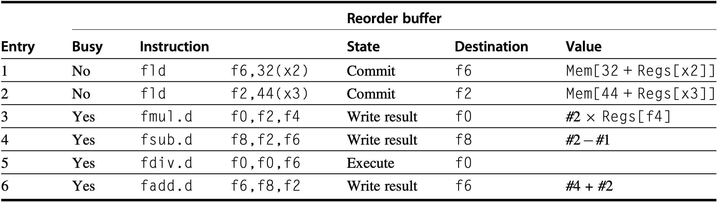
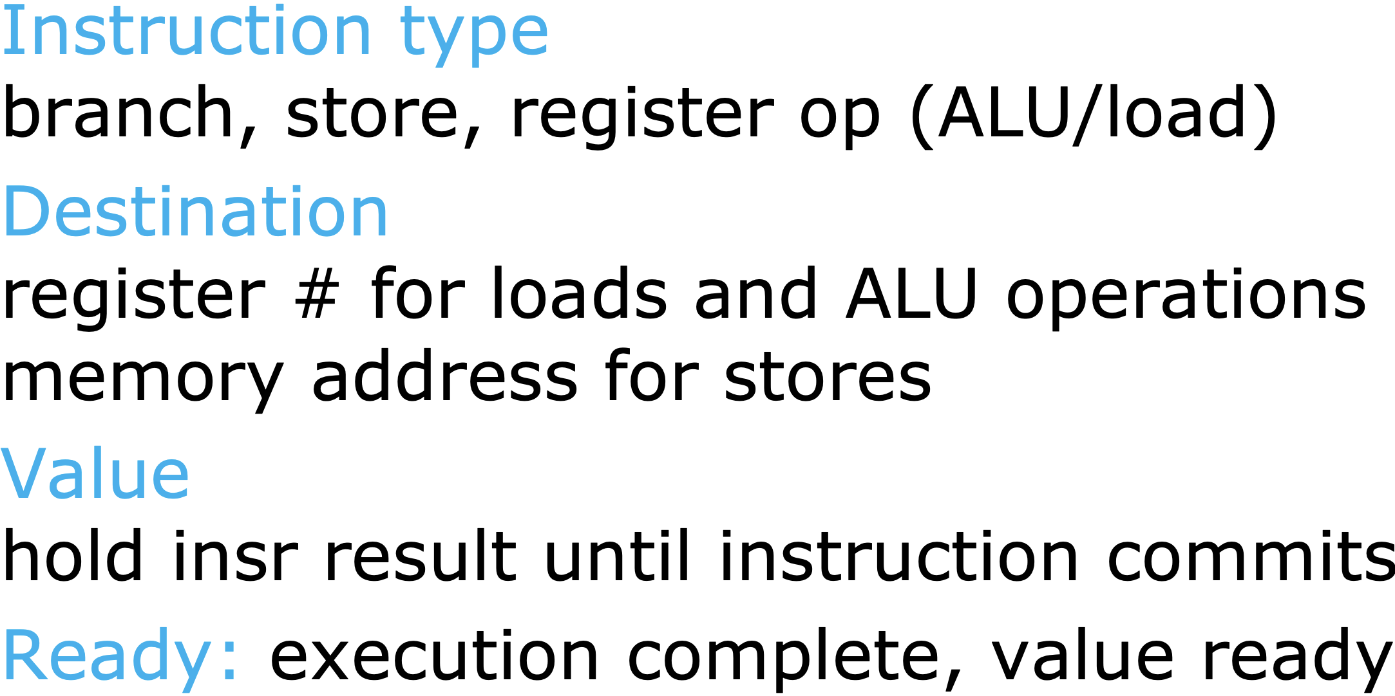
Speculation Example
f10
f10
both fld have committed
fmul.d is ready to commit
Notes:
Figure3.16 Atthetimethefmul.disreadytocommit,onlythetwofldinstructionshavecommitted,although several others have completed execution. The fmul.d is at the head of the ROB, and the two fld instructions are there only to ease understanding. The fsub.d and fadd.d instructions will not commit until the fmul.d instruc- tion commits, although the results of the instructions are available and can be used as sources for other instructions. The fdiv.d is in execution, but has not completed solely because of its longer latency than that of fmul.d. The Value column indicates the value being held; the format #X is used to refer to a value field of ROB entry X. Reorder buffers 1 and 2 are actually completed but are shown for informational purposes. We do not show the entries for the load/store queue, but these entries are kept in order.

Slide 255
Speculation Example
f10
f10
still in execution
due to long latency
both fld have committed
fmul.d is ready to commit
Notes:
Figure3.16 Atthetimethefmul.disreadytocommit,onlythetwofldinstructionshavecommitted,although several others have completed execution. The fmul.d is at the head of the ROB, and the two fld instructions are there only to ease understanding. The fsub.d and fadd.d instructions will not commit until the fmul.d instruc- tion commits, although the results of the instructions are available and can be used as sources for other instructions. The fdiv.d is in execution, but has not completed solely because of its longer latency than that of fmul.d. The Value column indicates the value being held; the format #X is used to refer to a value field of ROB entry X. Reorder buffers 1 and 2 are actually completed but are shown for informational purposes. We do not show the entries for the load/store queue, but these entries are kept in order.

Slide 256
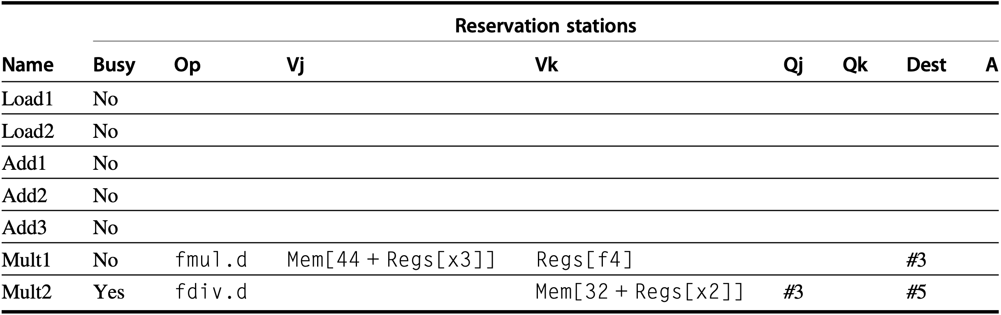
Speculation Example
f10
f10
could be blank as Mult1 is not busy?
Notes:
Figure3.16 Atthetimethefmul.disreadytocommit,onlythetwofldinstructionshavecommitted,although several others have completed execution. The fmul.d is at the head of the ROB, and the two fld instructions are there only to ease understanding. The fsub.d and fadd.d instructions will not commit until the fmul.d instruc- tion commits, although the results of the instructions are available and can be used as sources for other instructions. The fdiv.d is in execution, but has not completed solely because of its longer latency than that of fmul.d. The Value column indicates the value being held; the format #X is used to refer to a value field of ROB entry X. Reorder buffers 1 and 2 are actually completed but are shown for informational purposes. We do not show the entries for the load/store queue, but these entries are kept in order.

Slide 257
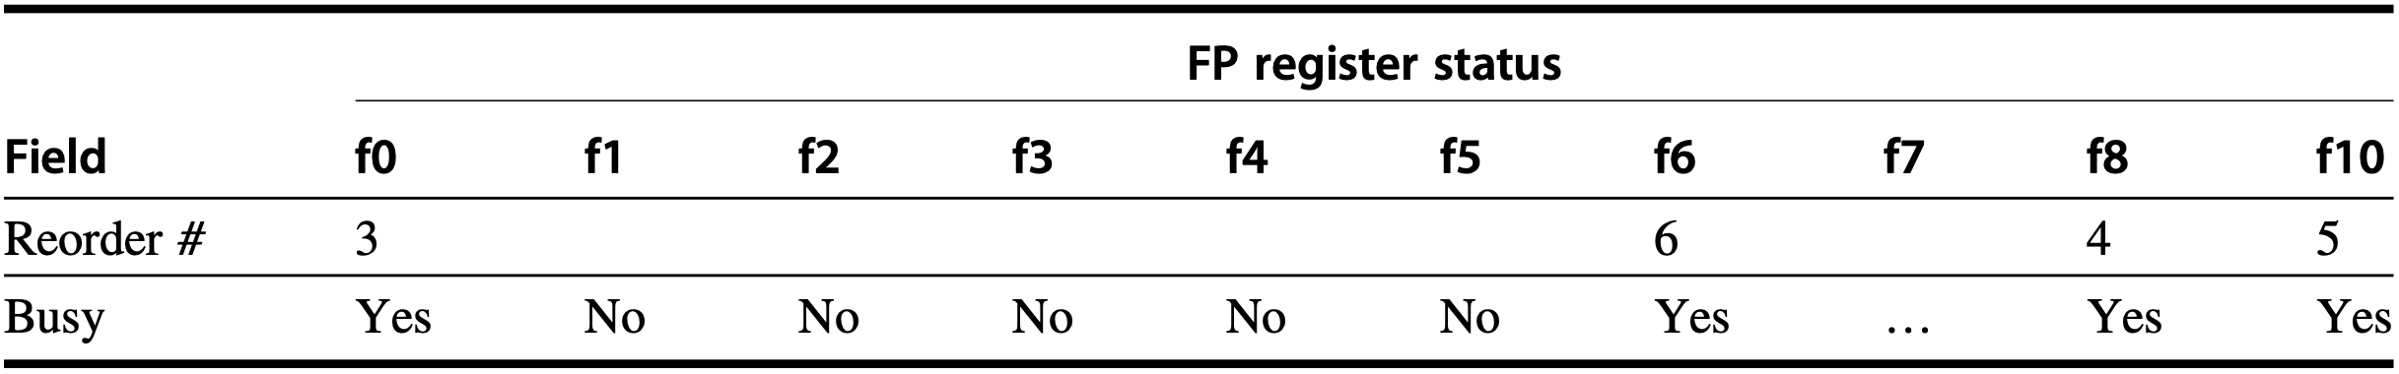
Speculation Example
f10
f10
which ROB entry’s destination is this register
could be blank as Mult1 is not busy?
Notes:
Figure3.16 Atthetimethefmul.disreadytocommit,onlythetwofldinstructionshavecommitted,although several others have completed execution. The fmul.d is at the head of the ROB, and the two fld instructions are there only to ease understanding. The fsub.d and fadd.d instructions will not commit until the fmul.d instruc- tion commits, although the results of the instructions are available and can be used as sources for other instructions. The fdiv.d is in execution, but has not completed solely because of its longer latency than that of fmul.d. The Value column indicates the value being held; the format #X is used to refer to a value field of ROB entry X. Reorder buffers 1 and 2 are actually completed but are shown for informational purposes. We do not show the entries for the load/store queue, but these entries are kept in order.

Slide 258
Speculation Example
f10
f10
which ROB entry’s destination is this register
could be blank as Mult1 is not busy?
Notes:
Figure3.16 Atthetimethefmul.disreadytocommit,onlythetwofldinstructionshavecommitted,although several others have completed execution. The fmul.d is at the head of the ROB, and the two fld instructions are there only to ease understanding. The fsub.d and fadd.d instructions will not commit until the fmul.d instruc- tion commits, although the results of the instructions are available and can be used as sources for other instructions. The fdiv.d is in execution, but has not completed solely because of its longer latency than that of fmul.d. The Value column indicates the value being held; the format #X is used to refer to a value field of ROB entry X. Reorder buffers 1 and 2 are actually completed but are shown for informational purposes. We do not show the entries for the load/store queue, but these entries are kept in order.

Slide 259
Speculation Example
f10
f10
which ROB entry’s destination is this register
could be blank as Mult1 is not busy?
Notes:
Figure3.16 Atthetimethefmul.disreadytocommit,onlythetwofldinstructionshavecommitted,although several others have completed execution. The fmul.d is at the head of the ROB, and the two fld instructions are there only to ease understanding. The fsub.d and fadd.d instructions will not commit until the fmul.d instruc- tion commits, although the results of the instructions are available and can be used as sources for other instructions. The fdiv.d is in execution, but has not completed solely because of its longer latency than that of fmul.d. The Value column indicates the value being held; the format #X is used to refer to a value field of ROB entry X. Reorder buffers 1 and 2 are actually completed but are shown for informational purposes. We do not show the entries for the load/store queue, but these entries are kept in order.

Slide 260
Speculation Example
f10
f10
uncommitted instructions’ destination registers
could be blank as Mult1 is not busy?
Notes:
Figure3.16 Atthetimethefmul.disreadytocommit,onlythetwofldinstructionshavecommitted,although several others have completed execution. The fmul.d is at the head of the ROB, and the two fld instructions are there only to ease understanding. The fsub.d and fadd.d instructions will not commit until the fmul.d instruc- tion commits, although the results of the instructions are available and can be used as sources for other instructions. The fdiv.d is in execution, but has not completed solely because of its longer latency than that of fmul.d. The Value column indicates the value being held; the format #X is used to refer to a value field of ROB entry X. Reorder buffers 1 and 2 are actually completed but are shown for informational purposes. We do not show the entries for the load/store queue, but these entries are kept in order.

Slide 261
Speculation Example
f10
f10
wait for results to be written from ROB to destination registers
upon commit
could be blank as Mult1 is not busy?
Notes:
Figure3.16 Atthetimethefmul.disreadytocommit,onlythetwofldinstructionshavecommitted,although several others have completed execution. The fmul.d is at the head of the ROB, and the two fld instructions are there only to ease understanding. The fsub.d and fadd.d instructions will not commit until the fmul.d instruc- tion commits, although the results of the instructions are available and can be used as sources for other instructions. The fdiv.d is in execution, but has not completed solely because of its longer latency than that of fmul.d. The Value column indicates the value being held; the format #X is used to refer to a value field of ROB entry X. Reorder buffers 1 and 2 are actually completed but are shown for informational purposes. We do not show the entries for the load/store queue, but these entries are kept in order.

Slide 262
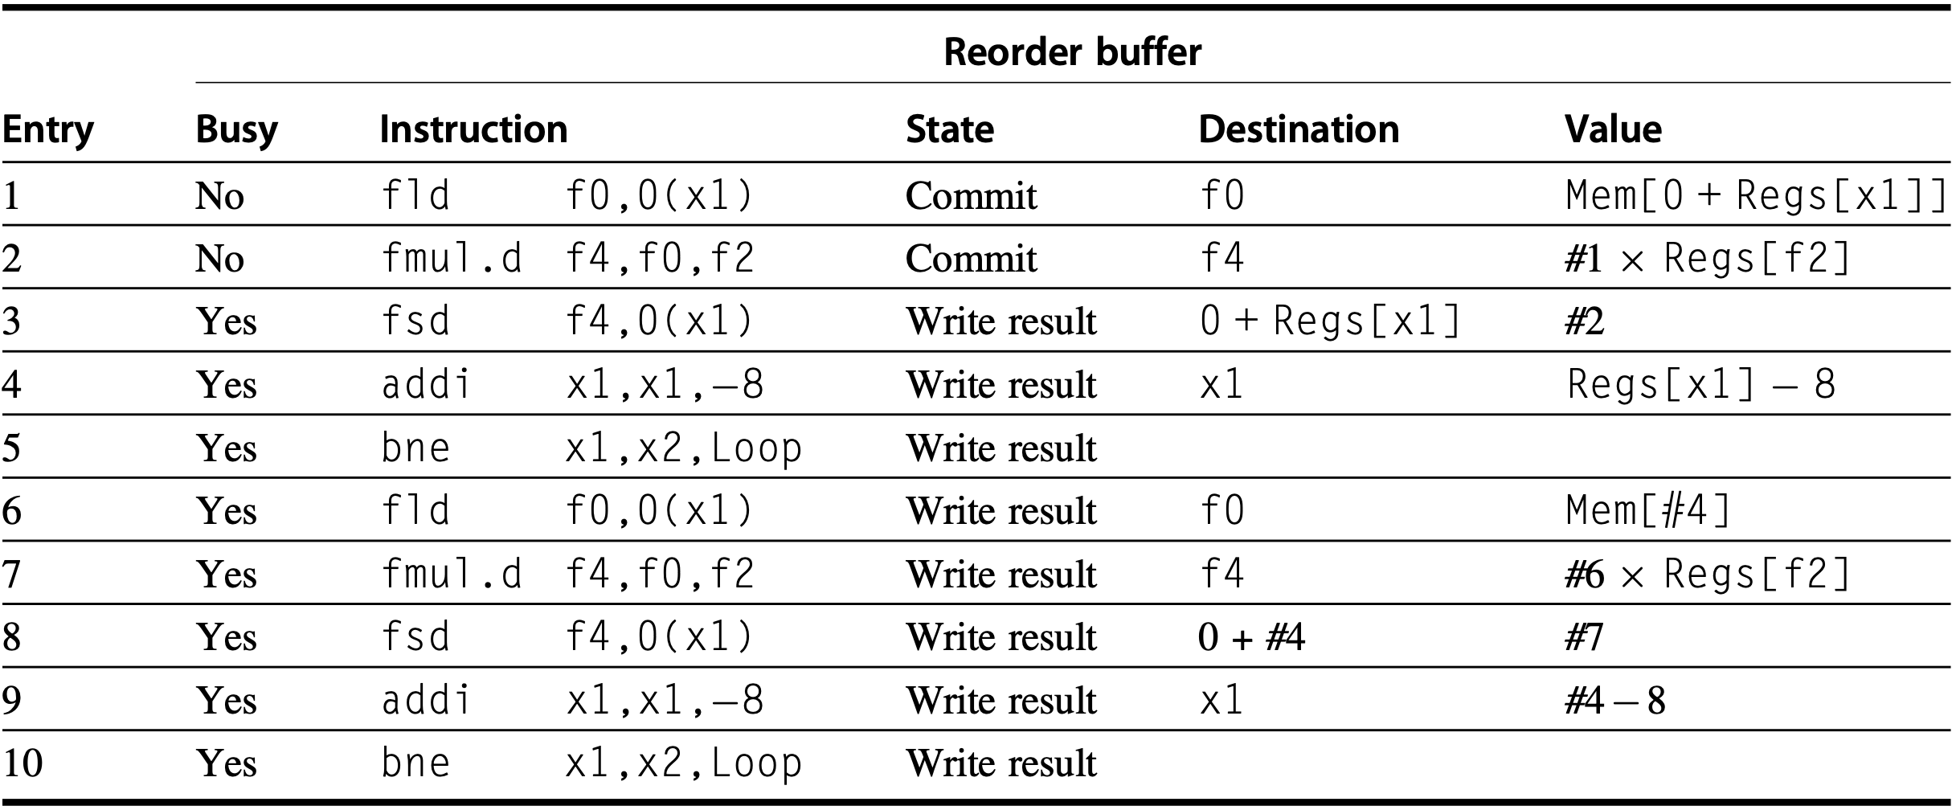
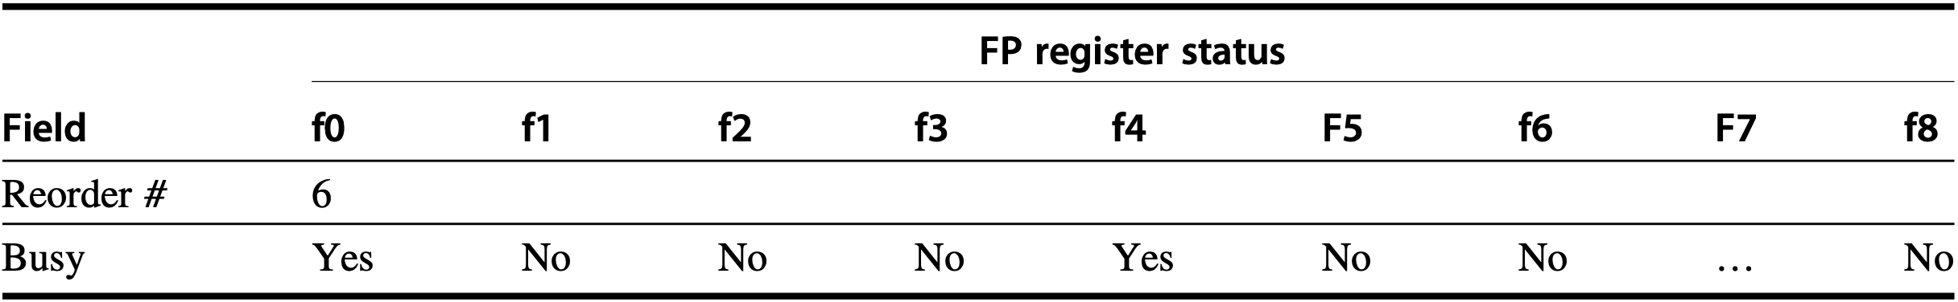
Speculation & Loop Unrolling
two iterations&fld/fmul committed
f
f
7
Notes:
Figure 3.17 Only the fld and fmul.d instructions have committed, although all the others have completed execution. Thus no reservation stations are busy and none are shown. The remaining instructions will be committed as quickly as possible. The first two reorder buffers are empty, but are shown for completeness.

Slide 263
show me the code, again

Slide 264
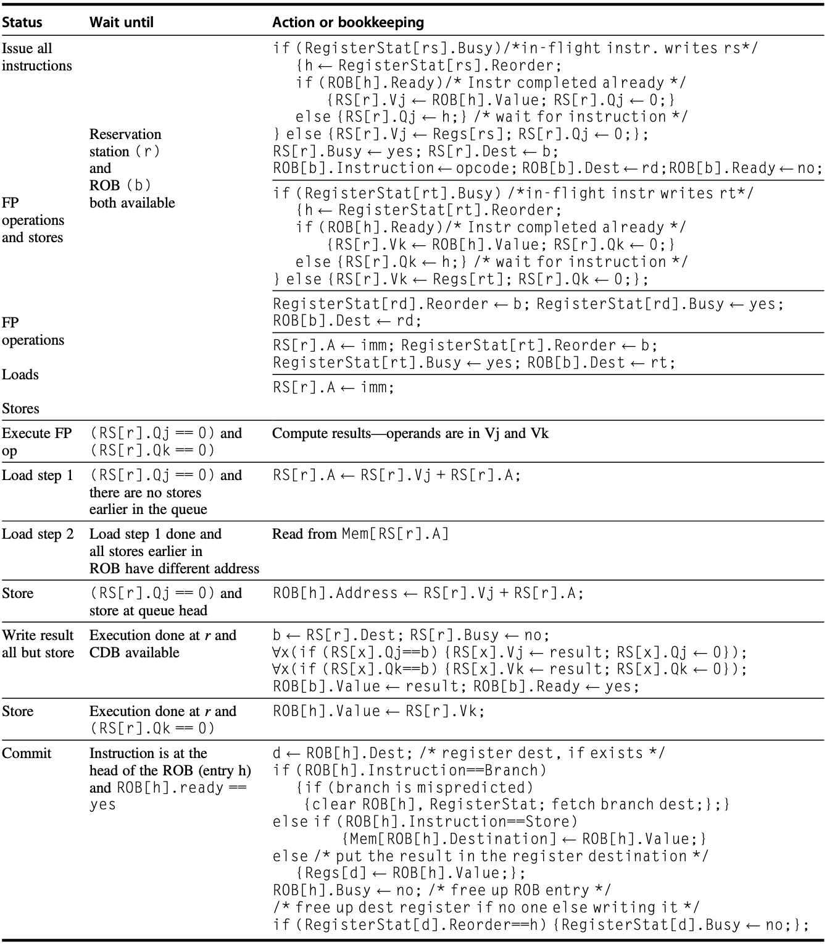
Hardware Speculation
Notes:
Figure 3.18 Steps in the algorithm and what is required for each step. For the issuing instruction, rd is the des- tination, rs and rt are the sources, r is the reservation station allocated, b is the assigned ROB entry, and h is the head entry of the ROB. RS is the reservation station data structure. The value returned by a reservation station is called the result. Register-Stat is the register data structure, Regs represents the actual registers, and ROB is the reorder buffer data structure.

Slide 265
Hardware Speculation
step-by-step

Slide 266
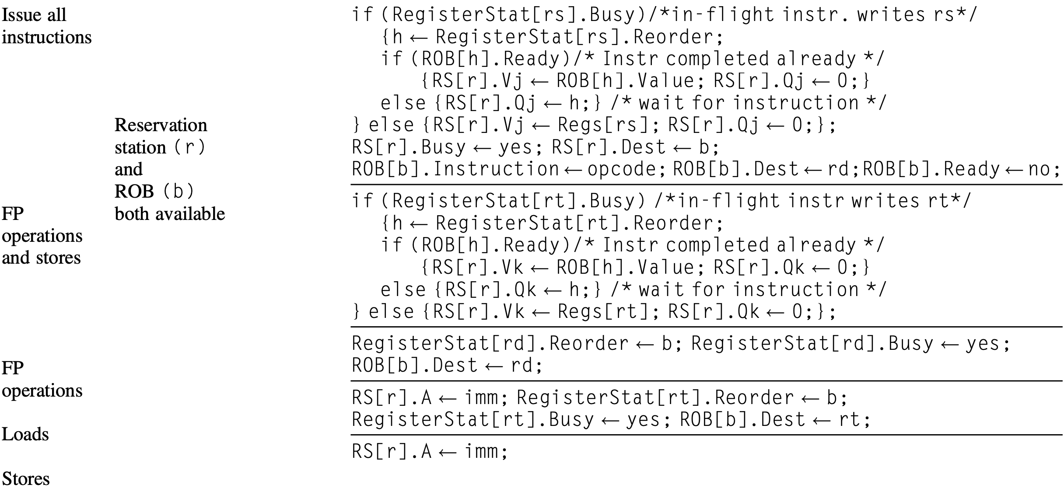
Issue

Slide 267
otherwise, structural hazard
should wait in instruction queue
Issue

Slide 268
if source operand rs is not available,
Issue

Slide 269
if source operand rs is not available
monitor rs’ ROB entry h’s status till its result is available;
pay attention to the assignment of h here,
not necessarily the ROB head as defined by default;
Issue

Slide 270
if source operand rs is not available
monitor rs’ ROB entry h’s status till its result is available
if the result is available,
send it from ROB to the reservation station;
Issue

Slide 271
if source operand rs is available,
send it from register to the reservation station;
Issue

Slide 272
occupy the reservation station,
tag it with the corresponding ROB entry b, that is,
the result of this reservation station will be written to b;
Issue

Slide 273
write instruction type to ROB entry b,
set destination register of ROB entry b as instruction’s dest rd,
the result of this ROB entry b will be finally written to rd;
Issue

Slide 274
similar policy to get the other operand rt ready;
Issue

Slide 275
link ROB entry b to the corresponding register rd;
the result of this ROB entry b will be finally written to rd;
Issue

Slide 276
link ROB entry b to the corresponding register rd;
the result of this ROB entry b will be finally written to rd;
for load, the other operand comes from imm;
Issue

Slide 277
for store, the other operand comes from imm;
store’s destination is memory instead of destination register;
Issue

Slide 278
FP: compute upon both operands are available
Execute

Slide 279
load/store: compute effective address
Execute

Slide 280
load/store: compute effective address
avoid RAW hazard, complete all stores before load;
may not have A-address conflict among them, for simplicity
without comparing address fields of them;
Execute

Slide 281
load/store: compute effective address
value to store need not arrive until just before store commit;
value can be placed directly into the store’s ROB entry by the
sourcing instruction;
so compute store’s effective address when it is at ROB head,
and about to commit;
Execute

Slide 282
load/store: compute effective address
avoid RAW hazard, if there are earlier stores with same addr,
store first, then load;
Execute

Slide 283
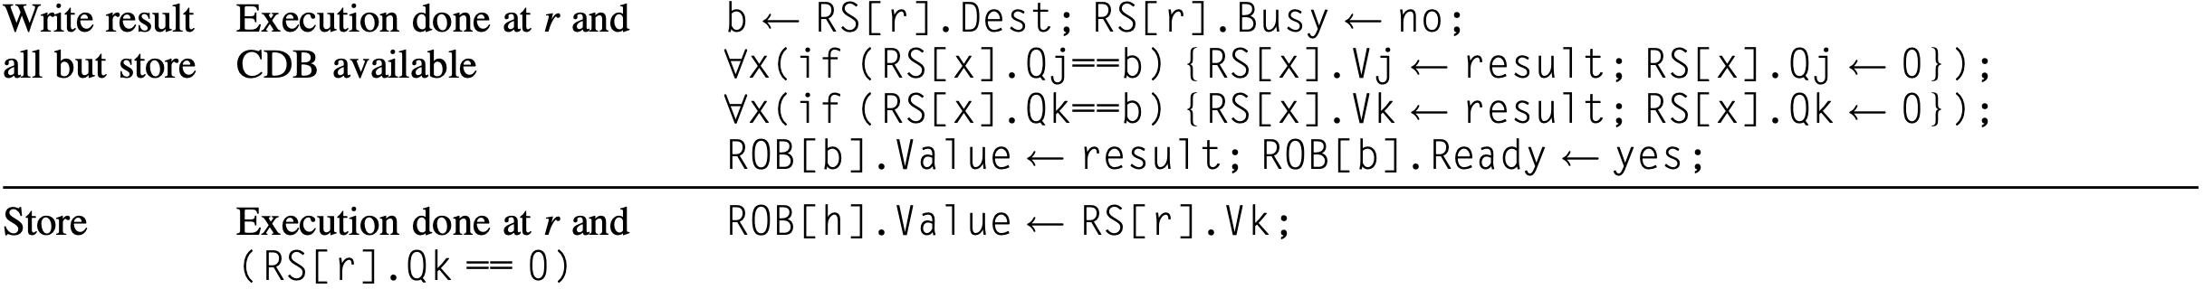
broadcast result to ROB entry and all dependent stations;
Write Result

Slide 284
data to store is available, writted from station to ROB;
according to prior requirement, store is ROB head, so ROB[h];
Write Result

Slide 285
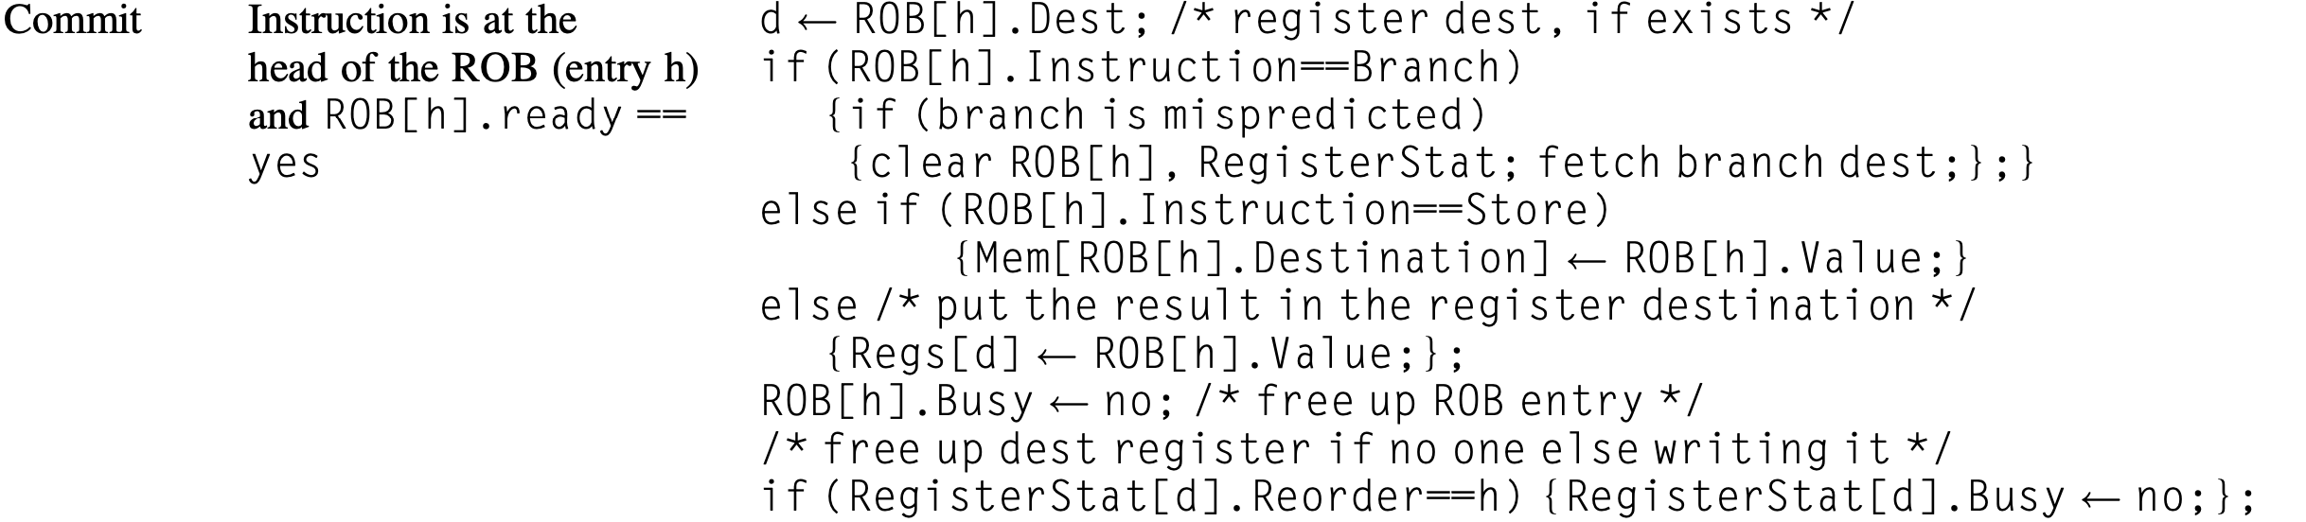
commit an instruction only when it reaches ROB head, and
its result is available;
Commit

Slide 286
commit an instruction only when it reaches ROB head, and
its result is available;
if misprediction, clear ROB (according to the textbook?)
(at least clear mispredicted branch&its dependent instructions)
Commit

Slide 287
commit an instruction only when it reaches ROB head, and
its result is available;
store: write result to memory
Commit

Slide 288
commit an instruction only when it reaches ROB head, and
its result is available;
normal commit: write result to destination register
Commit

Slide 289
Hardware Speculation
commit an instruction only when it reaches ROB head, and
its result is available;
after commit, release ROB entry and the corresponding station.
Commit

Slide 290
Hardware Speculation
Commit
Notes:
wowowow

Slide 291
Hardware Speculation
Example: free reservation station on result broadcast (not instruction dispatch); issue, capture, dispatch in same cycle; 1-cycle add, 10-cycle mul, 40-cycle div;
inst | operand | issue | exe | write | commit
div | x2, x3, x4 | 1 | ?
mul | x1, x5, x6
add | x3, x7, x8
mul | x1, x1, x3
sub | x4, x1, x5
add | x1, x4, x2

Slide 292
Hardware Speculation
Example: free reservation station on result broadcast (not instruction dispatch); issue, capture, dispatch in same cycle; 1-cycle add, 10-cycle mul, 40-cycle div;
inst | operand | issue | exe | write | commit
div | x2, x3, x4 | 1 | 2 | 42 | 43
mul | x1, x5, x6
add | x3, x7, x8
mul | x1, x1, x3
sub | x4, x1, x5
add | x1, x4, x2

Slide 293
Hardware Speculation
Example: assume single-issue pipeline free reservation station on result broadcast (not instruction dispatch); issue, capture, dispatch in same cycle; 1-cycle add, 10-cycle mul, 40-cycle div;
inst | operand | issue | exe | write | commit
div | x2, x3, x4 | 1 | 2 | 42 | 43
mul | x1, x5, x6 | 2 | 3 | 13 | 44
add | x3, x7, x8
mul | x1, x1, x3
sub | x4, x1, x5
add | x1, x4, x2

Slide 294
Hardware Speculation
Example: free reservation station on result broadcast (not instruction dispatch); issue, capture, dispatch in same cycle; 1-cycle add, 10-cycle mul, 40-cycle div;
inst | operand | issue | exe | write | commit
div | x2, x3, x4 | 1 | 2 | 42 | 43
mul | x1, x5, x6 | 2 | 3 | 13 | 44
add | x3, x7, x8 | 3 | 4 | 5 | 45
mul | x1, x1, x3
sub | x4, x1, x5
add | x1, x4, x2

Slide 295
Hardware Speculation
Example: need mul reservation station free reservation station on result broadcast (not instruction dispatch); issue, capture, dispatch in same cycle; 1-cycle add, 10-cycle mul, 40-cycle div;
inst | operand | issue | exe | write | commit
div | x2, x3, x4 | 1 | 2 | 42 | 43
mul | x1, x5, x6 | 2 | 3 | 13 | 44
add | x3, x7, x8 | 3 | 4 | 5 | 45
mul | x1, x1, x3 | 14
sub | x4, x1, x5
add | x1, x4, x2

Slide 296
Hardware Speculation
Example: free reservation station on result broadcast (not instruction dispatch); issue, capture, dispatch in same cycle; 1-cycle add, 10-cycle mul, 40-cycle div;
inst | operand | issue | exe | write | commit
div | x2, x3, x4 | 1 | 2 | 42 | 43
mul | x1, x5, x6 | 2 | 3 | 13 | 44
add | x3, x7, x8 | 3 | 4 | 5 | 45
mul | x1, x1, x3 | 14 | 15 | 25 | 46
sub | x4, x1, x5
add | x1, x4, x2

Slide 297
Hardware Speculation
Example: need x1 as soure operand free reservation station on result broadcast (not instruction dispatch); issue, capture, dispatch in same cycle; 1-cycle add, 10-cycle mul, 40-cycle div;
inst | operand | issue | exe | write | commit
div | x2, x3, x4 | 1 | 2 | 42 | 43
mul | x1, x5, x6 | 2 | 3 | 13 | 44
add | x3, x7, x8 | 3 | 4 | 5 | 45
mul | x1, x1, x3 | 14 | 15 | 25 | 46
sub | x4, x1, x5 | 15 | 26
add | x1, x4, x2

Slide 298
Hardware Speculation
Example: free reservation station on result broadcast (not instruction dispatch); issue, capture, dispatch in same cycle; 1-cycle add, 10-cycle mul, 40-cycle div;
inst | operand | issue | exe | write | commit
div | x2, x3, x4 | 1 | 2 | 42 | 43
mul | x1, x5, x6 | 2 | 3 | 13 | 44
add | x3, x7, x8 | 3 | 4 | 5 | 45
mul | x1, x1, x3 | 14 | 15 | 25 | 46
sub | x4, x1, x5 | 15 | 26 | 27 | 47
add | x1, x4, x2

Slide 299
Hardware Speculation
Example: need x2 as soure operand free reservation station on result broadcast (not instruction dispatch); issue, capture, dispatch in same cycle; 1-cycle add, 10-cycle mul, 40-cycle div;
inst | operand | issue | exe | write | commit
div | x2, x3, x4 | 1 | 2 | 42 | 43
mul | x1, x5, x6 | 2 | 3 | 13 | 44
add | x3, x7, x8 | 3 | 4 | 5 | 45
mul | x1, x1, x3 | 14 | 15 | 25 | 46
sub | x4, x1, x5 | 15 | 26 | 27 | 47
add | x1, x4, x2 | 16 | 43

Slide 300
Hardware Speculation
Example: free reservation station on result broadcast (not instruction dispatch); issue, capture, dispatch in same cycle; 1-cycle add, 10-cycle mul, 40-cycle div;
inst | operand | issue | exe | write | commit
div | x2, x3, x4 | 1 | 2 | 42 | 43
mul | x1, x5, x6 | 2 | 3 | 13 | 44
add | x3, x7, x8 | 3 | 4 | 5 | 45
mul | x1, x1, x3 | 14 | 15 | 25 | 46
sub | x4, x1, x5 | 15 | 26 | 27 | 47
add | x1, x4, x2 | 16 | 43 | 44 | 48

Slide 301
how i understood tomasulo

Slide 302
and speculation

Slide 303
Review
Branch prediction
Register renaming
Scoreboarding
Tomasulo
Speculation
Notes:
In this lecture, we have learned pipelining. It makes faster CPU by starting the execution of one instruction before completing the previous one.
We learn pipelining principles and implementation through five-stage pipelined RISC.
We also discuss pipeline hazards that limit ideal pipelining and corresponding solutions.

Slide 304
Appendix C
Chapter 3.3-3.6
Notes:
The following content corresponds to chapter 3 (mostly 3.1 – 3.2)
atop the basic working principles of pipelining we have learnt from Appendix C.

Slide 305
Further Reading
Dynamic Branch Prediction by Onur Mutlu

Slide 306
?

Slide 307

Thank You
be in the moment

Slide 308

be in the moment

Slide 309
#What’s More
Want to Be Happier? Stay in The Moment
by Matt Killingsworth
Avoid the Comparison Trap and Run Your Own Race
by Jeff Goins
The Genius Fallacy
by Jean Yang

Slide 310
#What’s More
Depth and Persistence: What Researchers Need to Know About Impostor Syndrome
by Danfeng Yao

Slide 311



#What’s More
be in the moment with zyzyzy
sweet little lie
flying
traumerei
pzy
bzy
gzy
Notes:
Speaking of “be in the moment”, I contacted zyzyzy for their favorite instrumental music for concentration.
Here’s what they recommended.
Hope you enjoy, xixi

Slide 312


#What’s More
be in the moment with zyzy
always with me
nanachi in the light
czy
lzy
Notes:
Speaking of “be in the moment”, I contacted zyzy for their favorite instrumental music for concentration.
Here’s what they recommended.
Hope you enjoy, xixi

Slide 313

#What’s More
be in the moment with zy
sumeru
xzy
Notes:
Speaking of “be in the moment”, I contacted zy OF OUR CLASS for a favorite instrumental music for concentration.
Here’s what is recommended.
Hope you enjoy, xixi

Slide 314

#What’s More
everdream
https://www.bilibili.com/video/BV1PW41127BQ
Notes:
Repeated this piece for days when I was working with Weixin, Ke, and Jinhong to catch up the ddl for our first paper on computer architecture: http://list.zju.edu.cn/kaibu/memcloak.pdf
It made me concentrated and inspired.

